Slide 1
“Producing each of its creations ... nature intermingled the harmony of beauty and the harmony of expediency and shaped it into the unique form which is perfect from the point of view of an engineer.”
(M. Tupolev)

Slide 2
Correlating Structure with Function on the Nanoscale: Structural Colours
Ille C. Gebeshuber^{1,2,3}
¹ Institute for Microengineering and Nanoelectronics Universiti Kebangsaan Malaysia
² AC²T Austrian Center of Competence for Tribology
³ Vienna University of Technology, Austria
http://www.ille.com

Slide 3
Outline
Engineering meets Biology meets Arts
Physics of Structural Colours
Beetles whiter than white, white Butterflies
Peacock Feathers
Brittle Stars
Iridescent Plants and Fruits
Butterflies and Moths
Insects with Metallic Colours
Biomimetic Colours, Smart Colours

Slide 4
From the Macro- to the Nanoscale
10⁰m
10⁻¹m
10⁻²m
10⁻³m
10⁻⁴m
10⁻⁵m
10⁻⁶m
10⁻⁷m
10⁻⁸m
10⁻⁹m
10⁻¹⁰m
10⁻¹¹m
woman
small animal
lady bug
flea
amoeba
red blood cell
cholera bacterium
tobacco mosaic virus
large organic molecule
large molecule
atom
atom orbitals
light microscopy
transmission and scanning
electron microscopy
scanning probe microscopy
Gebeshuber I.C., Drack M., Aumayr F., Winter HP. and Franek F.
Scanning Probe Microscopy: From living cells to the subatomic range
In: Applied Scanning Probe Methods III, Springer, 2006, 27-53.

Slide 5
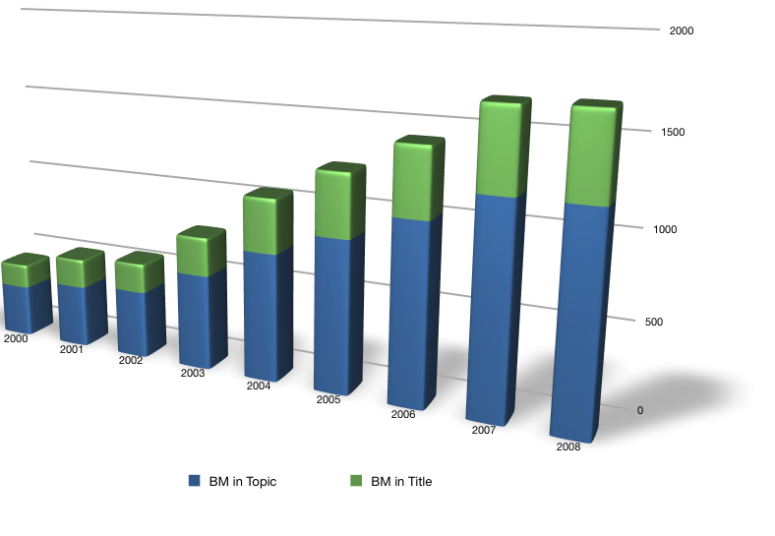
The Rise of Biomimetics

Slide 6
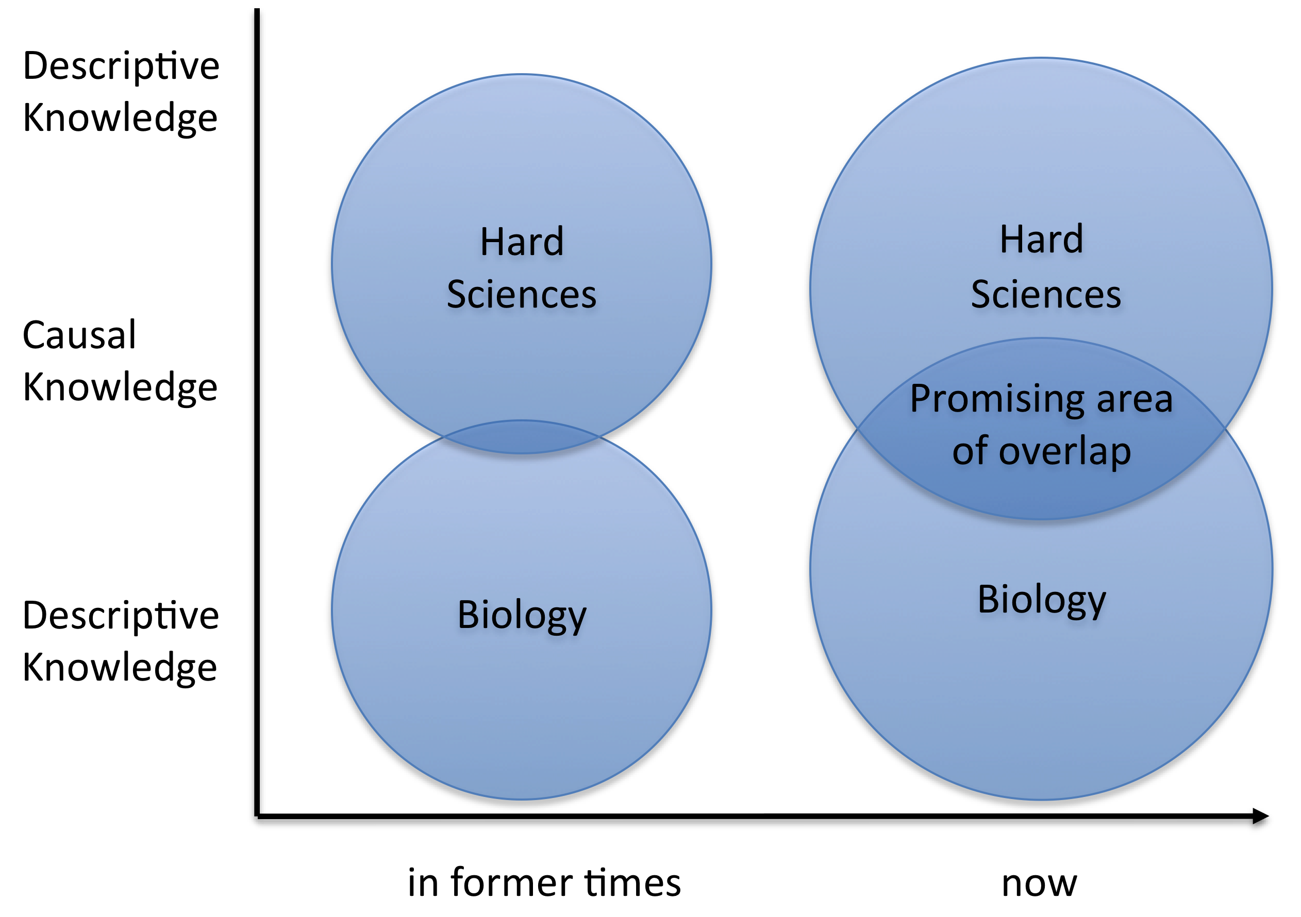
Hard Sciences meet Biology
I.C. Gebeshuber, H. Stachelberger and B.Y. Majlis
Exploring the innovational potential of biomimetics for novel 3D
micro- and nanoelectromechanical Systems (MEMS and NEMS)
6th Plant Biomech. Conf., Cayenne, French Guyana, 2009.

Slide 7
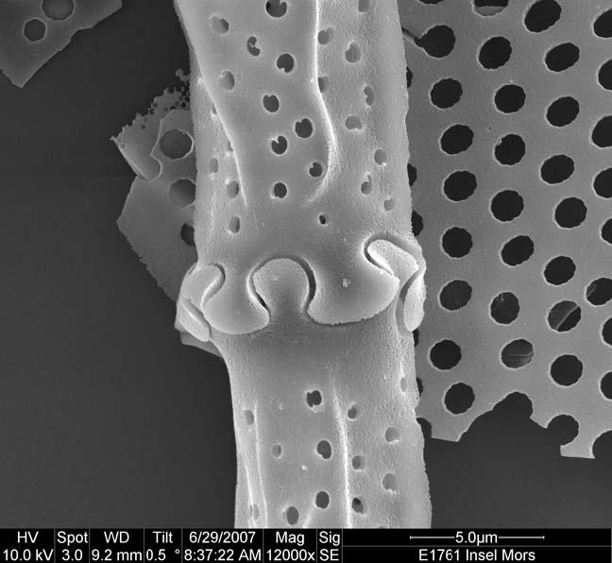
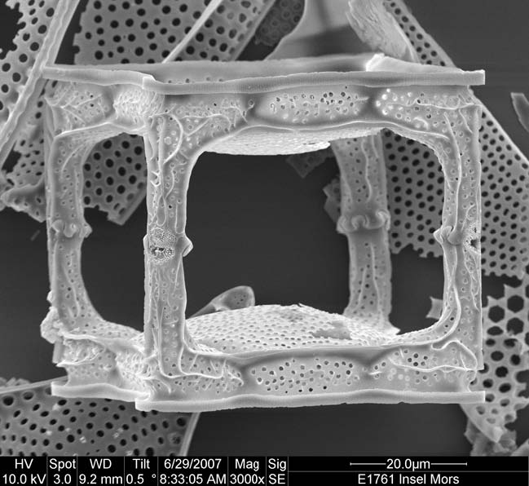
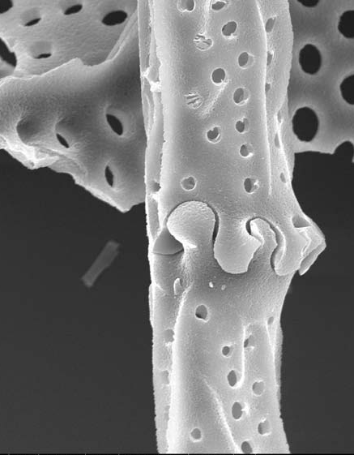
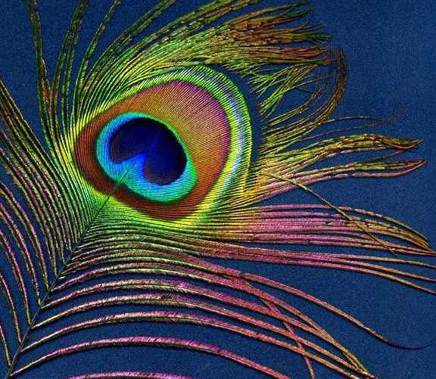
Gebeshuber I.C.
Biotribology inspires new technologies
Nano Today 2(5), 30-37, 2007

Slide 8
Colours
Colors in biology have two sources: chemical and physical
Chemical color arises through the use of pigments.
Structural colors result from the interaction of light waves with a featured structure having the same order of size as the light wavelength.
Structural colors arise through interference and diffraction.

Slide 9
Colours
In Opticks, Isaac Newton related iridescence (the change in observed color with viewing angle) to optical interference:
‘The finely colour’d feathers of some birds, and particularly those of the peacocks’ tail, do in the very same part of the feather appear of several colours in several positions of the eye, after the very same manner that thin plates were found to do.’
(Isaac Newton, 1704, Optiks)

Slide 10
Colours
In the 1920s, chemical engineer Clyde Mason looked at bird feathers through an optical microscope and reported observations of structural elements responsible for their coloration.
Nowadays, we find nanoscale architectures in an astonishing variety of plants and animals.

Slide 11
The physics of colours
λ=2(n₁ d₁ +n₂ d₂ )
λ - position of primary reflected peak
n₁,n₂ - refractive indices respectively for material 1 and 2
d₁,d₂ - thickness of layers respectively of material 1 and 2

Slide 12
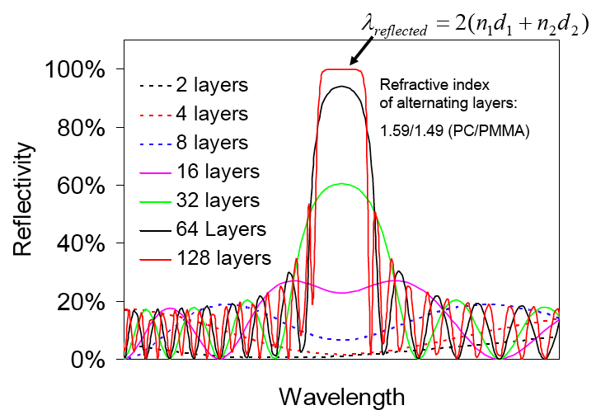

Slide 14
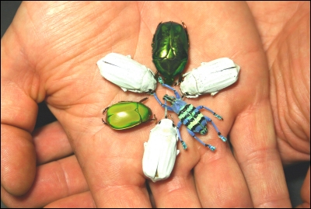
Beetles whiter than white
P. Vukusic et al. (2007) Science

Slide 15
Beetles whiter than white
Cyphochilus from south east asia
The bug's scales are five micrometers thick.
Scales contain a porous network of random protein fibers that scatter all wavelengths of light strongly, the prerequisite for an intense white color.

Slide 16
Beetles whiter than white
The scales are made of a tangle of seemingly randomly oriented filaments, each about 250 nanometers wide.
A random microscopic structure is key to producing a white color, which results when all wavelengths of light scatter equally from a surface.

Slide 17
Beetles whiter than white
The protein structure is at least two orders of magnitude thinner than man-made materials of equivalent whiteness.

Slide 18
Beetles whiter than white
Possible technological applications:
Ultra-thin reflectors
Novel light sources
Light emitting diodes
Writing paper
Teeth prosthesis
White paint

Slide 19
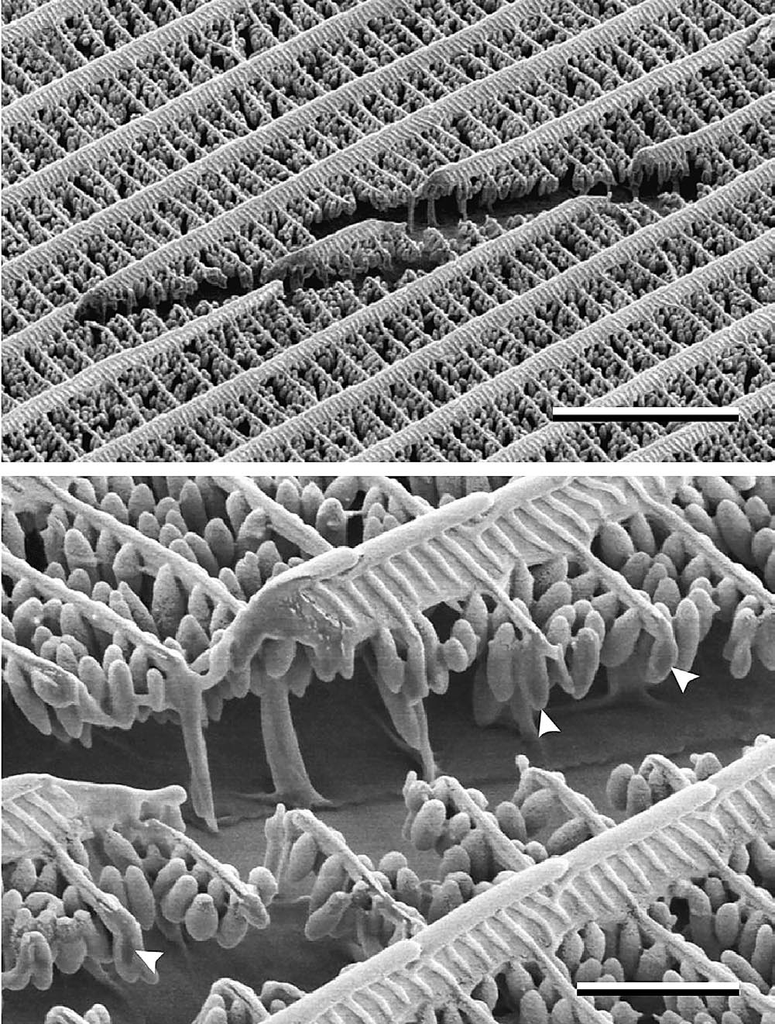
White butterflies
white
black
5υm
1cm
1υm
The beads presu-mably cause the matt-white colour of the wings and increase the reflectance amplitude.
1υm
40υm
D.G. Stavenga, S. Stowe, K. Siebke, J. Zeil and K. Arikawa, Butterfly wing colours: Scale beads make white pierid wings brighter, R. Soc. Lond. B 271 (2004), pp. 1577-1584

Slide 20
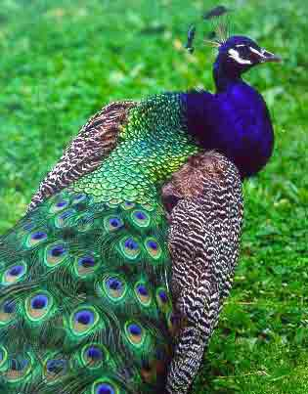
Peacock Feathers

Slide 21
Reflectance
Reflections from the front and back of the peacock feather structures act like a Fabry-Perot interference device to enhance color in a specific wavelength range.
J. Zi, X. Yu, Y. Li, X. Hu, C. Xu, X. Wang, X. Liu and R. Fu
Coloration strategies in peacock feathers
PNAS 100(22), 12576-12578, 2003

Slide 22
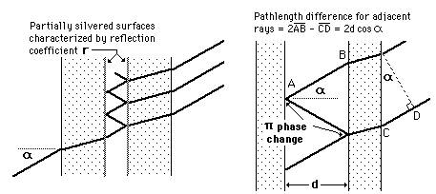
Fabry-Perot interferometer

Slide 23
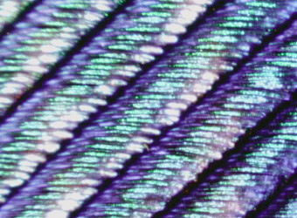
Peacock feather
50x 100x

Slide 24
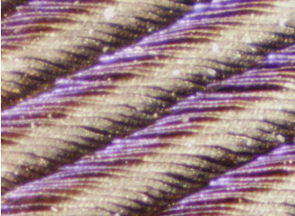
Peacock feather
200x 200x

Slide 25
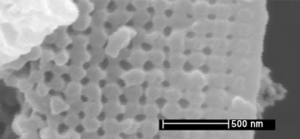
Peacock feather
The structures which produce the colors are arrays of melanin cylinders.
Array spacing of melanin cylinders:
blue region 140 nm
green region 150 nm (see image)
yellow region 165 nm.
The surface of the barbule is made of keratin, containing about 10 rows of the melanin cylinders in the green region, 6 rows for the yellow region.

Slide 26
Brittle stars

Slide 27
Joanna Aizenberg

Slide 28
Brittle stars
Like many other organisms, brittle stars control the growth of biominerals.
The surface of the brittle star Ophiocoma wendtii is made of cristalline CaCO₃ which make the whole surface to a perfect microlens array.
The brittle star shows optical properties that would have caused envy in Carl Zeiss.

Slide 29
Perfect lenses
The whole surface on the brittle star is covered with a microlens array.
The diameter of a single lens is 20υm to 40υm.
Each lens is oriented in a slightly different direction -> the organism gets an image of the whole environment.
Perhaps even comparable to the complex eye of a fly.

Slide 30
Double refraction
CaCo₃ crystals usually exhibit double refraction.
But not along the c-axis.
The CaCo₃ microlenses of the brittle star grow along the c-axis.
Calcite @ the National Museum of Natural History, Washington, DC.

Slide 31
Spherical aberration

Slide 32
Correction for spherical aberration in brittle stars
The shape of the lenses in the brittlestar are not sherical, but correct for the spheric aberration.
SEM of an individual lens in O. wendtii
L₀ - functional region of this lens
red line - lens that is compensated for spherical aberration
blue lines - light paths
scale bar 10υm
Nature 424 (2003) 852

Slide 33
Brittle stars with sunglasses
Brittle stars produce pigments that act like tunable sunglasses: during the day, the pigments shade the light receptors, at night they are removed, for improved far sight possibilities (G. Hendler, Natural Science Museum, Los Angeles).

Slide 34
Chromatic aberration
Brittle stars dope their calcite crystals with Magnesium atoms, to overcome chromatic aberation.

Slide 35
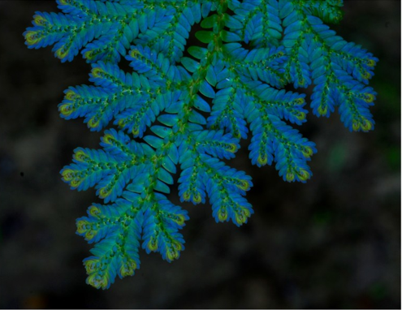
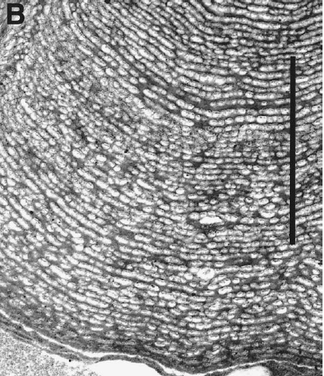
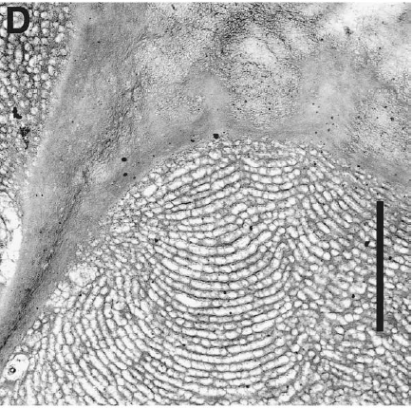
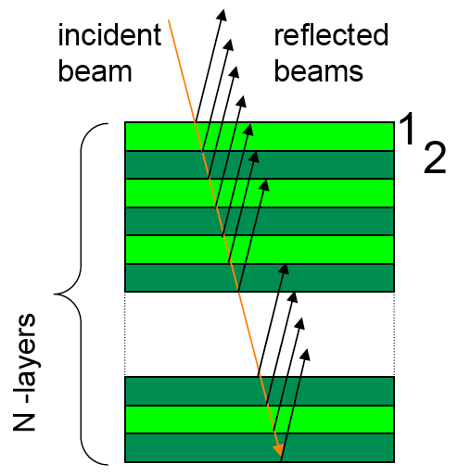
Iridescent Plants and Fruits
scale bars 2μm
Selaginella willdenowii
K.S. Gould and D.W. Lee
Physical and ultrastructural basis of blue leaf iridescence in four Malaysian understory plants
Am. J. Bot. 83(1), 45-50, 1996
C. Hebant and D.W. Lee
Ultrastructural basis and developmental control of blue iridescence in Selaginella leaves
Am. J. Bot. 71(2), 216-219, 1984
D.W. Lee and J.B. Lowry
Physical basis and ecological significance of iridescence in blue plants
Nature 254, 50-51, 1975

Slide 36
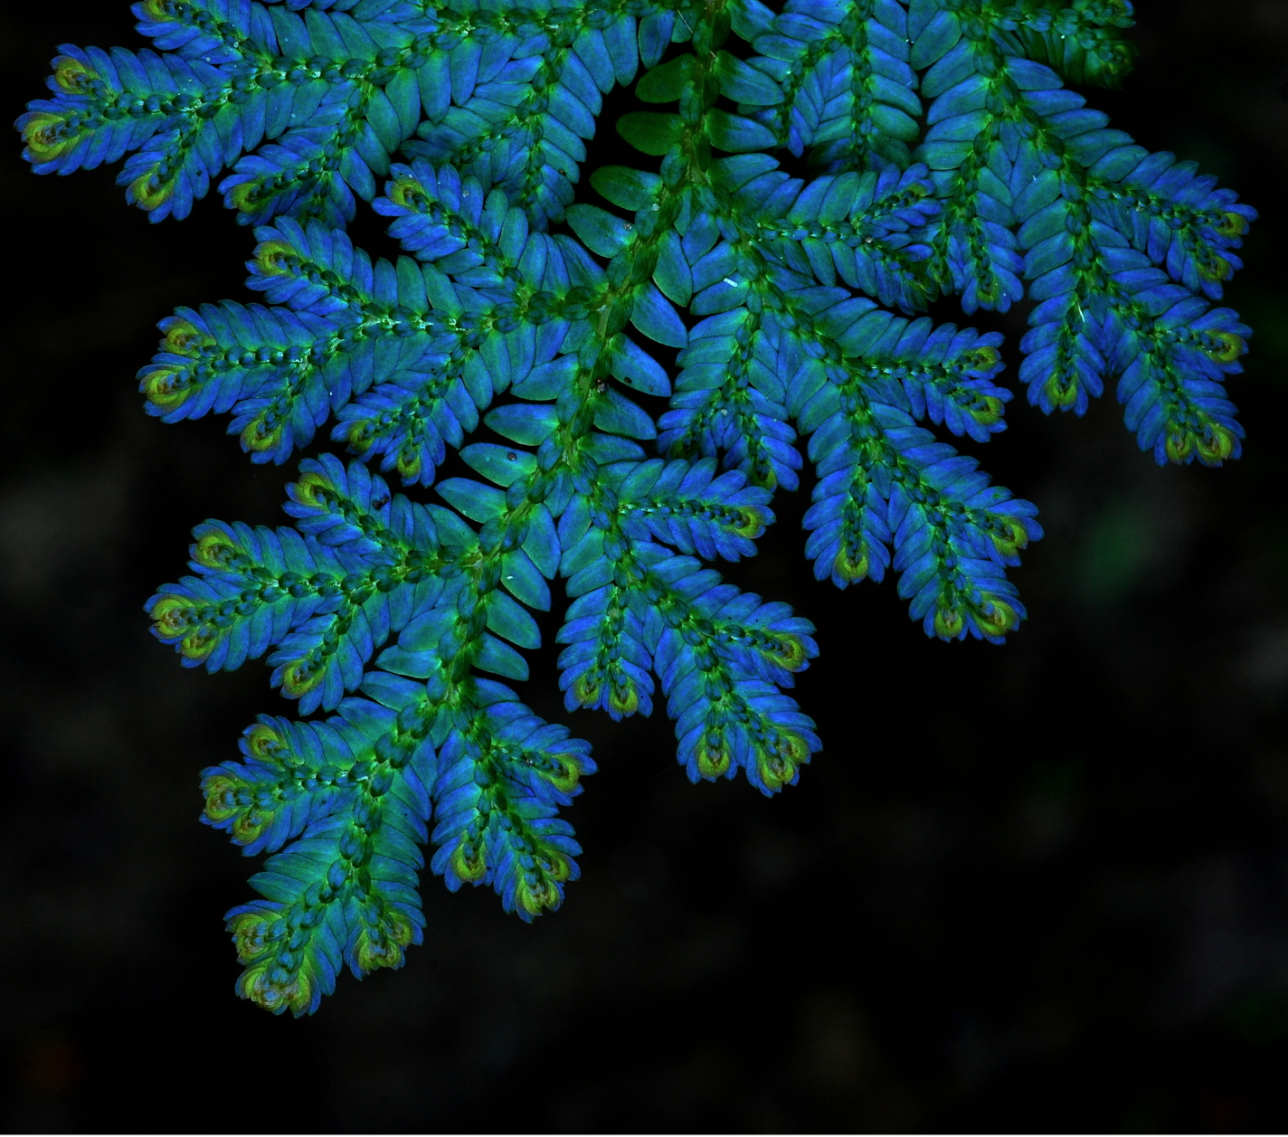
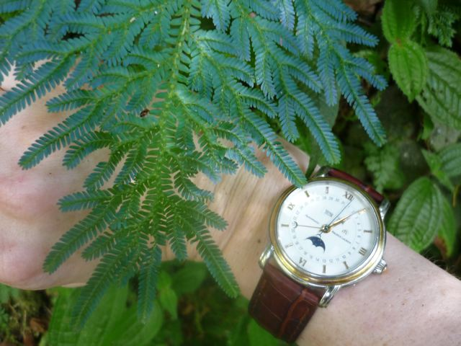
Blauer Farn
farne
© Foozi Saad, IPGM, Malaysia

Slide 37
Butterfly scales
The structural colours of butterflies and moths (Lepidoptera) have been attributed to a diversity of physical mechanisms, including multilayer interference, diffraction, Bragg scattering, Tyndall scattering and Rayleigh scattering.
R.O. Prum et al. (2006) J. Exp. Biol. 209, 748

Slide 38
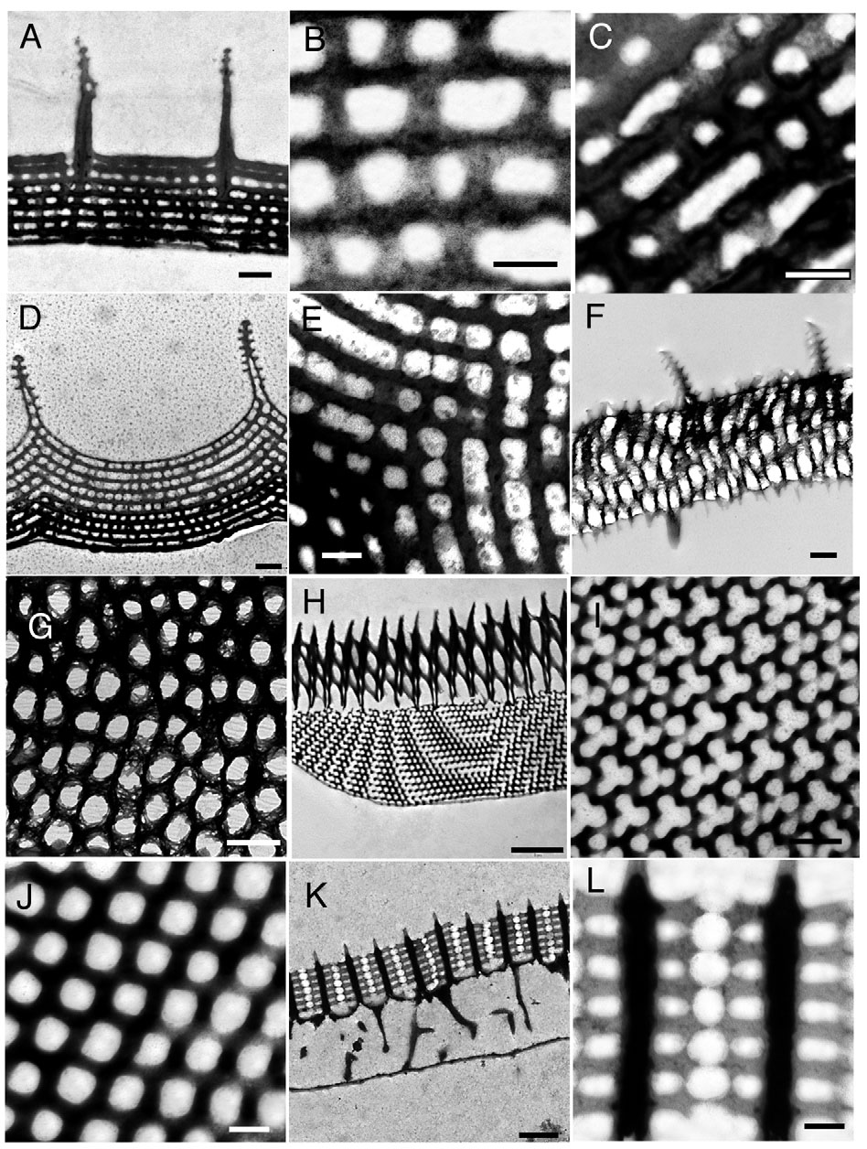
Scale bars 500nm (A,D, F,G), 200nm (B,C,E,J,L), 2υm (H), and 1υm (K).
R.O. Prum et al. (2006) J. Exp. Biol. 209, 748

Slide 39
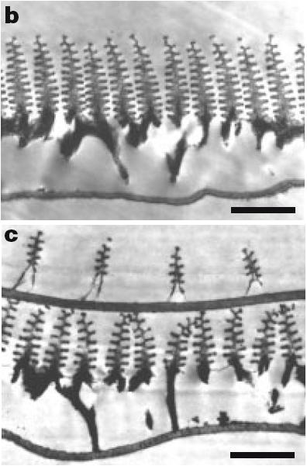
Morpho rhetenor
Scale bar b 1.8υm, c 1.3υm

Slide 40
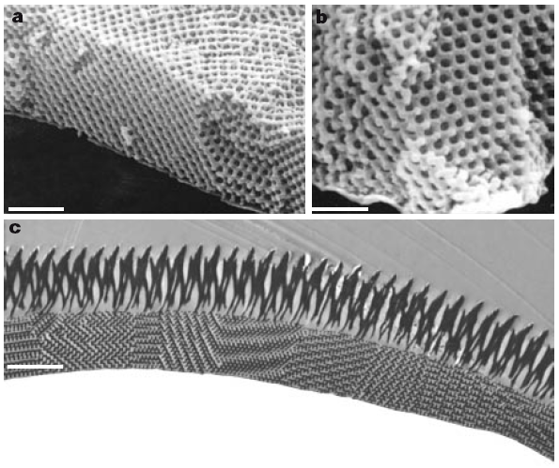
Parides sesostris
Scale bars 1.2υm, 750nm, 2.5μm.
J.R. Sambles and P. Vukusic
Photonic structures in biology
Nature 424, 852-855, 2003

Slide 41
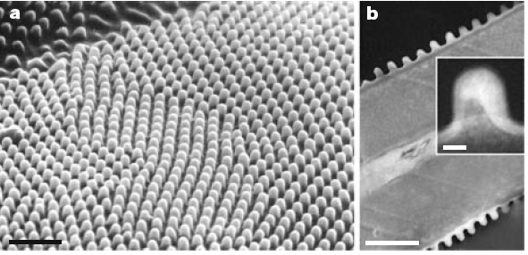
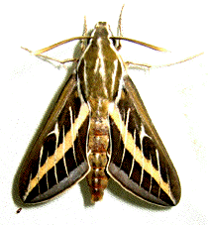
Antireflective surfaces
a Moth eye, scale bar 1υm
b Moth wing, scale bar 1υm
c Single nipple, scale bar 100nm
J.R. Sambles and P. Vukusic
Photonic structures in biology
Nature 424, 852-855, 2003

Slide 42
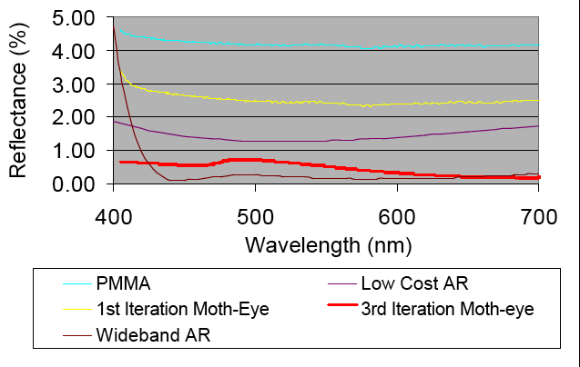
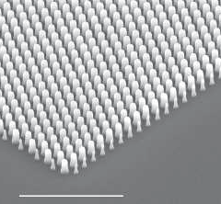
Antireflective surfaces
ReflexiteTM
http://www.instrumentation-optics.com/
2um
S.A. Boden and D.M. Bagnall
Biomimetic subwavelength surfaces for near-zero
reflection sunrise to sunset
Proc. 4th IEEE World Conference on Photovoltaic
Energy Conversion, Hawaii 1358-1361, 2006

Slide 43
Smart colors - man-made
T. Schalkhammer, Attophotonics, Wiener Neustadt

Slide 44
Aquareact - irreversible
T. Schalkhammer, Attophotonics, Wiener Neustadt

Slide 45
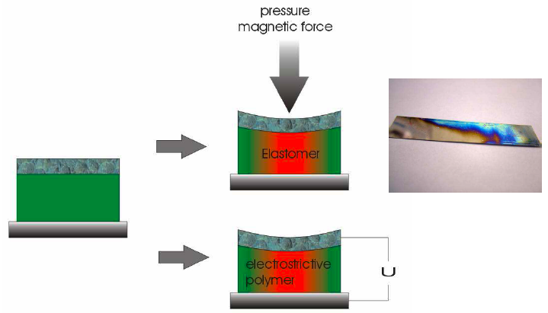
Pressure sensitive colors - man-made
T. Schalkhammer, Attophotonics, Wiener Neustadt

Slide 46
Conclusion
"There are more things in heaven and earth, Horatio, than are dreamt of in your philosophy."
(Shakespeare, Hamlet, 1601)

Slide 47
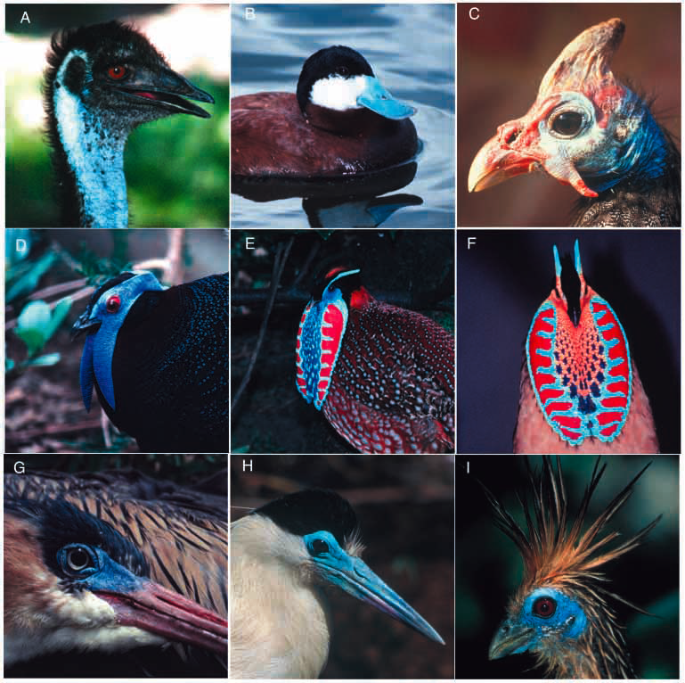
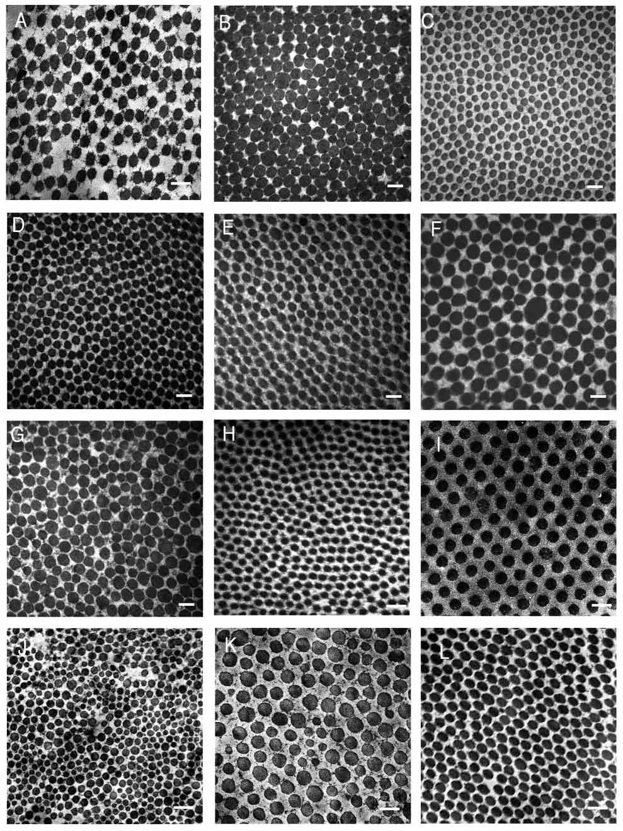
Bird structural colours caused by coherently scattering dermal collagen arrays
R.O. Prum and R. Torres (2003) J. Exp. Biol. 206, 2409

