Slide 1
Plant Surfaces: Structures and Functions for Biomimetic Applications
Ille C. Gebeshuber, TU Wien
Quelle: Springer HB of Nanotechnology, Ed. B. Bhushan, 2017

Slide 2
This lecture gives an overview of plant surface structures and their evolution, combines surface chemistry and architecture with their functions and refers to possible biomimetic applications.
Life: 3.5 billion years, 10 million species
The complexity of the hierarchical structures and their functionality in biological organisms surpasses all abiotic natural surfaces.

Slide 4
Global environmental change implies a dramatic loss of species and with it many biological role models.
Plants
Superhydrophilicity and superhydrophobicity are focal points in this chapter.
Superhydrophobicity is restricted in nature to living organisms.

Slide 5
Land-living vascular plants have a particularly intriguing surface chemistry and architecture with hierarchical structural order.

Slide 6
Functions of plant surface characteristics
Six categories:
1. Mechanical properties
2. Influence on reflection and absorption of spectral radiation
3. Reduction of water loss or increase of water uptake, moisture harvesting
4. Adhesion and nonadhesion (lotus effect, insect trapping)
5. Drag and turbulence increase
6. Air retention underwater for drag reduction or gas exchange
This list is far from complete.

Slide 7
Major challenge for engineers and materials scientists
The durability of the fragile nanocoatings

Slide 8
Content
1. Chemistry of Plant Surfaces
2. Structuring of Plant Surfaces: Hierarchical Architecture Between Nano- and Macrostructures
3. Physical Basis of Surface Wetting
4. Superhydrophilic and Superhydrophobic Plant Surfaces
5. Functional Diversity of Plant Surfaces
6. Biomimetic Application
7. Living Prototypes: Evolution of Plant Surfaces and Biodiversity

Slide 9
500 Million Years of Evolution for Innovative Technologies
Surfaces
Green
plants
stunning diversity of hierarchical
surface structures

Slide 10
Saguaro (Carnegiea gigantea), the largest cactus
up to 21m tall
stems are ribbed – large areas of the plant are shaded
ribs and elastic cuticle allow a rapid increase of the volume after sporadic rainfalls: the stems expand

Slide 11
Giant Arum (Amorphophallus titanum) lives in the deepest shadows of the humid rainforest understories in Sumatra
flower reaches a height of three meters
and is the largest
weights less than one kilogram: the largest lightweight
construction amongst plants, possibly even in any organism
riblets serve as mechanical stabilizers
the unpleasant-smelling central column heats periodically to almost 40 degree C

Slide 12
Pollen and spores: particularly refined hierarchical structures
Pollen: attachment and detachment to the pollinating insect and the stigma of the flower, and possibly temperature control under insolation

Slide 13
Pollen

Slide 14
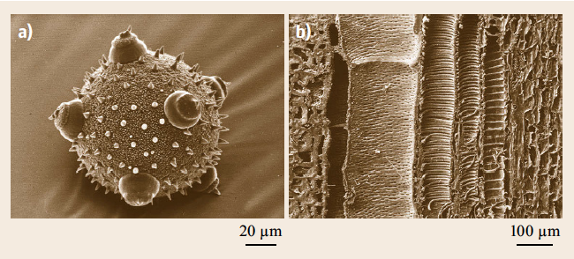
(a) Pumpkin (Cucurbita pepo) pollen grain. Surface structures might increase the Reynolds number
(b) A vessel-element of the same plant exhibiting complex spiral and perforated structures to transport water within the plant.

Slide 15
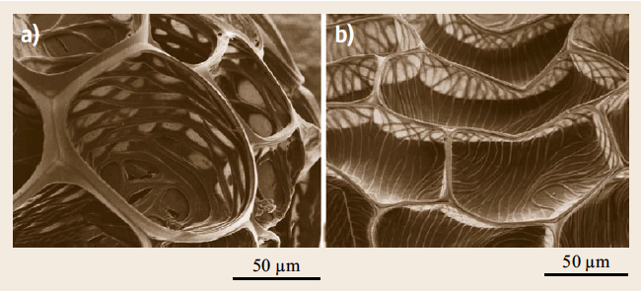
Seeds
Image shows two seed surfaces with concave cell sculpturing constructions that generate high Reynolds numbers to prolong the floating time.

Slide 16
We see high structural and functional diversity of the surfaces of the some 450 000 different species of land plants.
Grasses: superhydrophobic, 12 000 species

Slide 17
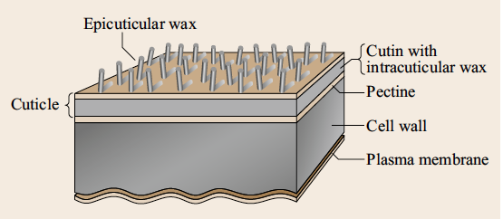
Outermost layers of a plant cell
An outermost wax layer, an underlying wax film, the cuticula, made of a cutin network and integrated waxes, a pectin layer, the plasma membrane.
The plasma membrane separates the water-containing living part of the cells from the outermost nonliving outer cell wall and cuticle.

Slide 18
Vascular Plants
There is a basic and obvious difference in surface structure and function between aquatic and terrestrial plants.
In terrestrial (vascular) plants an epidermis is present, a specialized outermost cell layer with its function as a transpiration barrier.
Outside is the polymer cuticle with its superimposed waxes.
The cuticle is absent in roots

Slide 19
The cuticle is basically a biopolymer made of a polyester called cutin, impregnated with integrated (intracuticular) waxes.
Additionally, waxes on the cuticle surface (epicuticular waxes) play an important role in surface structuring at the subcellular scale.
They occur in different morphologies, show a large variability in their chemistry and are able to self-assemble into three-dimensional crystals.

Slide 20
Epicuticular waxes form the boundary layer for many interactions with the plant’s environment, like wettability or spectral reflection

Slide 21
We focus on superhydrophobic and superhydrophilic surfaces, which are of particular importance for biomimetic applications (e.g., self-cleaning: lotus effect).
Superhydrophilicity means that a droplet imposed on a surface spreads instantly and a contact angle cannot even be measured, e.g., in the leaves of Ruellia.
In contrast, on a superhydrophobic surface water remains as an almost globular droplet with a contact angle of more than 150 degrees.

Slide 22
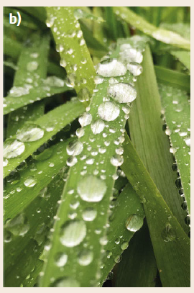
Plant surfaces exposed to the air are very often superhydrophobic.
But all plant roots are superhydrophilic – like the surfaces of water plants.
Phragmites autralis
Reet (Schilfrohr)

Slide 23
Biomimetics
Biomimetics is a modern scientific field.
The construction of an electric battery based on observations of the Torpedo fish (today we call it Electric Ray) by Allessandro Volta in 1800 was the first milestone of bionics.
The publication of the lotus effect in 1997 led to a change of paradigms in surface technologies.
Self cleaning lotus leaves are mentioned as early as the second century B.C. in the Sanskrit text of the Bhagavad Gita (e.g., book 5,10)
Biological role models provide an extraordinary diversity for innovative surface technologies.

Slide 24
1. Chemistry of Plant Surfaces
In land or vascular plants the waxes range from monomolecular layers to thick crusts or threedimensional (3-D) crystals, and form the boundary layer of the surface.
They are sometimes visible as a white or bluish coloration of leaves and fruits, as in wheat, cabbage, grapes, or plums.

Slide 25
Waxes can also be found in fungi, lichens and animals.
The epicuticular waxes occur in widely differing morphologies, all of which are crystalline and thus self-assembling.
Waxes are absent in roots.

Slide 26
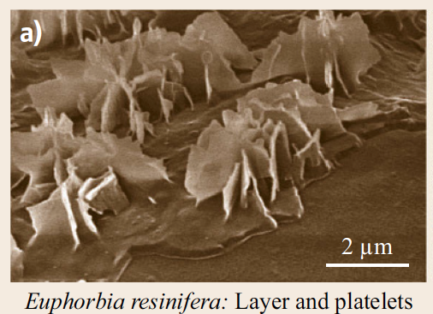
SEM micrographs of epicuticular waxes
In (a) waxes on a leaf of Euphorbia resinifera have been partially removed to show the composite structure of a basal wax layer with three-dimensional wax platelets on it.

Slide 27
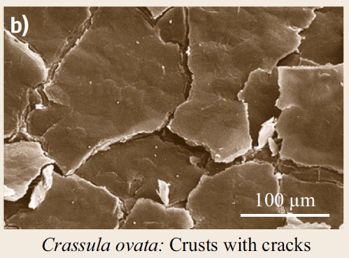
SEM micrographs of epicuticular waxes
In (b) a wax crust with fissures on a leaf of Crassula ovata is shown.

Slide 28
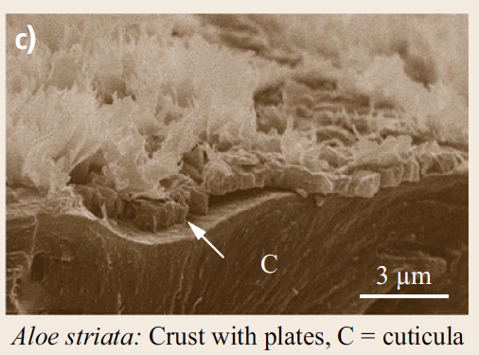
SEM micrographs of epicuticular waxes
A cross-section through the periclinal wall of Aloe striata in (c) shows the cuticle (indicated by C) and a wax layer (indicated by an arrow) with wax platelets on top.

Slide 29
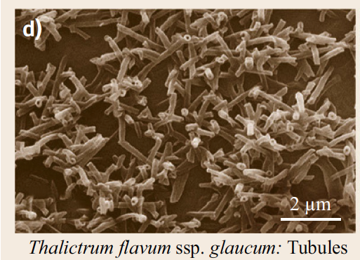
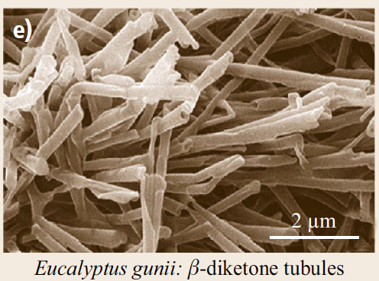
SEM micrographs of epicuticular waxes
In (d) nonacosanol tubules on Thalictrum flavum spp. glaucum leaves and in (e) β-diketone wax tubules on Eucalyptus gunnii leaves are shown.

Slide 30
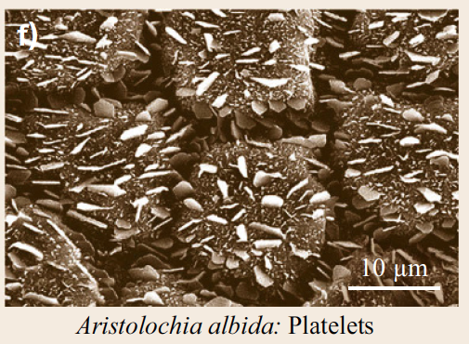
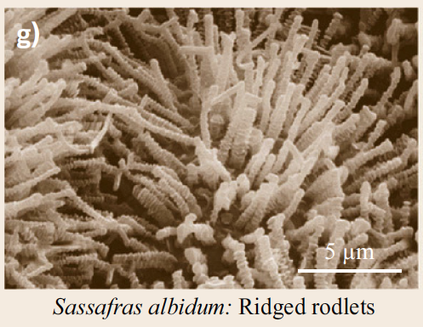
SEM micrographs of epicuticular waxes
In (f) wax platelets on Aristolochis albida leaf and in (g) transversely ridged rodlets on a leaf of Sassafras albidum are shown.

Slide 31
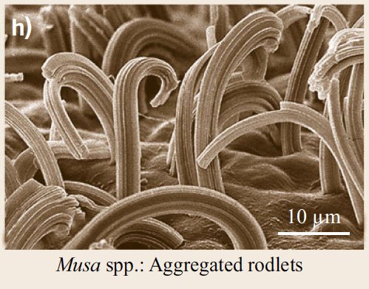
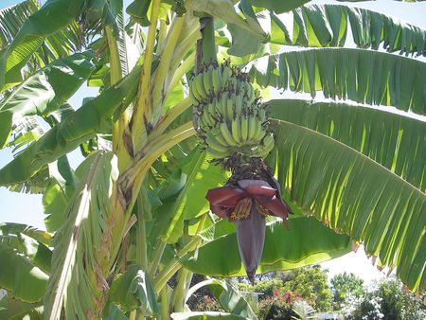
SEM micrographs of epicuticular waxes
In (h) longitudinally aggregated wax threads form large aggregated rodlets on the lower side of the leaves of Musa species (spp.).

Slide 32
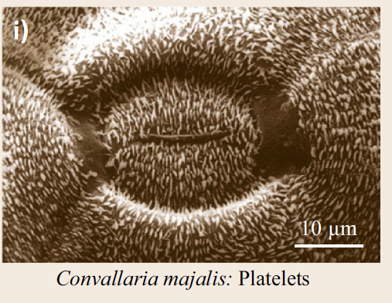
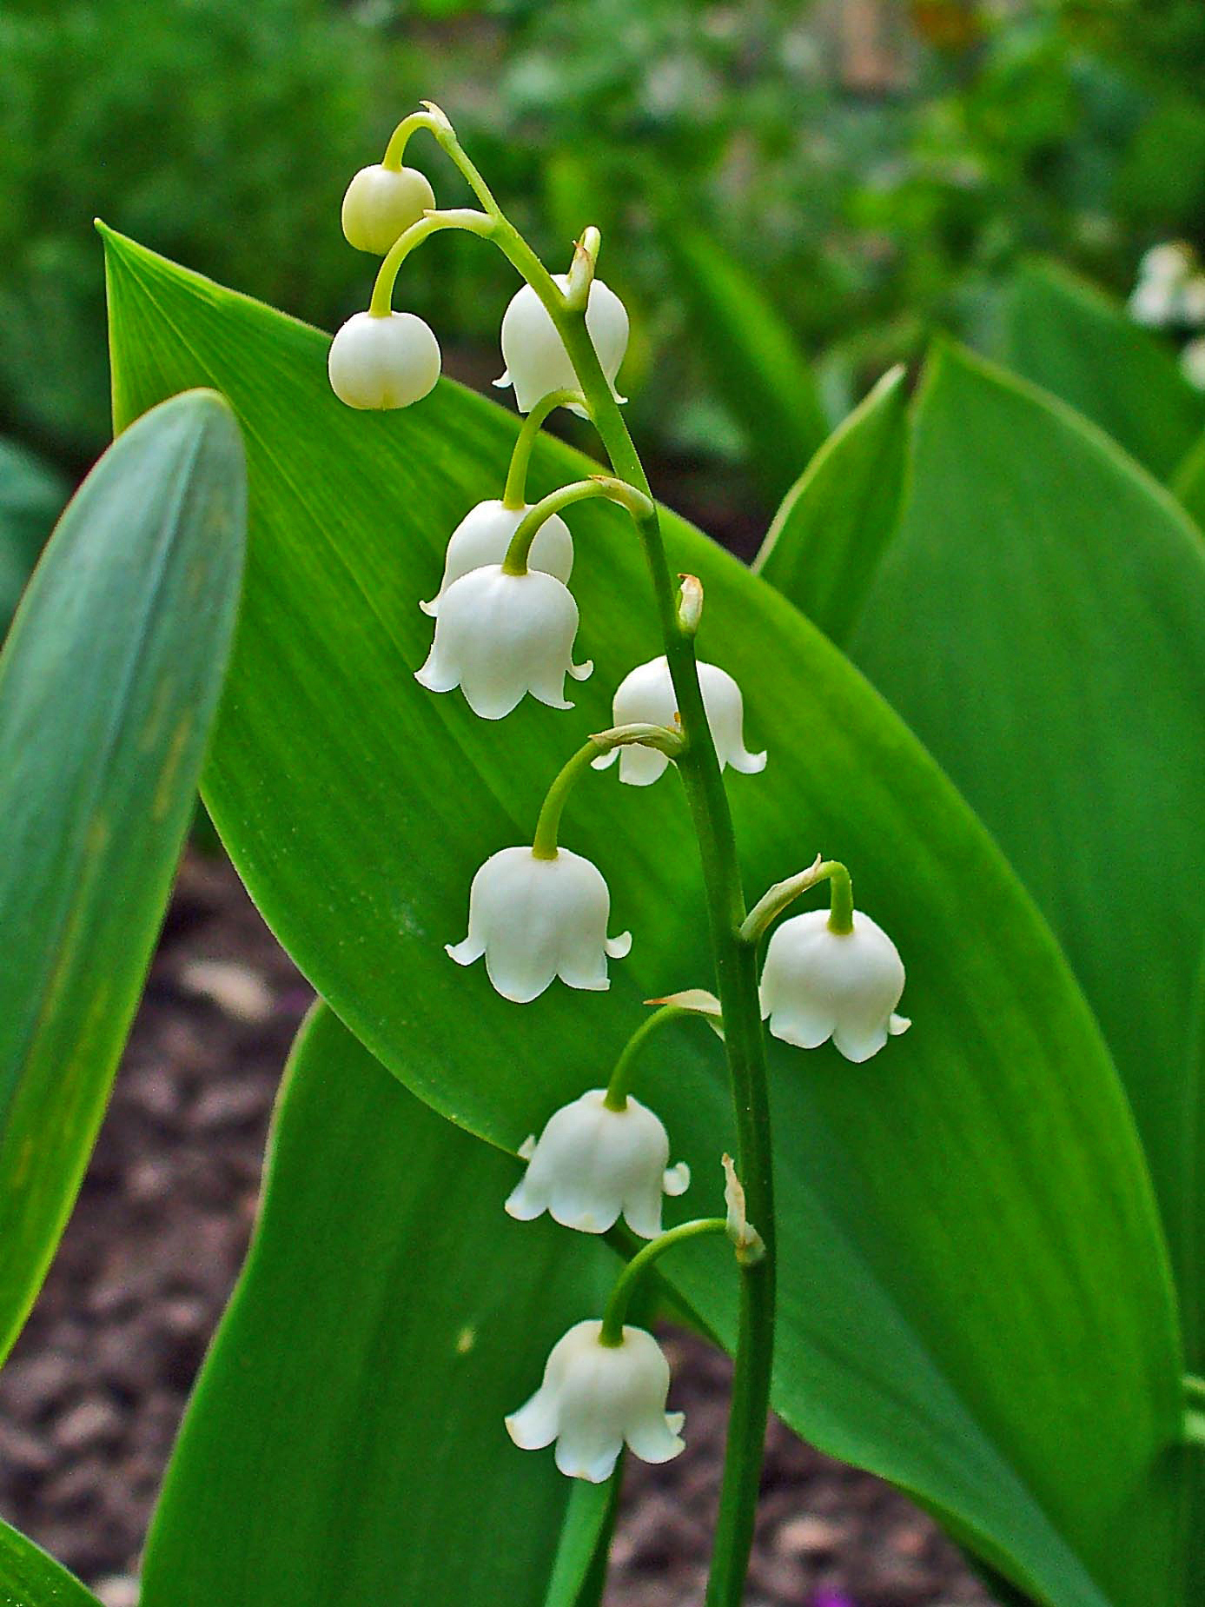
SEM micrographs of epicuticular waxes
In Convallaria majalis leaves, shown in (i), wax platelets are arranged in a pattern, similar to magnetic field lines, around the stomata.

Slide 33
1.1. Chemical Composition of Wax
The term wax is used for a variety of biogenic products that contain fatty materials of various kinds.
Well known examples are beeswax, paraffin and carnauba wax from wax palms (Copernicia prunifera).

Slide 34
The most common chemical compounds in plant waxes

Slide 35
Environmental factors, such as temperature or light intensity, influence the quantity of waxes and their chemical composition.
Epicuticular wax structures usually occur in the size range from 0.2 to 100μm.
Comprehensive overviews of the terminology and micromorphology of epicuticular waxes are given by Barthlott et al. (23 different wax types).

Slide 36
In this classification, the wax morphologies include thin films and several three-dimensional structures such as crusts, platelets, filaments, rods and tubules, which have a hollow center.
A further subclassification is based on the arrangement of the crystals, e.g., whether they are randomly distributed, in clusters, in parallel orientation, or in specific arrangements.

Slide 37
Common wax types in plant species and their major chemical compounds

Slide 38
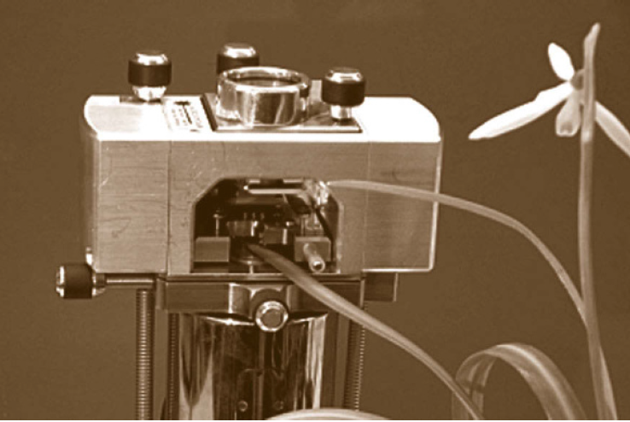
Probably all terrestrial plant surfaces are covered by thin (in the extreme monomolecular) wax films.
Wax film formation has been investigated on a living plant surface by atomic force microscopy

Slide 39
Thin wax films (< 0,5μm) are called two-dimensional (2-D) waxes, and the thicker wax layers (0,5-1μm) and wax crusts (> 1μm) are called three-dimensional (3-D) waxes.
Nonacosan-10-ol is the most common waxy coating of all major vascular plant groups and was evolved with the conquest of land some 450 million years ago .
The nonacosanol tubules are usually 0.3-1.1μm long and 0.1-0.2μm wide.
The second type of tubules contains high amounts of β-diketones.
Their length reaches from 2 to 5μm, and diameters vary between 0.2 and 0.3μm.

Slide 40
Waxes are termed platelets when flat crystals are connected with their narrow side to the surface.
Platelets vary considerably in shape, chemical composition and spatial pattern.

Slide 41
1.2 Chemical Heterogeneities
In leaves of Quercus robur, contact angles range from 30 degrees to 130 degrees depending on the part of the leaf where wettability was determined.
The aquatic watermilfoil Myriophyllum brasiliense is superhydrophilic.
But: As soon a flowering shoot approaches the water level wax crystals are generated and the new leaves outside of the water exhibit a contact angle of 162 degrees like in a lotus leaf.

Slide 42
1.3 Crystallinity
All aliphatic plant surface waxes have a crystalline order.
In SEM microscopy, the crystal structure is rapidly destroyed by the electron beam intensity.
Very thin mono- or bimolecular layers of waxes form two-dimensional crystals at the molecular level.
Self-assembly of waxes is an inherent result of the crystalline nature.
Recrystallization studies of waxes, which were isolated from plant surfaces showed that most waxes recrystallized in their original morphology, as found on the plant surfaces.

Slide 43
The processes of self-assembly in molecular systems are determined by five characteristics:
the components, interactions, reversibility, environment and mass transport with agitation.
The most important driving forces are weak and noncovalent intermolecular interactions, such as Van der Waals and Coulomb interactions, hydrophobic interactions and hydrogen bonds.

Slide 44
Crystal growth on a leaf of snowdrop (Galanthus nivalis)

Slide 45
The regeneration of the wax film results in a multilayered crystalline coverage on the plant cuticle.

Slide 46
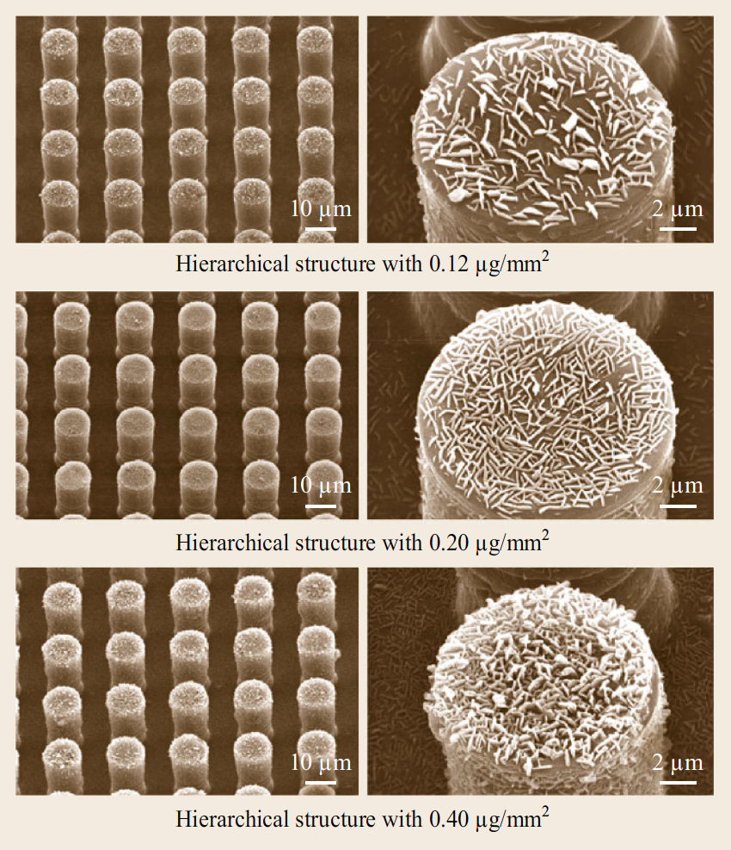
Recrystallization of the waxes on artificial substrates

Slide 47
Recrystallization of the waxes on artificial substrates
On a nonpolar, crystalline substrate (highly ordered pyrolytic graphite, HOPG) platelets grow with a vertical orientation to the substrates, whereas on a polar surface, such as mica, crystals grow horizontally to the substrate surface.
On amorphous polar glass only amorphous wax layers grow.
This substrate dependence demonstrates epitaxial control of crystal growth depending on the orientation and order of the first layers of molecules adhering on the substrate surface.

Slide 49
The substrates on which the crystals grow influence the crystal morphology and their orientation.
This fact can be used to create different kinds of nano- and micropatterns on technical surfaces.

Slide 51
However, the cutin matrix of the cuticle, which acts as a substrate in plant surfaces, is assumed to be amorphous, and an epitaxial growth on an amorphous substrate seems paradoxical.

Slide 52
2. Structuring of Plant Surfaces: Hierarchical Architecture Between Nano- and Macrostructures
The cuticle covers leaves, flowers, stems, fruits and seeds and serves as a protective continuous layer covering the primary organs of all vascular plants and mosses.
But in roots and secondary structures (e.g., bark) a cuticle is not present.
The cuticle is a hydrophobic composite material, composed of a polymer called cutin and integrated and superimposed lipids called waxes.

Slide 53
2.2. Hierarchical Sculpturing

Slide 54
Hairs and Glands

Slide 55
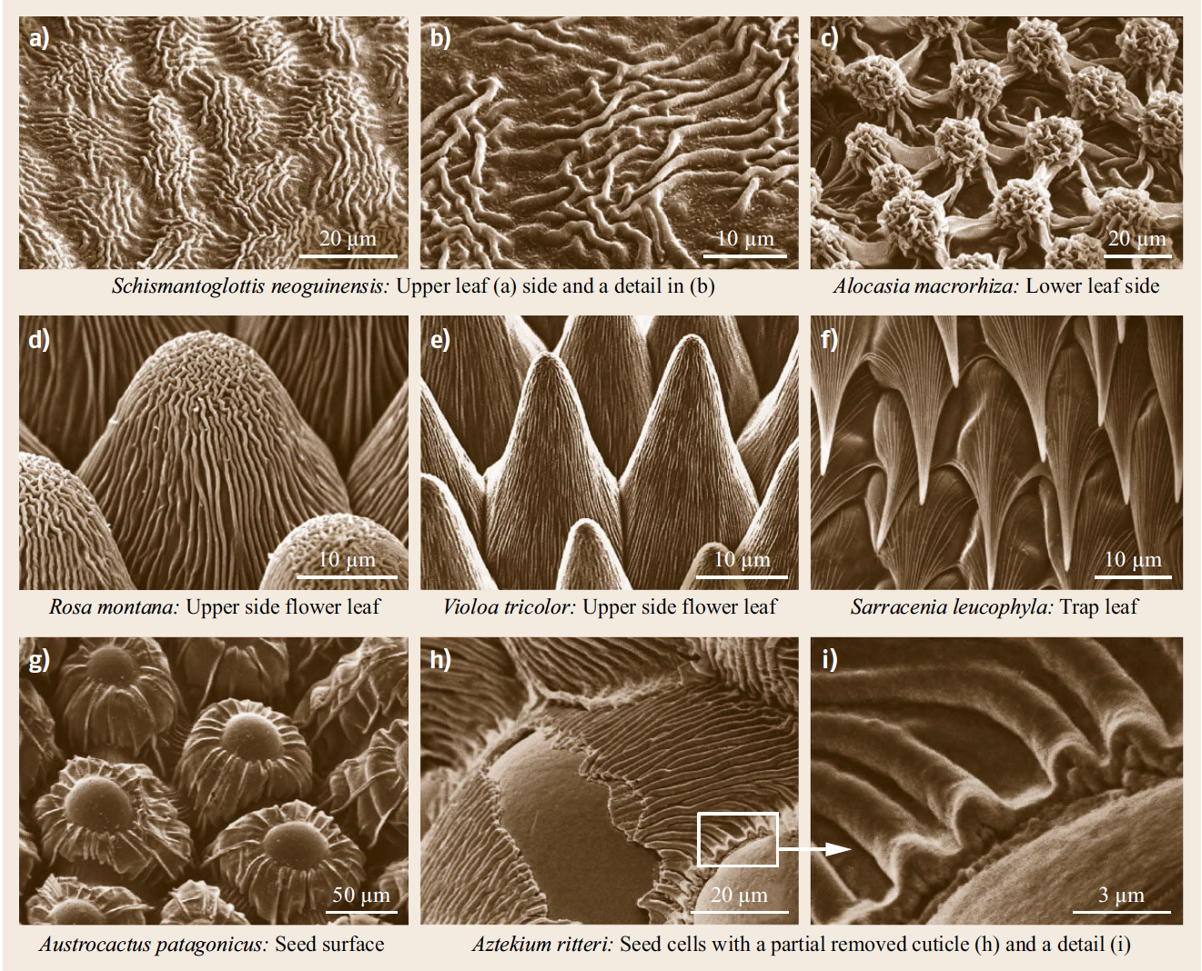
Cell Surfaces with Cuticular Foldings

Slide 56
Some microstructures on epidermis cells arise from subcuticular inserts of mineral crystals

Slide 57
Cell-surface structuring by subcuticular silicon dioxide and apatite insertions

Slide 58
Apatite
Apatite: Ca₅[(F,Cl,OH)|(PO₄)₃]

Slide 59
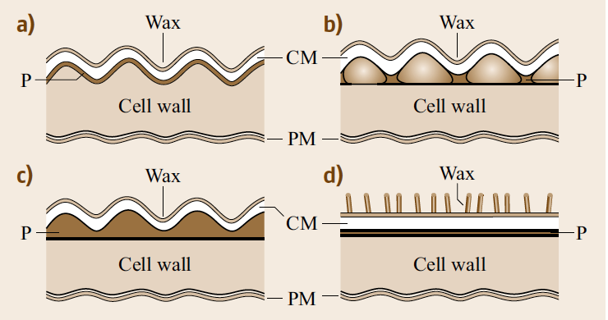
Cross-sections through plant epidermis cells
In (a) the surface profile is induced by coves of the underlying cell wall,
in (b) by insertion of subcuticular minerals,
in (c) by folding of the cuticle and
in (d) by waxes.

Slide 60
3. Physical Basis of Wetting
Wetting is the fundamental process of liquid interaction at solid–gaseous interfaces.
It describes how a liquid comes into contact with a solid surface.

Slide 61
3.1. Static Wetting
A parameter to quantify this wettability is the contact angle (CA).
A high contact angle describes surfaces on which a water droplet forms a spherical shape and the contact area between the liquid and the solid is low.
Contact angle measurement is the main method for the characterization of the hydrophobicity or hydrophilicity of surfaces.

Slide 62
The CA of a liquid on a surface depends on the surface tension (molecular forces) of the specific liquid, solid surface and the surrounding gas.

Slide 63
If a droplet moves over a solid surface, the CA at the front of the droplet (advancing CA) is greater than that at the back of the droplet (receding CA).
On water-repellent surfaces, a droplet applied starts to roll off the surface when it is tilted to a specific angle.
This tilt angle (TA) is simply defined as the tilting angle of a surface on which an applied drop of water starts to move.

Slide 64
Low TA (< 10 degrees) is characteristic for superhydrophobic and self-cleaning surfaces.

Slide 65
3.2. Dynamic Interactions
Dynamic interactions include bouncing, splashing and spreading of droplets.
Falling drops can impact without any breakup or impact with a splash or splashing, in which the impacting drop releases smaller droplets flying away from the point of impact.

Slide 66
Dynamic wetting processes and their control may play an underestimated role in the interaction between plant surfaces and rain, the maintenance of air layers underwater, or e.g., in pesticide applications.

Slide 67
Bouncing water droplets
https://www.youtube.com/watch?v=pbGz1njqhxU
Making droplets stick:
https://www.youtube.com/watch?v=NStQ_MasrGs
© Marcus Reugels

