Slide 1
Nanorobotics
Ille C. Gebeshuber
TU Wien
Quelle: Springer Handbook of Nanotechnology, 4th Edition 2017

Slide 2
https://www.youtube.com/watch?v=ObvxPSQNMGc
Nanobot
Nanobot (Havana Parody) | A Capella Science ft. Dorothy Andrusiak
Acapellascience
(Thanks to Julius Piso for the link)

Slide 3
Content of this Lecture on Nanorobotics
1. Overview of Nanorobotics
2. Actuation at Nanoscales
3. Nanorobotic Manipulation Systems
4. Nanorobotic Assembly
5. Applications

Slide 4
Definition
Nanorobotics is the study of robotics at the nanometer scale, and includes robots that are nanoscale in size and large robots capable of manipulating objects that have dimensions in the nanoscale range with nanometer resolution.
With the ability to position and orient nanometer-scale objects, nanorobotic manipulation is a promising way to enable the assembly of nanosystems including nanorobots.

Slide 5
1. Overview of Nanorobotics
Progress in robotics over the past years has dramatically extended our ability to explore the world from perception, cognition and manipulation perspectives at a variety of scales extending from the edges of the solar system down to individual atoms.
Erzählen von ÖGART – und Automatisierungstag!
Overview of Nanorobotics

Slide 6
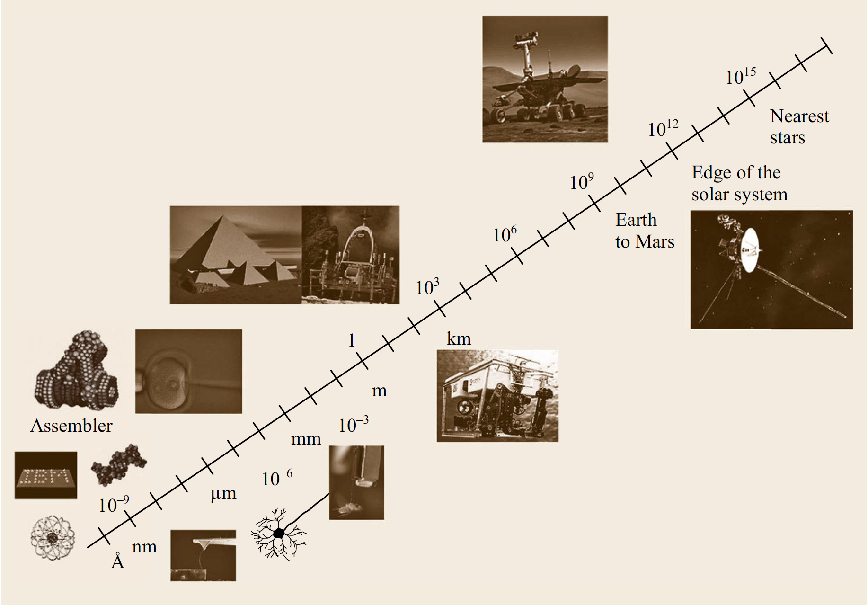
Robotic exploration
Overview of Nanorobotics

Slide 7
Richard Feynman 1959
„What I want to talk about is the problem of manipulating and controlling things on a small scale. . . I am not afraid to consider the final question as to whether, ultimately – in the great future – we can arrange the atoms the way we want: the very atoms, all the way down!“
He asserted that:
„At the atomic level, we have new kinds of forces and new kinds of possibilities, new kinds of effects. The problems of manufacture and reproduction of materials will be quite different. The principles of physics, as far as I can see, do not speak against the possibility of maneuvering things atom by atom.“
Overview of Nanorobotics

Slide 8
The field of nanorobotics brings together several disciplines, including nanofabrication processes used for producing nanoscale robots, nanoactuators, nanosensors, and physical modeling at nanoscales.
Nanorobotic manipulation technologies, including the assembly of nanometer-sized parts, the manipulation of biological cells or molecules, and the types of robots used to perform these types of tasks also form a component of nanorobotics.
Overview of Nanorobotics

Slide 9
By the early 1980s, scanning tunneling microscopes (STMs) radically changed the ways in which we interacted with and even regarded single atoms and molecules.
The very nature of proximal probe methods encourages exploration of the nanoworld beyond conventional microscopic imaging. Scanned probes now allow us to perform engineering operations on single molecules, atoms, and bonds, thereby providing a tool that operates at the ultimate limits of fabrication.
They have also enabled exploration of molecular properties on an individual nonstatistical basis.
Overview of Nanorobotics

Slide 10
STMs and other nanomanipulators are nonmolecular machines but use bottom-up strategies.
Although performing only one molecular reaction at a time is obviously impractical for making large amounts of a product, it is a promising way to provide the next generation of nanomanipulators.
Most importantly, it is possible to realize the directed assembly of molecules or supermolecules to build larger nanostructures through nanomanipulation.
The products produced by nanomanipulation could be the first step of a bottom-up strategy in which these assembled products are used to selfassemble into nanomachines.
Overview of Nanorobotics

Slide 11
One of the most important applications of nanorobotic manipulation will be nanorobotic assembly.
However, it appears that until assemblers capable of replication can be built, the parallelism of chemical synthesis and self-assembly are necessary when starting from atoms; groups of molecules can self-assemble quickly due to their thermal motion, enabling them to explore their environments and find (and bind to) complementary molecules.
Given their key role in natural molecular machines, proteins are obvious candidates for early work in self-assembling artificial molecular systems.
Degrado demonstrated the feasibility of designing protein chains that predictably fold into solid molecular objects.
W.F. Degrado: Design of peptides and proteins, Adv. Protein Chem. 39, 51–124 (1998)
Overview of Nanorobotics

Slide 12
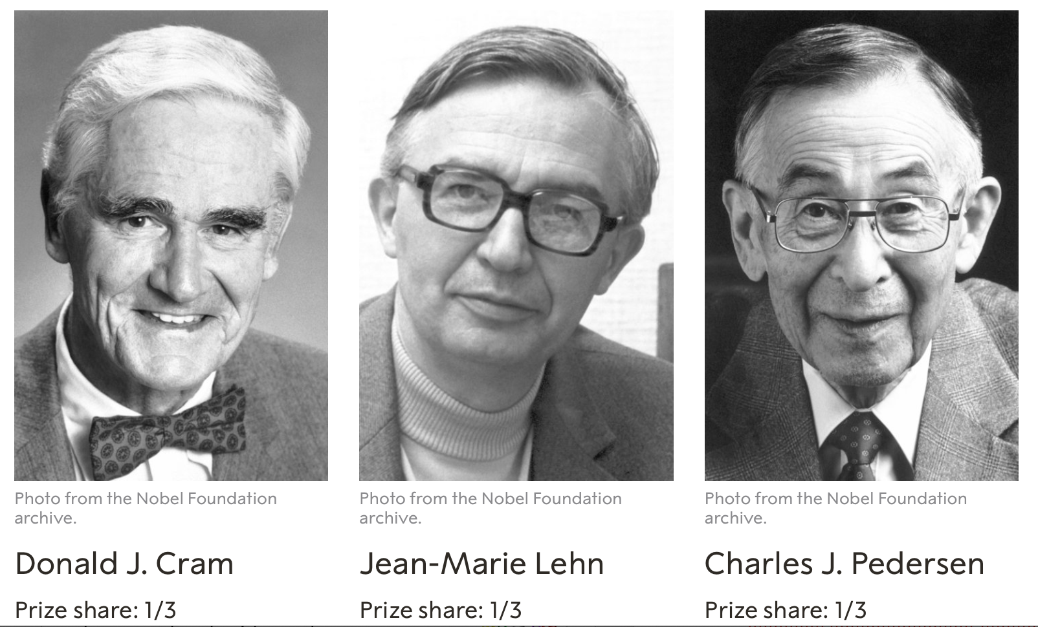
Progress is also being made in artificial enzymes and other relatively small molecules that perform functions like those of natural proteins; the 1987 Nobel prize for chemistry went to Cram and Lehn for such work on supramolecular chemistry.
Overview of Nanorobotics

Slide 13
Supramolecular Chemistry
Supramolecular chemistry is the domain of chemistry beyond that of molecules that focuses on the chemical systems made up of a discrete number of assembled molecular subunits or components.
The forces responsible for the spatial organization may vary from weak (intermolecular forces, electrostatic or hydrogen bonding) to strong (covalent bonding), provided that the degree of electronic coupling between the molecular component remains small with respect to relevant energy parameters of the component.
While traditional chemistry focuses on the covalent bond, supramolecular chemistry examines the weaker and reversible noncovalent interactions between molecules.
Overview of Nanorobotics

Slide 14
Several bottom-up strategies using self-assembly appear feasible.
Fujita et al.’s pioneering work has shown that self-assembly can be directed by adroitly exploiting the chemical and electrical bonds that hold natural molecules together, and hence get molecules to form desired nanometer-scale structures [ref].
M. Fujita, N. Fujita, K. Ogura, K. Yamaguchi: Spontaneous assembling of ten small components into a three-dimensionally interlocked compound consisting of the same two cage frameworks, Nature 400, 52–55 (1999)
Overview of Nanorobotics

Slide 15
Chemical synthesis, self assembly, and supramolecular chemistry make it possible to provide building blocks at relatively large sizes beginning from the nanometer scale.
Nanorobotic manipulation serves as the base for a hybrid approach to construct nanodevices by structuring these materials to obtain building blocks and assembling them into more complex systems.
Overview of Nanorobotics

Slide 16
2. Actuation at Nanoscales
The positioning of nanorobots and nanorobotic manipulators depends largely on nanoactuators.
While nanosized actuators for nanorobots are still under exploration and relatively far from implementation, microelectromechanical system (MEMS)-based efforts are focused on shrinking their sizes.
Herzeigen: Siliziumeinkristall
Actuation at Nanoscales

Slide 17
Actuation at Nanoscales
Nanometer resolution motion has been extensively investigated and can be generated using various actuation principles.
Electrostatics, electromagnetics, and piezoelectrics are the most common ways to realize actuation at nanoscales.
For nanorobotic manipulation, besides nanoresolution and compact sizes, actuators generating large strokes and high forces are best suited for such applications.
The speed criteria are of less importance as long as the actuation speed is in the range of a couple of hertz and above.
Actuation at Nanoscales

Slide 18
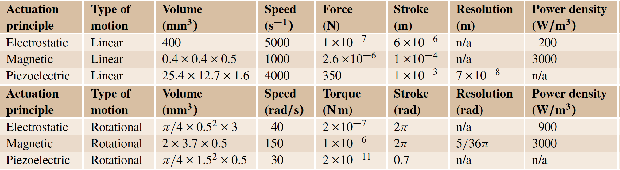
Actuation at Nanoscales
A small selection of early works on actuators suitable for nanorobotic applications.
Actuation at Nanoscales

Slide 19
During the design of an actuator, the tradeoffs among range of motion, force, speed (actuation frequency), power consumption, control accuracy, system reliability, robustness, load capacity, etc. must be taken into consideration.
Actuation at Nanoscales

Slide 20
Electrostatics
Electrostatic charge arises from a build up or deficit of free electrons in a material, which can exert an attractive force on oppositely charged objects, or a repulsive force on similarly charged objects.
Since electrostatic fields arise and disappear rapidly, such devices will likewise demonstrate very fast operation speeds and be little affected by ambient temperatures.
Actuation at Nanoscales

Slide 21
Examples of miniature devices using electrostatic force for actuation
Silicon micromotor
Actuation at Nanoscales

Slide 22
Examples of miniature devices using electrostatic force for actuation
Microvalve
Actuation at Nanoscales

Slide 23
Examples of miniature devices using electrostatic force for actuation
Microtweezer
This type of actuation is important for achieving nanosized actuation
Actuation at Nanoscales

Slide 24
Electrostatics
Electrostatic fields can exert great forces, but generally across very short distances.
When the electric field must act over larger distances, a higher voltage will be required to maintain a given force.
The extremely low-current consumption associated with electrostatic devices makes for highly efficient actuation.
Actuation at Nanoscales

Slide 25
Electromagnetics
Electromagnetism arises from electric current moving through a conducting material.
Attractive or repulsive forces are generated adjacent to the conductor and proportional to the current flow.
Structures can be built which gather and focus electromagnetic forces, and harness these forces to create motion.
Actuation at Nanoscales

Slide 26
Electromagnetics
Electromagnetic fields arise and disappear rapidly, thus permitting devices with very fast operation speeds.
Since electromagnetic fields can exist over a wide range of temperatures, performance is primarily limited by the properties of the materials used in constructing the actuator.
Actuation at Nanoscales

Slide 27
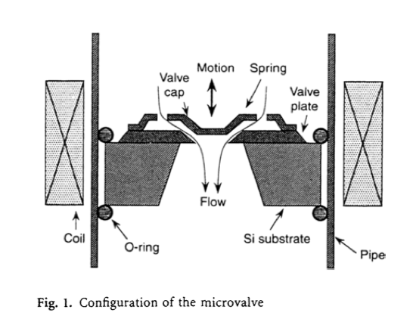
Example of a microfabricated electromagnetic actuator
Microvalve which uses a small electromagnetic coil wrapped around a silicon micromachined valve structure
Actuation at Nanoscales

Slide 28
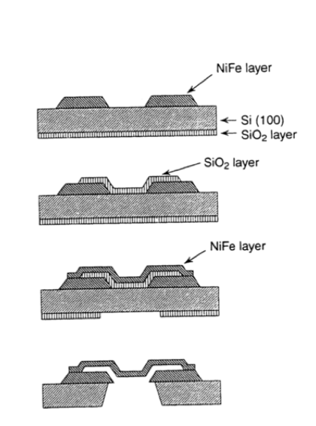
Example of a microfabricated electromagnetic actuator
Microvalve which uses a small electromagnetic coil wrapped around a silicon micromachined valve structure
Actuation at Nanoscales

Slide 29
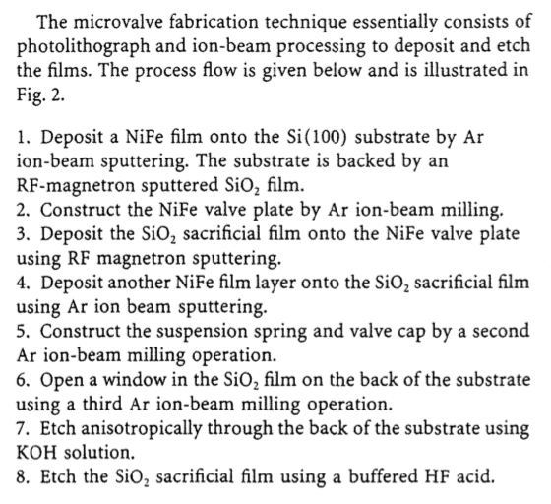
Example of a microfabricated electromagnetic actuator
Microvalve which uses a small electromagnetic coil wrapped around a silicon micromachined valve structure
Actuation at Nanoscales

Slide 30
Electromagnetics
However, the downward scalability of electromagnetic actuators into the micro- and nanorealm may be limited by the difficulty of fabricating small electromagnetic coils.
Furthermore, most electromagnetic devices require perpendicularity between the current conductor and the moving element, presenting a difficulty for planar fabrication techniques commonly used to make silicon devices.
An important advantage of electromagnetic devices is their high efficiency in converting electrical energy into mechanical work.
This translates into less current consumption from the power source.
Actuation at Nanoscales

Slide 31
Piezoelectrics
Piezoelectric motion arises from the dimensional changes generated in certain crystalline materials when subjected to an electric field or to an electric charge.
Structures can be built which gather and focus the force of the dimensional changes, and harness them to create motion.
Typical piezoelectric materials include quartz (SiO₂), lead zirconate titanate (PZT), lithium niobate, and polymers such as polyvinyledene fluoride (PVDF).
Actuation at Nanoscales

Slide 32
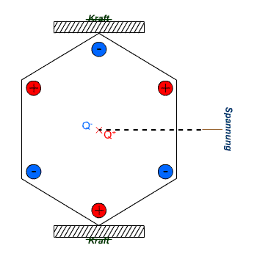
Piezoelectrics
Piezoelectric materials respond very quickly to changes in voltages and with great repeatability.
They can be used to generate precise motions with repeatable oscillations, as in quartz timing crystals used in many electronic devices.
Piezo materials can also act as sensors, converting tension or compression strains to voltages.
Actuation at Nanoscales

Slide 33
Piezoelectrics
Most commercially available nanomanipulators adopt this type of actuators, such as Picomotors from New Focus and Nanomotors from Klock.
STMs and most nanomanipulators use piezoelectric actuators.
Actuation at Nanoscales

Slide 34
Other Techniques
Other techniques include thermomechanical, phase change, shape memory, magnetostrictive, electrorheological, electrohydrodynamic, diamagnetism, magnetohydrodynamic, shape changing, polymers, biological methods (living tissues, muscle cells, etc.) and so on.
The table on the next slide lists a comparison of these.
Actuation at Nanoscales

Slide 35
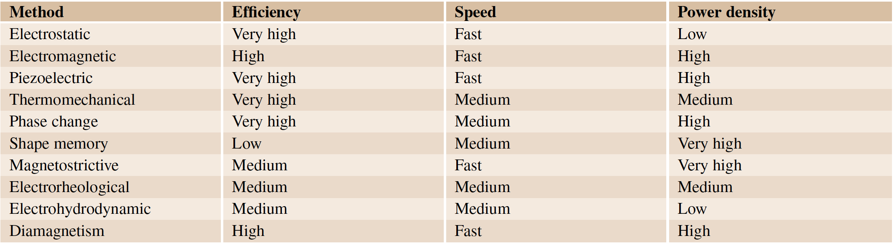
Other Techniques
Actuation at Nanoscales

Slide 36
3. Nanorobotic Manipulation Systems
Nanorobotic Manipulation Systems

Slide 37
Overview
Nanomanipulation, or positional and/or force control at the nanometer scale, is a key enabling technology for nanotechnology by filling the gap between top-down and bottom-up strategies, and may lead to the appearance of replication-based molecular assemblers.
These types of assemblers have been proposed as general-purpose manufacturing devices for building a wide range of useful products as well as copies of themselves (self-replication).
Nanorobotic Manipulation Systems

Slide 38
Presently, nanomanipulation can be applied to the scientific exploration of mesoscopic physical phenomena, biology and the construction of prototype nanodevices.
It is a fundamental technology for property characterization of nanomaterials, structures and mechanisms, for the preparation of nanobuilding blocks, and for the assembly of nanodevices such as nanoelectromechanical systems (NEMS).
Nanorobotic Manipulation Systems

Slide 39
Nanomanipulation was enabled by the inventions of the STM, atomic force microscope (AFM), and other types of scanning probe microscope (SPM).
Besides these, optical tweezers (laser trapping) and magnetic tweezers are also possible nanomanipulators.
Nanorobotic Manipulation Systems

Slide 40
Nanorobotic manipulators (NRM)
Nanorobotic manipulators (NRMs) are characterized by the capability of 3-D positioning, orientation control, independently actuated multiple end-effectors, and independent real-time observation systems, and can be integrated with scanning probe microscopes.
NRMs largely extend the complexity of nanomanipulation.
Nanorobotic Manipulation Systems

Slide 41
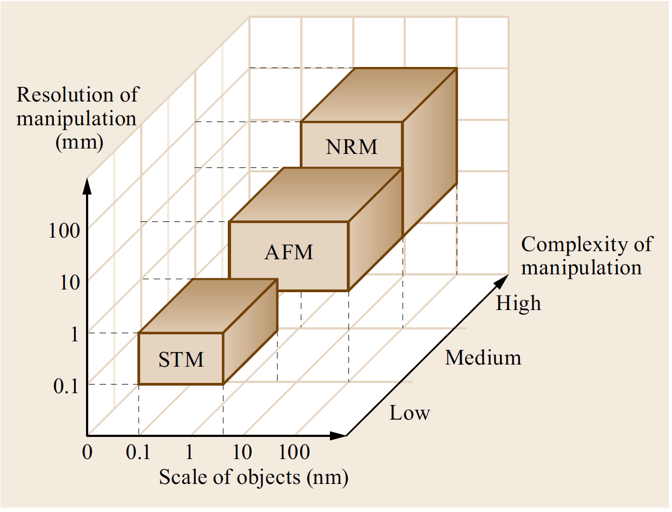
Comparison of STM, AFM, and NRM technology
Nanorobotic Manipulation Systems

Slide 42
STM as NM
With its incomparable imaging resolution, an STM can be applied to particles as small as atoms with atomic resolution.
However, limited by its two-dimensional (2-D) positioning and available strategies for manipulations, standard STMs are ill-suited for complex manipulation and cannot be used in 3-D space.
Nanorobotic Manipulation Systems

Slide 43
AFM as NM
AFM can be done in either contact or dynamic mode.
Generally, manipulation with an AFM involves moving an object by touching it with a tip.
A typical manipulation is like this: image a particle first in non-contact mode, then remove the tip oscillation voltage and sweep the tip across the particle in contact with the surface and with the feedback disabled.
Nanorobotic Manipulation Systems

Slide 44
AFM as NM
Mechanical pushing can exert larger forces on objects and, hence, can be applied for the manipulation of relatively larger objects.
One-dimensional (1-D) to 3-D objects can be manipulated on a 2-D substrate.
However, the manipulation of individual atoms with an AFM remains a challenge.
Nanorobotic Manipulation Systems

Slide 45
By separating the imaging and manipulation functions, nanorobotic manipulators can have many more degrees of freedom including rotation for orientation control, and, hence, can be used for the manipulation of zero-dimensional (0-D, symmetric spheres) to 3-D objects in 3-D free space.
Limited by the relative lower resolution of electron microscopes, NRMs are difficult to use for the manipulation of atoms.
However, their general robotic capabilities including 3- D positioning, orientation control, independently actuated multiple end-effectors, separate real-time observation system, and integrations with SPMs inside makes NRMs quite promising for complex nanomanipulation.
Nanorobotic Manipulation Systems

Slide 46
A nanomanipulation system generally includes nanomanipulators as the positioning device, microscopes as eyes, various end-effectors including probes and tweezers among others as its fingers, and types of sensors (force, displacement, tactile, strain, etc.) to facilitate the manipulation and/or to determine the properties of the objects.
Key technologies for nanomanipulation include observation, actuation, measurement, system design and fabrication, calibration and control, communication, and human–machine interface.
Nanorobotic Manipulation Systems

Slide 47
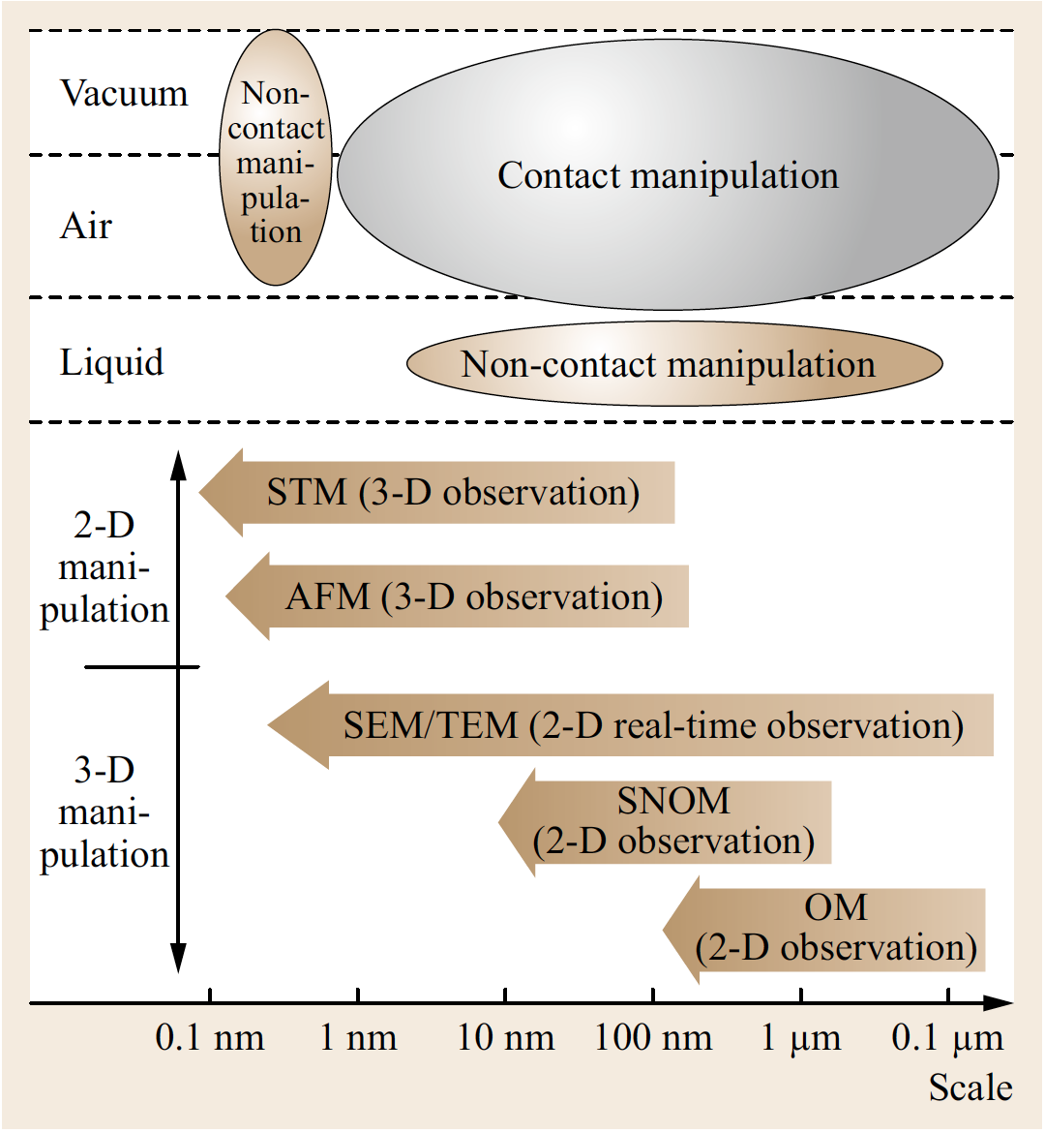
Microscopes, environments and strategies of nanomanipulation.
Nanorobotic Manipulation Systems

Slide 48
The 3 types of nanomanipulation
(1) lateral non-contact
(2) lateral contact
(3) vertical manipulation.
Generally, lateral non-contact nanomanipulation is mainly applied for atoms and molecules in UHV with an STM or bioobject in liquid using optical or magnetic tweezers.
Contact nanomanipulation can be used in almost any environment, generally with an AFM, but is difficult for atomic manipulation.
Vertical manipulation can be performed by NRMs (nanorobotic manipulators).
Nanorobotic Manipulation Systems

Slide 49
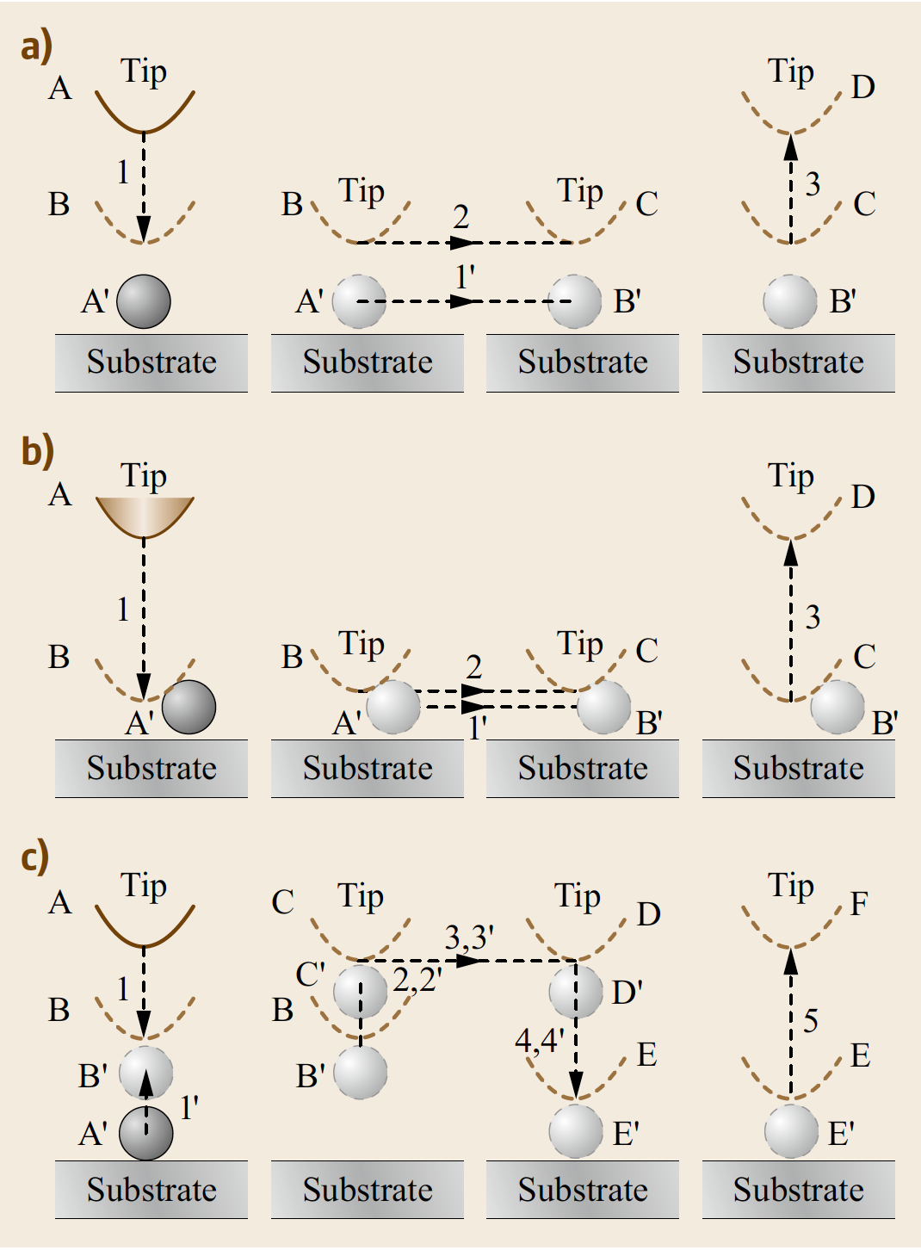
Basic strategies of nanomanipulation:
(a) Lateral non-contact nanomanipulation (sliding)
In the figure, A, B, C represent the positions of end-effector (e.g., a tip),
A‘, B‘, C‘ the positions of objects,
1, 2, 3 the motions of end-effector, and
1‘, 2‘, 3‘ the motions of objects.
Nanorobotic Manipulation Systems

Slide 50
Basic strategies of nanomanipulation:
(b) Lateral contact nanomanipulation(pushing/pulling)
Nanorobotic Manipulation Systems

Slide 51
Basic strategies of nanomanipulation:
(c) Vertical nanomanipulation (picking and placing)
Nanorobotic Manipulation Systems

Slide 52
Nanorobotic Manipulation Systems
Nanorobotic manipulators are the core components of nanorobotic manipulation systems.
The basic requirements for a nanorobotic manipulation system for 3-D manipulation include nanoscale positioning resolution, a relative large working space, enough degrees of freedom (DOFs) including rotational ones for 3-D positioning and orientation control of the end-effectors, and usually multiple end-effectors for complex operations.
Nanorobotic Manipulation Systems

Slide 53
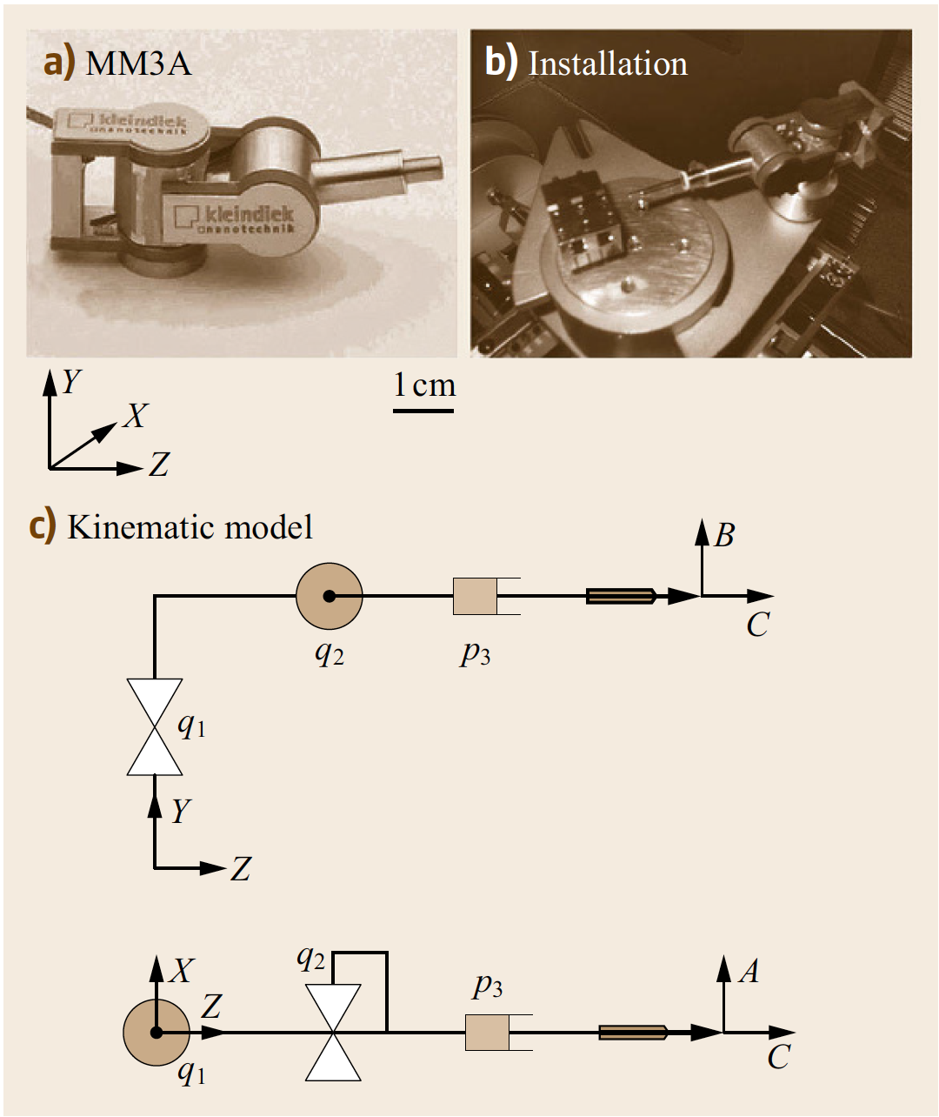
Commercially available nanomanipulator
(MM3A from Kleindiek) installed inside a SEM
The manipulator has three degrees of freedom, and nanometer to subnanometer-scale resolution.
Nanorobotic Manipulation Systems

Slide 54
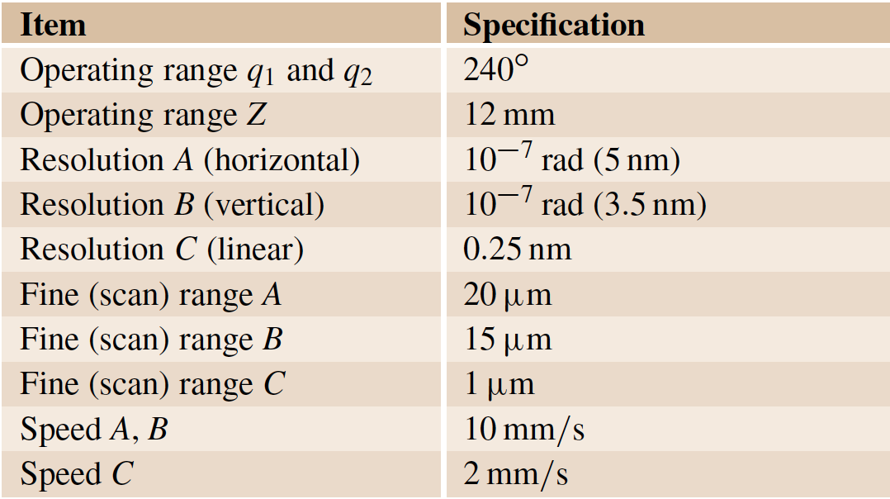
Specifications of MM3A from Kleindiek
Nanorobotic Manipulation Systems

Slide 55
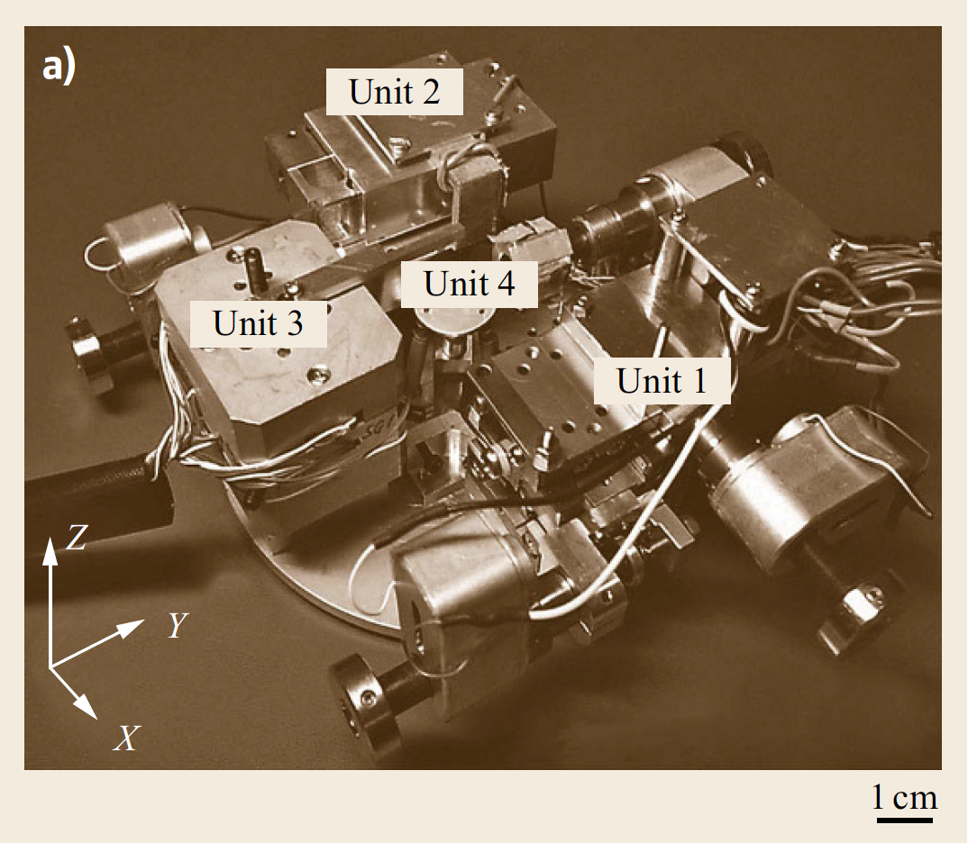
Nanorobotic system with 16 degrees of freedom
This nanorobotic manipulation system can be equipped with three to four AFM cantilevers as end-effectors for both manipulation and measurement.
Nanorobotic Manipulation Systems

Slide 56
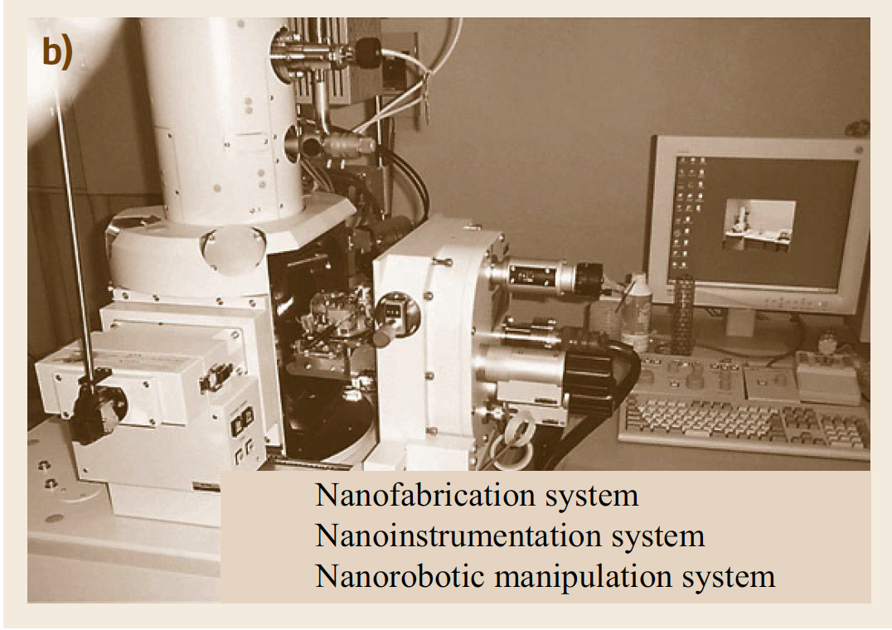
Nanorobotic system with 16 degrees of freedom
Nanorobotic Manipulation Systems

Slide 57
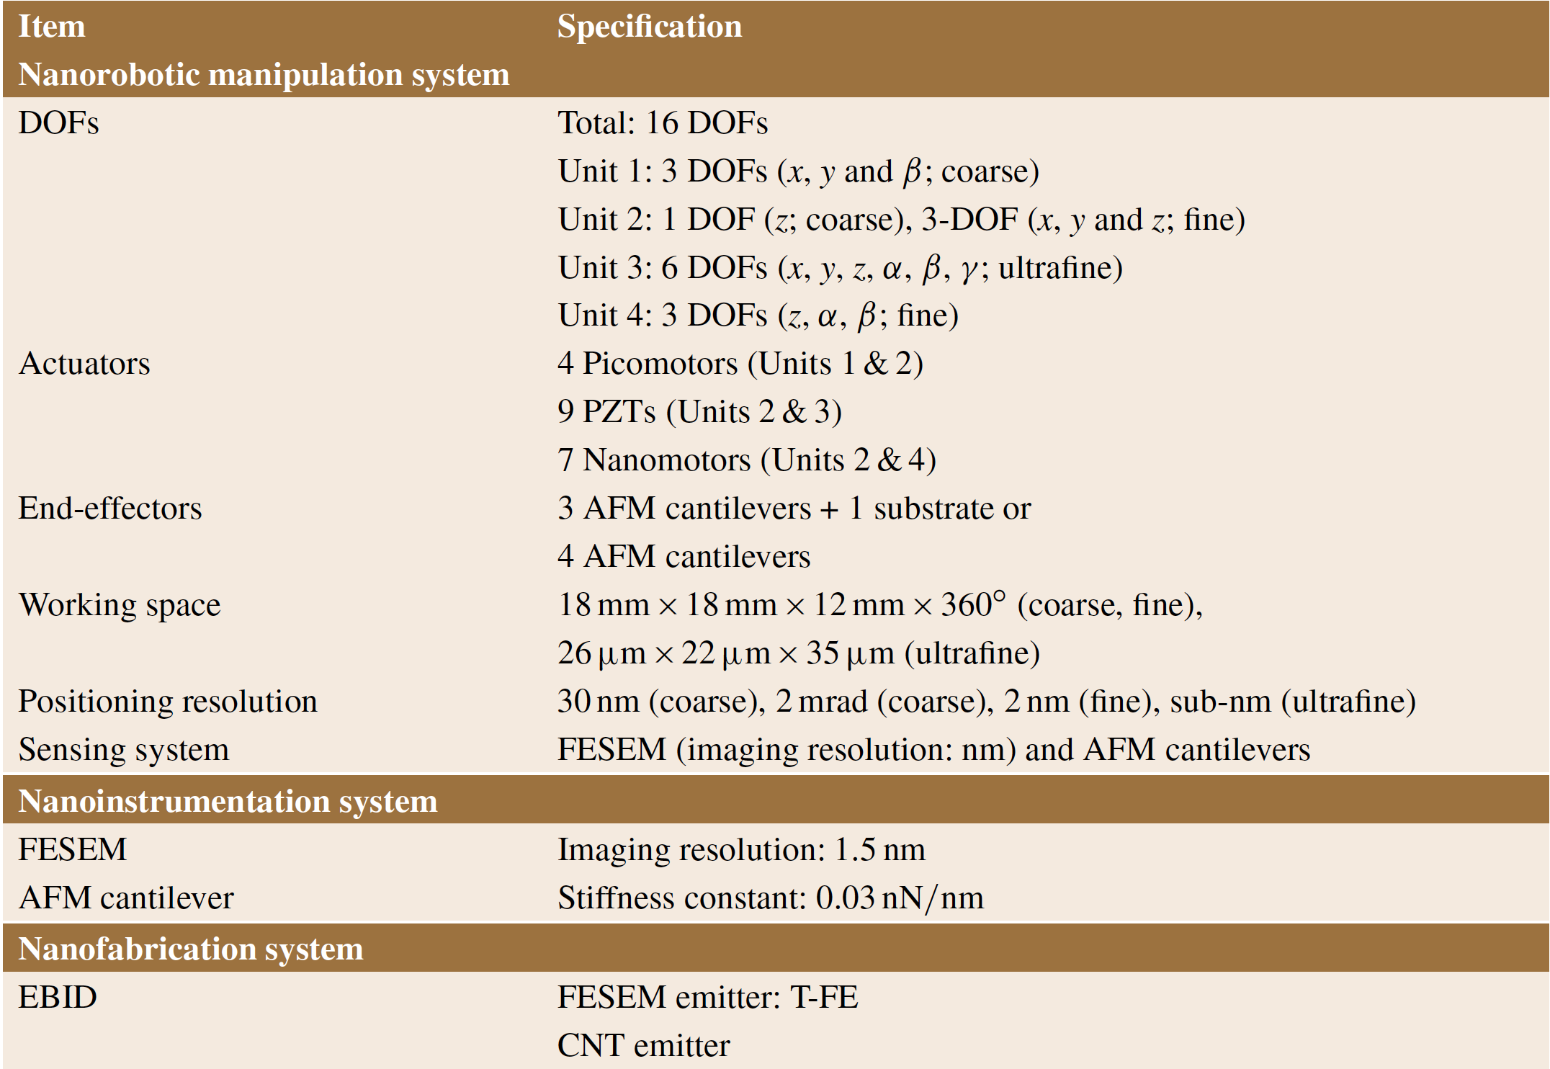
Specifications of this system
Nanorobotic Manipulation Systems

Slide 58
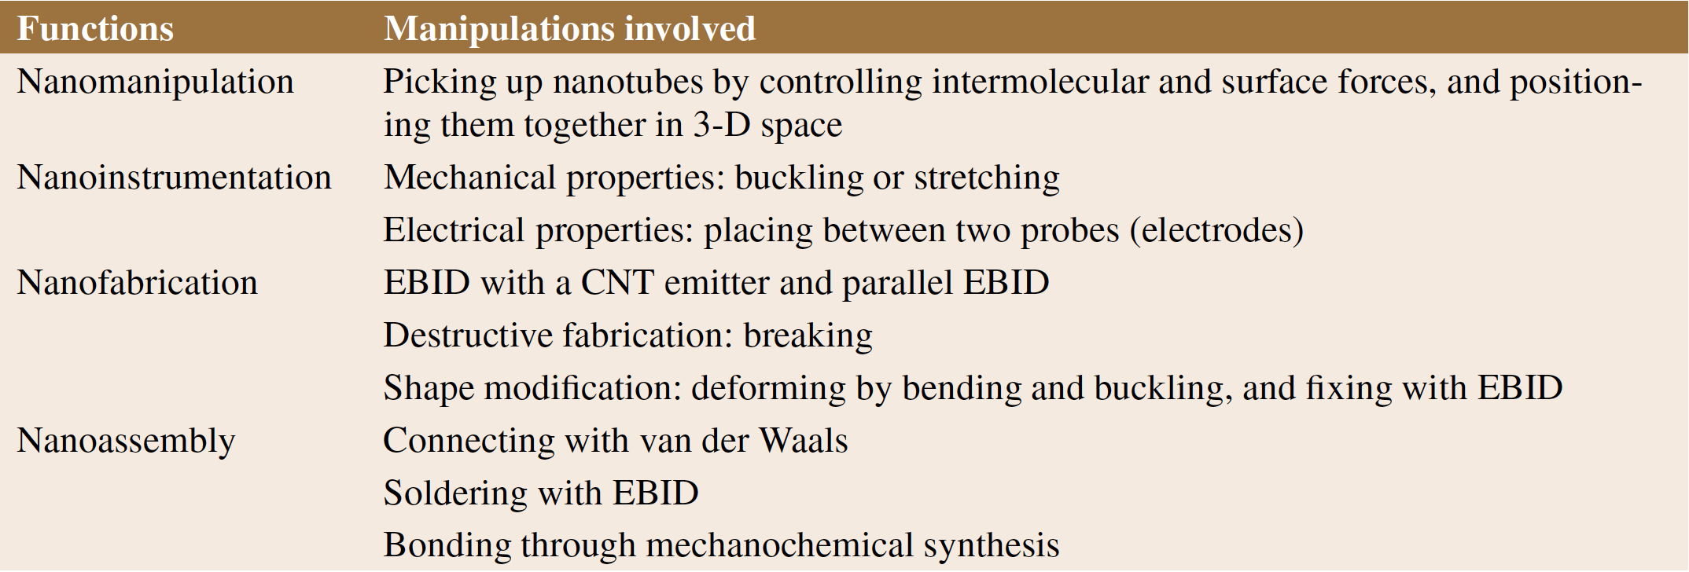
Functions of this nanorobotic manipulation system for nanomanipulation, nanoinstrumentation, nanofabrication and nanoassembly
Nanorobotic Manipulation Systems

Slide 59
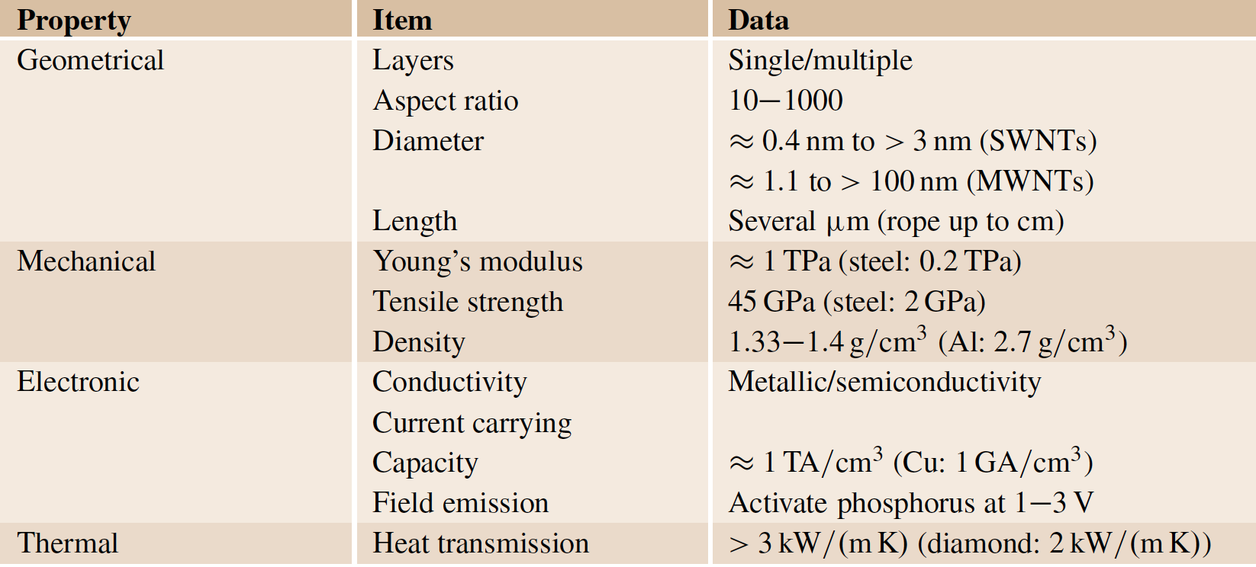
Functions of this nanorobotic manipulation system
Nanorobotic Manipulation Systems

Slide 60
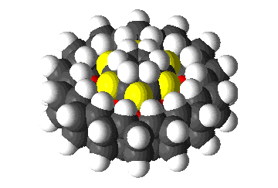
With the advancement of nanotechnology, one could shrink the size of nanomanipulators and insert more DOFs inside the limited vacuum chamber of a microscope, and, perhaps, the molecular version of manipulators such as that dreamed of by Drexler could be realized [ref].
K. Drexler: Nanosystems: Molecular Machinery,
Manufacturing and Computation (Wiley Interscience,
New York 1992)
Nanorobotic Manipulation Systems

Slide 61
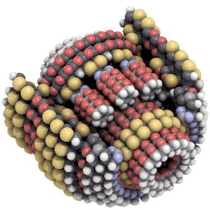
K. Drexler: Nanosystems: Molecular Machinery,
Manufacturing and Computation (Wiley Interscience,
New York 1992)
Nanorobotic Manipulation Systems

Slide 62
Example:
Construction of MWNT-based nanostructures with a nanorobotic manipulation system
http://apexnews.co/2018/02/07/
multi-walled-carbon-nanotubes-market-size-demand-and-trends-by-types-2018/
Nanorobotic Manipulation Systems

Slide 63
Construction of MWNT-based nanostructures
Nanorobotic manipulators … position and orient nanotubes for the fabrication of nanotube probes and emitters.
https://www.researchgate.net/figure/Nanotube-with-functional-chemical-
group-as-probe-of-cantilever-of-scanning-atomic-force_fig3_313589690
Nanorobotic Manipulation Systems

Slide 64
Construction of MWNT-based nanostructures
Nanorobotic manipulators … position and orient nanotubes for performing nanosoldering with electron-beam-induced deposition (EBID).
https://www.felmi-zfe.at/research/research-areas/
functional-nanofabrication/febip/
Nanorobotic Manipulation Systems

Slide 65
EBID
https://www.felmi-zfe.at/research/research-areas/
functional-nanofabrication/febip/
Nanorobotic Manipulation Systems

Slide 66
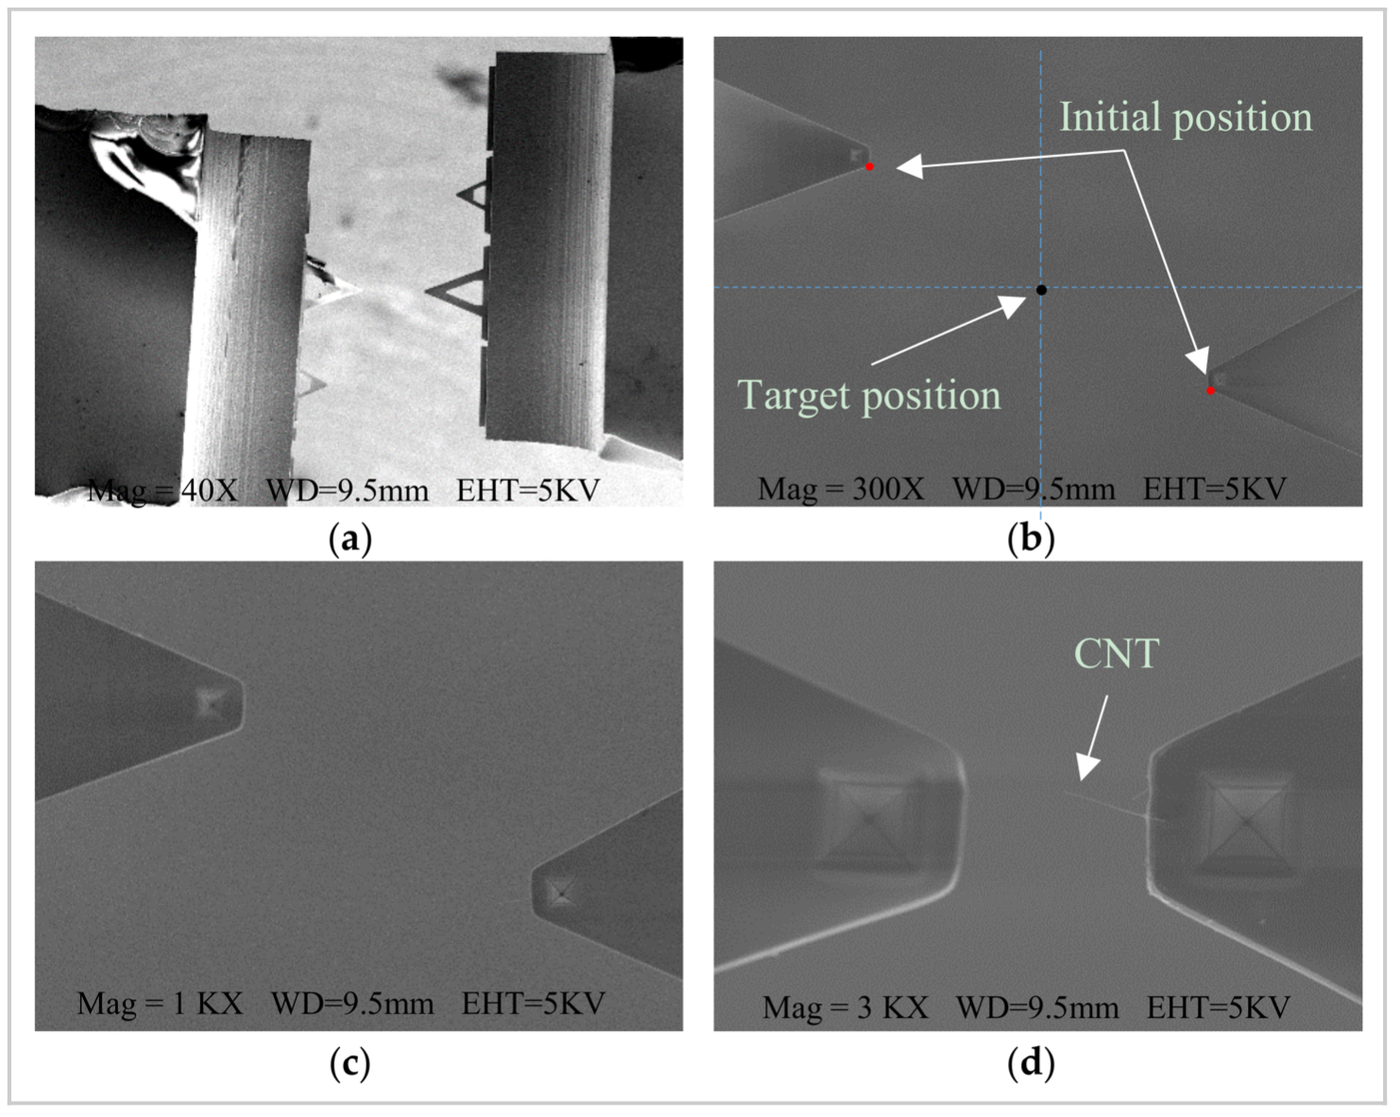
Construction of MWNT-based nanostructures
Nanorobotic manipulators … position and orient nanotubes for the property characterization of single nanotubes for selection purposes and for characterizing junctions to test connection strength.
Nanorobotic Manipulation Systems

Slide 67
Note: always give scalebars, not magnification!
https://www.mdpi.com/1424-8220/18/4/1137
Nanorobotic Manipulation Systems

Slide 68
Construction of MWNT-based nanostructures
Nanorobotic manipulators … position and orient nanotubes for the property characterization of single nanotubes for selection purposes and for characterizing junctions to test connection strength.
https://www.nature.com/articles/
srep11336/figures/1
Nanorobotic Manipulation Systems

Slide 69
Nanorobotic manipulators … position and orient nanotubes for the property characterization of single nanotubes for selection purposes and for characterizing junctions to test connection strength.
Strong carbon nanotube solids with welded scaffold.
https://www.nature.com/articles/
srep11336/figures/1
Nanorobotic Manipulation Systems

Slide 70
End of Example

Slide 71
Nanorobotic manipulation within the nanolaboratory has opened a new path for constructing nanosystems in 3-D space, and will create opportunities for new nanoinstrumentation and nanofabrication processes.
Nanorobotic Manipulation Systems

Slide 72
4. Nanorobotic Assembly
https://www.nanotechnik.com/nanomanipulation.html
Nanorobotic Assembly

Slide 73
Overview
Nanomanipulation is a promising strategy for nanoassembly.
Key techniques for nanoassembly include the structuring and characterization of nanobuilding blocks, the positioning and orientation control of the building blocks with nanometer-scale resolution, and effective connection techniques.
Nanorobotic manipulations, which is characterized by multiple DOFs with both position and orientation controls, independently actuated multi-probes, and a real-time observation system, have been shown to be effective for assembling nanotube-based devices in 3-D space.
Nanorobotic Assembly

Slide 74
Overview
The well-defined geometries, exceptional mechanical properties, and extraordinary electric characteristics, among other outstanding physical properties of Carbon Nanotubes (CNTs) qualify them for many potential applications, especially in nanoelectronics, NEMS, and other nanodevices.
Carbon nanotubes are known to be distinctly metallic or semiconducting, depending on their diameter and chirality. Although the chirality is usually considered a fixed structural parameter, we have shown that twisting a nanotube necessarily changes its chirality by definition.
http://www.weizmann.ac.il/
materials/ernesto/res3.html
Nanorobotic Assembly

Slide 75
Example: Twisting a nanotube
Carbon nanotubes are known to be distinctly metallic or semiconducting, depending on their diameter and chirality.
Although the chirality is usually considered a fixed structural parameter, we have shown that twisting a nanotube necessarily changes its chirality by definition.
http://www.weizmann.ac.il/
materials/ernesto/res3.html
Nanorobotic Assembly

Slide 76
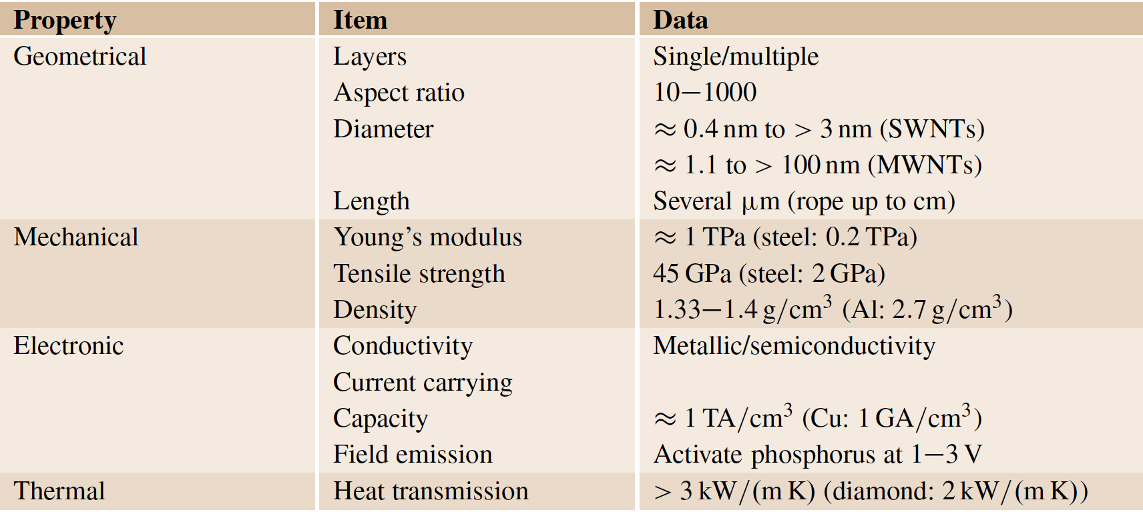
Physical properties of Carbon Nanotubes (CNTs)
Nanorobotic Assembly

Slide 77
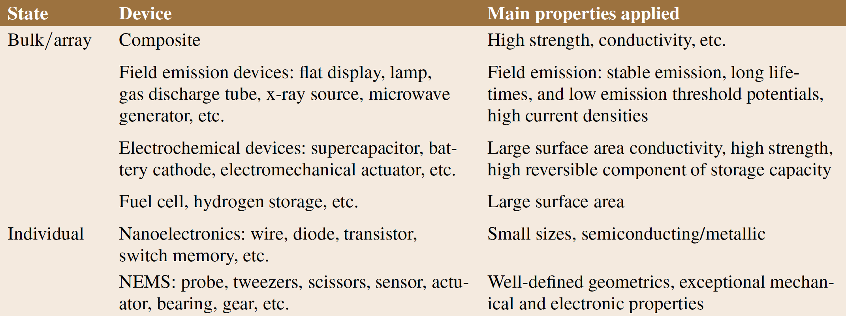
Potential Applications of Carbon Nanotubes
Nanorobotic Assembly

Slide 78
There will be a lecture solely on CNTs ☺

Slide 79
For NEMS, some of the most important characteristics of nanotubes include their nanometer diameter, large aspect ratio (10-1000), TPa-scale Young’s modulus, excellent elasticity, ultrasmall interlayer friction, excellent capability for field emission, various electric conductivities, high thermal conductivity, high current carrying capability with essentially no heating, sensitivity of conductance to various physical or chemical changes, and charge-induced bond-length change.
Nanorobotic Assembly

Slide 80
Nanocoils
https://www.researchgate.net/figure/SEM-image-of-the-carbon-
nanocoil-captured-from-the-same-angle-as-Fig-2-after-field_fig2_243746588
Nanorobotic Assembly

Slide 81
Nanocoils
Helical 3-D nanostructures, or nanocoils, have been synthesized from various materials, including helical carbon nanotubes and zinc oxide nanobelts.
Nanorobotic Assembly

Slide 82
Nanocoils
Helical geometries and tubes with diameters between 10 nm and 10um have been achieved.
Nanorobotic Assembly

Slide 83
Nanocoils
Because of their interesting morphology, mechanical, electrical, and electromagnetic properties, potential applications of these nanostructures in NEMS include nanosprings, electromechanical sensors, magnetic-field detectors, chemical or biological sensors, generators of magnetic beams, inductors, actuators, and highperformance electromagnetic-wave absorbers.
Nanorobotic Assembly

Slide 84
Left: Nanorobotic manipulation of an InGaAs/GaAs nanocoil with two metal connectors.
Right: I-V curves for different deformations of the nanocoil.
G.G. Hwang et al., Nano Lett. 9, 554, 2009
Nanorobotic Assembly

Slide 85
Pulling the coil for stiffness characterization of a SiGe/Si/Cr nanospring.
The results show that it has ultra-high flexibility (0.003 N/m) and exceptionally wide linear range (91% elongation from their unextended state).
Nanorobotic Assembly

Slide 86
http://www.msrl.ethz.ch/de/forschung/Forschungsarchiv/nems-based-on-3d-nanocoils.html
Nanorobotic Assembly

Slide 87
Fabrication flow of rolled-up nanocoil.
Nanorobotic Assembly

Slide 88
http://www.msrl.ethz.ch/de/forschung/Forschungsarchiv/nems-based-on-3d-nanocoils.html
Nanorobotic Assembly

Slide 89
Finite Element Method simulation of nanocoil
(from Dr. Dominik Bell).
Nanorobotic Assembly

Slide 90
http://www.msrl.ethz.ch/de/forschung/Forschungsarchiv/nems-based-on-3d-nanocoils.html
Nanorobotic Assembly

Slide 91
Freestanding SiGe/Si nanocoil with two contacts.
Nanorobotic Assembly

Slide 92
http://www.msrl.ethz.ch/de/forschung/Forschungsarchiv/nems-based-on-3d-nanocoils.html
Nanorobotic Assembly

Slide 93
NEMS based on individual single- or multiwalled carbon nanotubes (SWNTs or MWNTs) and nanocoils are of increasing interest, indicating that capabilities for incorporating these individual building blocks at specific locations on a device must be developed.
However, for nanotube-based structures, nanorobotic assembly is still the only technique capable of in situ structuring, characterization and assembly.
Nanorobotic Assembly

Slide 94
Because the as-fabricated nanocoils are not free-standing from their substrate, nanorobotic assembly is virtually the only way to incorporate them into devices at present.
https://www.researchgate.net/figure/I-V-properties-for-carbon-nanocoils-with-the-
average-diameters-of-500-nm-200-nm-80-nm_fig2_239663349
Nanorobotic Assembly

Slide 95
Carbon Nanotubes
Nanotube manipulation in two dimensions on a surface was first performed with an AFM by contact pushing on a substrate.
Nanorobotic Assembly

Slide 96
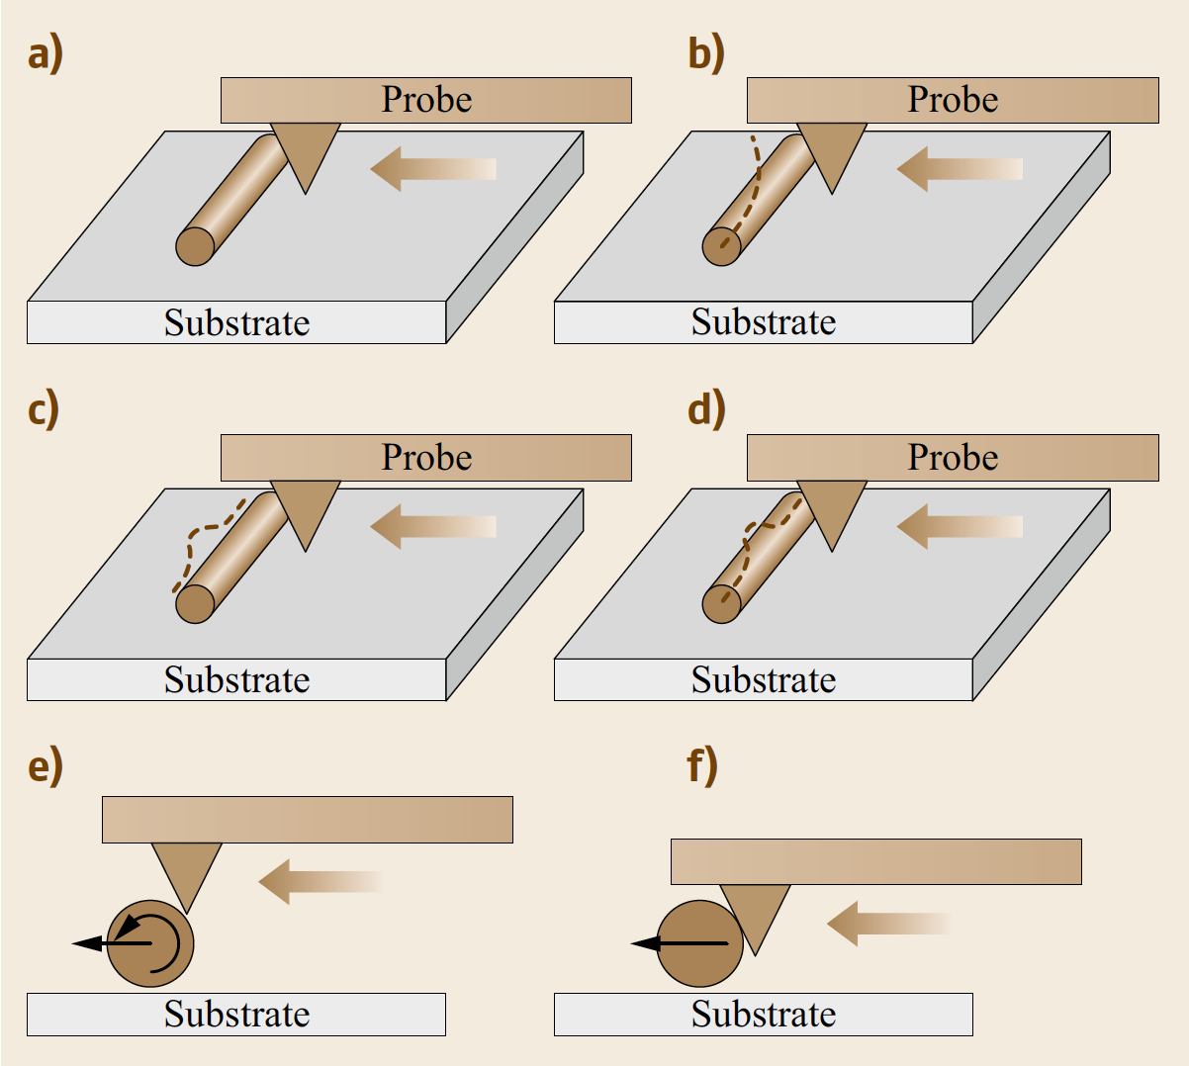
Typical methods for 2-D pushing of CNTs
Note: Nanotubes cannot be regarded as 0-D points.
Nanorobotic Assembly

Slide 97
Manipulation of CNTs in 3-D space is important for assembling CNTs into structures and devices.
The basic techniques for the nanorobotic manipulation of carbon nanotubes are shown in the next few slides.
These serve as the basis for handling, structuring, characterizing and assembling NEMS.
Nanorobotic Assembly

Slide 98
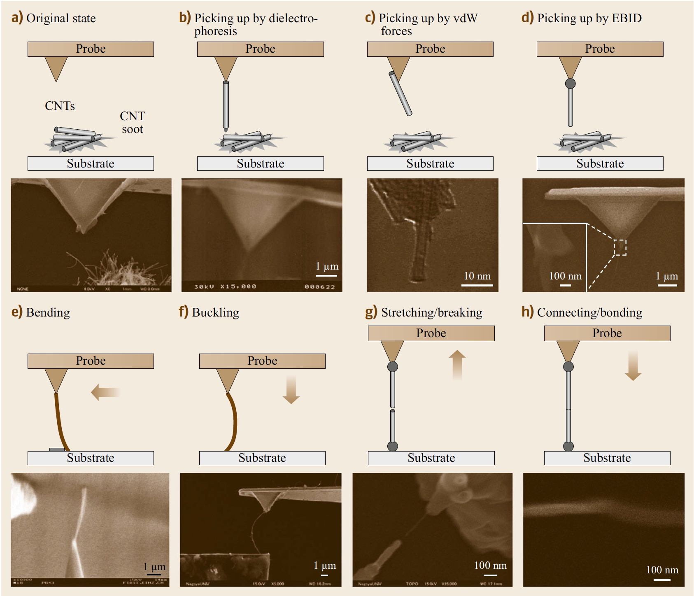
a. The basic procedure is to pick up a single tube from nanotube soot.
b. This has been shown first by using dielectrophoresis through nanorobotic manipulation.
By applying a bias between a sharp tip and a plane substrate, a nonuniform electric field can be generated between the tip and the substrate with the strongest field near the tip.
This field can cause a tube to orient along the field or further jump to the tip by electrophoresis or dielectrophoresis (determined by the conductivity of the objective tubes).
Nanorobotic Assembly

Slide 99
Removing the bias, the tube can be placed at other locations at will.
This method can be used for free-standing tubes on nanotube soot or on a rough surface on which surface van der Waals forces are generally weak.
A tube strongly rooted in CNT soot or lying on a flat surface cannot be picked up in this way.
Nanorobotic Assembly

Slide 100
c. The interaction between a tube and the atomically flat surface of the AFM cantilever tip has been shown to be strong enough to pick up a tube with the tip.
d. By using EBID, it is possible to pick up and fix a nanotube onto a probe.
For handling a tube, a weak connection between the tube and the probe is desired.
Nanorobotic Assembly

Slide 101
e. f. Bending and buckling a CNT are important for in situ property characterization of a nanotube, which is a simple way to get the Young’s modulus of a nanotube without damaging the tube (if performed within its elastic range) and, hence, can be used for the selection of a tube with desired properties.
Nanorobotic Assembly

Slide 102
Young’s modulus
Young's modulus is a measure of the ability of a material to withstand changes in length when under lengthwise tension or compression. Sometimes referred to as the modulus of elasticity, Young's modulus is equal to the longitudinal stress (force per unit area) divided by the strain (resulting compression/stretching, known as deformation).
Stress-Strain Curve:
Spannungs-Dehnungsdiagramm
Nanorobotic Assembly

Slide 103
Young’s modulus
The linear portion of the curve is the elastic region and the slope is the modulus of elasticity or Young's Modulus ( Young's Modulus is the ratio of the compressive stress to the longitudinal strain). ... Therefore, the stress needed to initiate the movement will be large.
Stress-Strain Curve:
Spannungs-Dehnungsdiagramm
Nanorobotic Assembly

Slide 104
e. f. Bending and buckling a CNT are important for in situ property characterization of a nanotube, which is a simple way to get the Young’s modulus of a nanotube without damaging the tube (if performed within its elastic range) and, hence, can be used for the selection of a tube with desired properties.
Nanorobotic Assembly

Slide 105
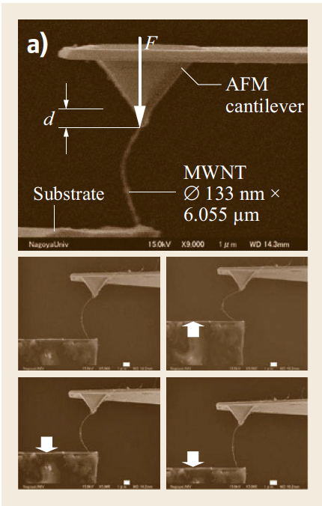
In-situ mechanical property characterization of a nanotube by buckling it
a) Process of buckling: an individual
MWNT being buckled. Scale bars: 1um.
Nanorobotic Assembly

Slide 106
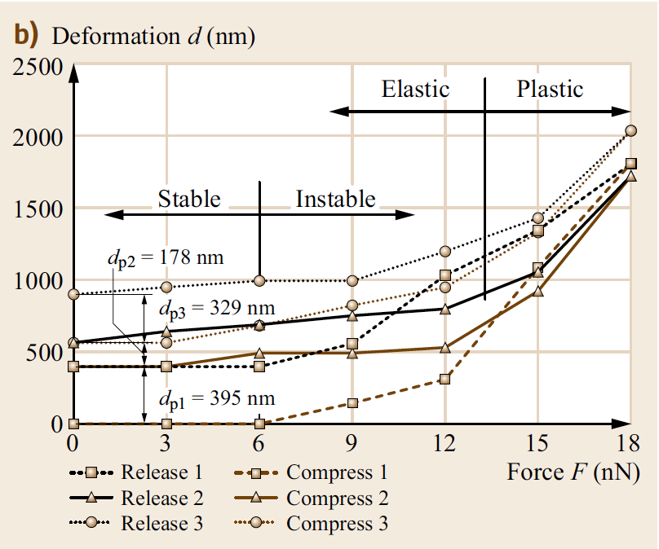
In-situ mechanical property characterization of a nanotube by buckling it
b) Elastic and plastic properties of an MWNT. Property curve of the elastic and plastic deformations
of the MWNT (diameter 133nm*6.055um), where d and F are the axial deformation and buckling force.
Nanorobotic Assembly

Slide 107
For a CNT, the maximum angular displacement will appear at the fixed left end under pure bending or at the middle point under pure buckling.
A combination of these two kinds of loads will achieve a controllable position of the kink point and a desired kink angle theta.
If the deformation is within the elastic limit of the nanotube, it will recover as the load is released.
To avoid this, EBID can be applied at the kink point to fix the shape.
Nanorobotic Assembly

Slide 108
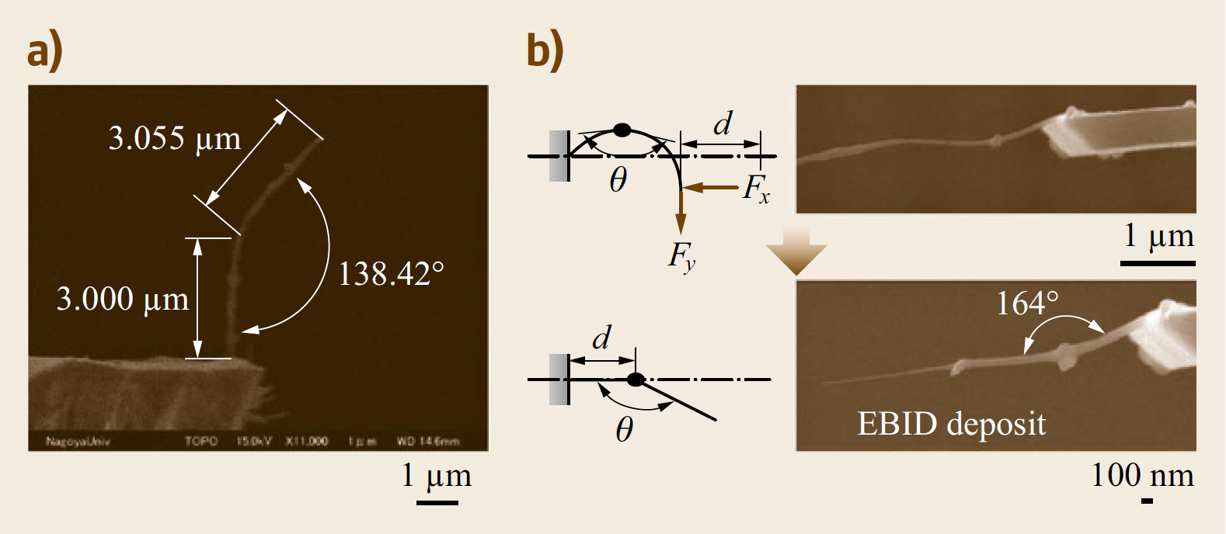
To obtain any desired angle for a kinked junction it is possible to fix the shape of a buckled nanotube within its elastic limit by using EBID.
Nanorobotic Assembly

Slide 109
Stretching a nanotube between two probes or a probe and a substrate has generated several interesting results
Nanorobotic Assembly

Slide 110
The first demonstration of 3-D nanomanipulation of nanotubes took this as an example to show the breaking mechanism of an MWNT, and to measure the tensile strength of CNTs.
By breaking an MWNT in a controlled manner, interesting nanodevices have been fabricated.
This technique – destructive fabrication – has been presented to get sharpened and layered structures of nanotubes and to improve control of the length of nanotubes.
Nanorobotic Assembly

Slide 111
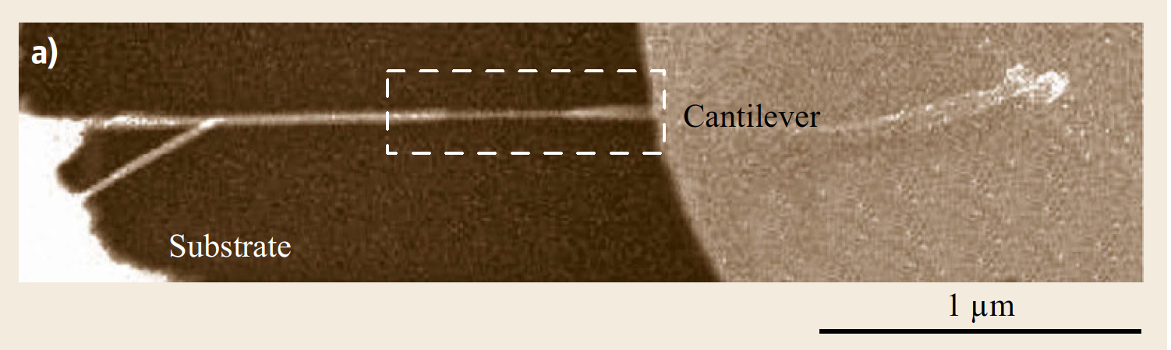
Destructive fabrication
A MWNT that is supported between a substrate (left end) and an AFM cantilever.
Nanorobotic Assembly

Slide 112
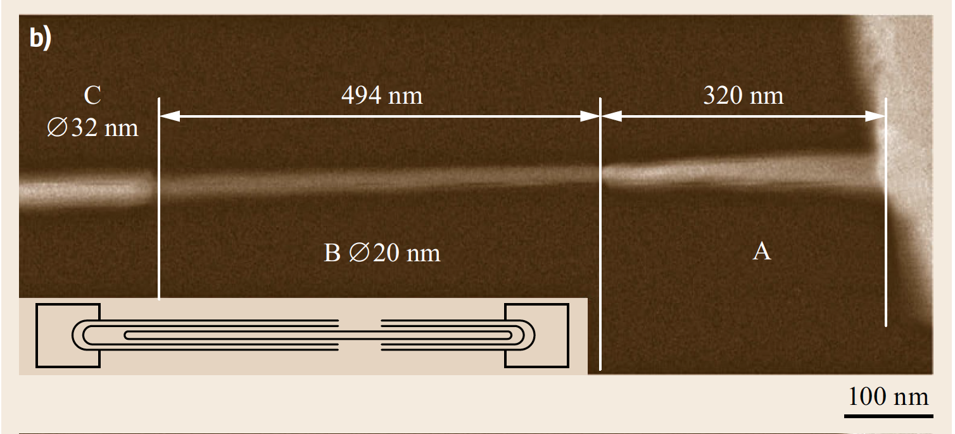
CNT with thinner neck formed by destructive fabrication, i. e., by moving the cantilever to the right
Nanorobotic Assembly

Slide 113
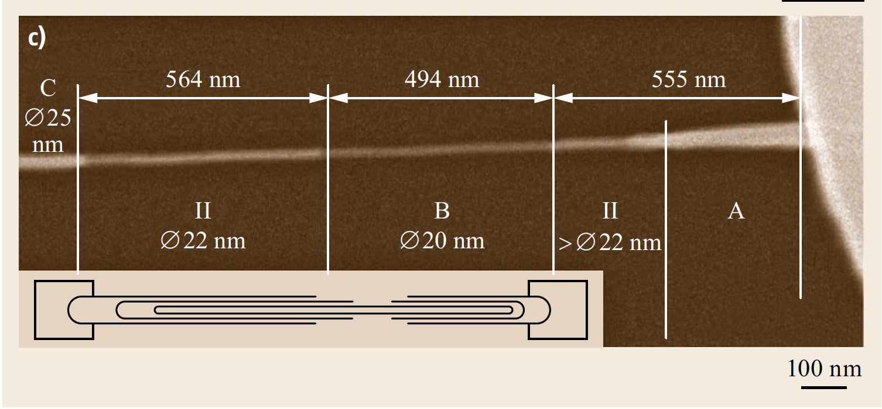
Linear bearing motion observed in an incompletely broken MWNT
Nanorobotic Assembly

Slide 114
The middle part (Part B) remained unchanged in its length and diameter, while its two ends brought out two new parts I and II from parts A and B, respectively.
Part II has uniform diameter (diameter 22 nm), while part I is a tapered structure with a smallest diameter of 25 nm.
The interlayer friction has been predicted to be very small, but direct measurement of the friction remains a challenging problem.
Nanorobotic Assembly

Slide 115
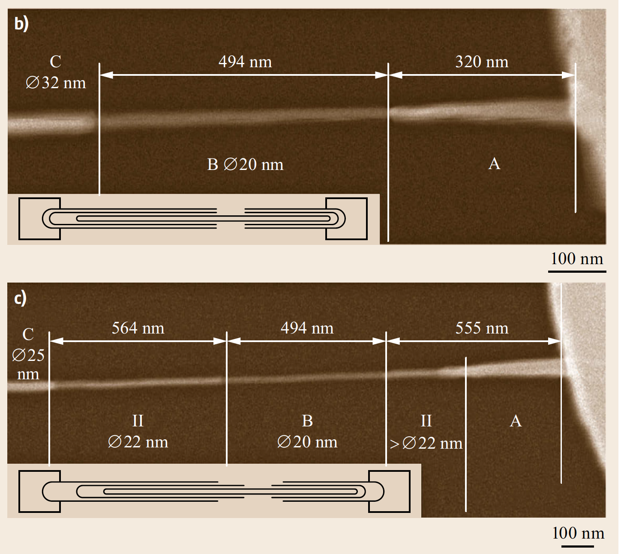
Nanorobotic Assembly

Slide 116
The reverse process, namely the connection of broken tubes, has been demonstrated recently, and the mechanismis revealed as rebonding of unclosed dangling bonds at the ends of broken tubes.
Based on this interesting phenomenon, mechanochemical nanorobotic assembly has been performed.
Nanorobotic Assembly

Slide 117
Assembly of nanotubes is a fundamental technology for enabling nanodevices.
The most important tasks include the connection of nanotubes and placing of nanotubes onto electrodes.
Nanorobotic Assembly

Slide 118
A test MEMS device with a single CNT bridging two electrodes.
The fabrication process is a conventional silicon-on-insulator MEMS process, and the placement of the tube is achieved seamlessly during the CVD CNT growth.
https://www.nanowerk.com/spotlight/spotid=11804.php
Nanorobotic Assembly

Slide 119
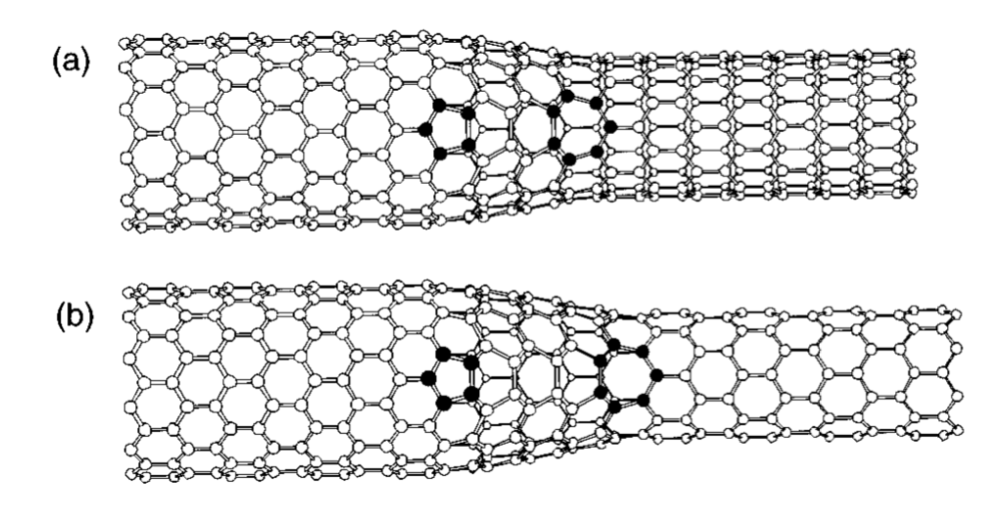
Pure nanotube circuits created by interconnecting nanotubes of different diameters and chirality could lead to further size reductions in devices.
Nanotube intermolecular and intramolecular junctions are basic elements for such systems.
Nanorobotic Assembly

Slide 120
An intramolecular kink junction behaving like a rectifying diode has been reported.
Although some kinds of junctions have been synthesized with chemical methods, there is no evidence yet showing that a self-assembly-based approach can provide more complex structures.
3-D nanorobotic manipulation based nanoassembly is a promising strategy both for the fabrication of nanotube junctions and for the construction of more complex nanodevices with such junctions.
Nanorobotic Assembly

Slide 121
Nanotube junction classification
by the kind of components – SWNTs or MWNTs;
OR by geometric configuration – V (kink), I, X- (cross), T-, Y- (branch), and 3-D junctions;
OR by conductivity – metallic or semiconducting;
OR by connection methods – intermolecular (connected with van der Waals force, EBID, etc.) or intramolecular (connected with chemical bonds) junctions.
Here start lecture on December 5, 2018
Nanorobotic Assembly

Slide 122
Nanorobotic Assembly

Slide 123
MWNT junctions by emphasizing the connection methods
by connecting with van der Waals forces
https://www.youtube.com/watch?v=HGc9RFD7iSE ,
joining by electron-beam-induced deposition
https://www.youtube.com/watch?v=12MvvaH9FvI
and bonding through mechanochemistry.
Nanorobotic Assembly

Slide 124
MWNT junctions connected with van der Waals forces
To fabricate such junctions, the main process is to position two or more nanotubes together with nanometer resolution;
they will then be connected naturally by intermolecular van der Waals forces.
Such junctions are mainly for structures where contact rather than strength is emphasized.
Placing them onto a surface can make them more stable. In some cases, when lateral movement along the surface of nanotubes is desired while keeping them in contact, van der Waals-type connections are the only ones that are suitable.
Nanorobotic Assembly

Slide 125
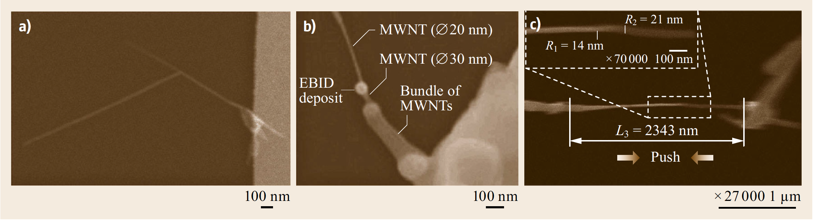
MWNT junctions
MWNTs connected with van der Waals force.
Nanorobotic Assembly

Slide 126
The previous figure shows a T-junction connected with van der Waals forces, which is fabricated by positioning the tip of an MWNT onto another MWNT until they form a bond.
The contact is checked by measuring the shear connection force.
Nanorobotic Assembly

Slide 127
MWNT junctions
MWNTs connected with van der Waals force.
Nanorobotic Assembly

Slide 128
MWNT junctions connected with EBID
EBID provides a soldering method to obtain stronger nanotube junctions than those connected through van der Waals forces.
Hence, if the strength of nanostructures is emphasized, EBID can be applied.
Nanorobotic Assembly

Slide 129
MWNT junctions
(b) MWNTs joined with EBID.
Nanorobotic Assembly

Slide 130
MWNT junctions connected with EBID
The figure shows an MWNT junction connected through EBID, in which the upper MWNT is a single one with a diameter of 20 nm and the lower one is a bundle of MWNTs with an extruded single CNT with a diameter of 30 nm.
Nanorobotic Assembly

Slide 131
MWNT junctions
(b) MWNTs joined with EBID.
Nanorobotic Assembly

Slide 132
MWNT junctions connected with EBID
The development of conventional EBID has been limited by the expensive electron filament used and low productivity.
Rinzler and coworkers have presented a parallel EBID system by using CNTs as emitters because of their excellent field-emission properties.
Parallel EBID is a promising strategy for large-scale fabrications of nanotube junctions.
A.G. Rinzler, J.H. Hafner, P. Nikolaev, L. Lou, S.G. Kim, D. Tom.nek, P. Nordlander, D.T. Colbert, R.E. Smalley:
Unraveling nanotubes: field emission from an atomic wire, Science 269, 1550–1553 (1995)
Nanorobotic Assembly

Slide 133
MWNT junctions connected with EBID
Similar to its macro counterpart, welding, EBID works by adding material to obtain stronger connections, but in some cases, added material might influence normal functions for nanosystems.
So, EBID is mainly applied to nanostructures rather than nanomechanisms.
Nanorobotic Assembly

Slide 134
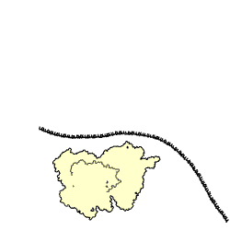
MWNT bonded through mechanochemistry
To construct stronger junctions without adding additional material, mechanochemical nanorobotic assembly is an important strategy.
Mechanochemical nanorobotic assembly is based on solid-phase chemical reactions, or mechanosynthesis, which is defined as chemical synthesis controlled by mechanical systems operating with atomic-scale precision, enabling direct positional selection of reaction sites.
Biological mechanosynthesis in the ribosome
Nanorobotic Assembly

Slide 135
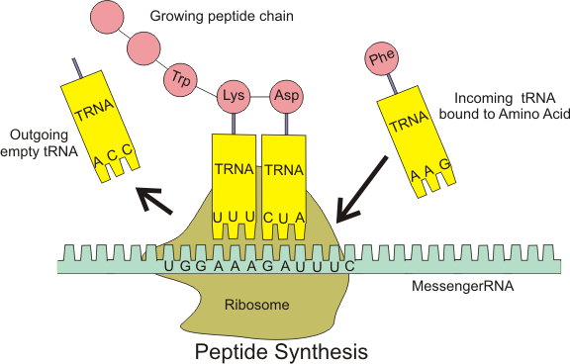
Biological mechanosynthesis in the ribosome
Nanorobotic Assembly

Slide 136
MWNT bonded through mechanochemistry
By picking up atoms with dangling bonds rather than natural atoms only, it is easier to form primary bonds, which provides a simple but strong connection.
Destructive fabrication provides a way to form dangling bonds at the ends of broken tubes.
Some of the dangling bonds may close with neighboring atoms, but generally a few bonds will remain dangling.
A nanotubewith dangling bonds at its end will bind more easily to another to form intramolecular junctions.
Nanorobotic Assembly

Slide 137
Dangling Bonds
A dangling bond is an unsatisfied valence on an immobilized atom.
An atom with a dangling bond is also referred to as an immobilized free radical or an immobilized radical, a reference to its structural and chemical similarity to a free radical.
Nanorobotic Assembly

Slide 138
Production of a CNT with dangling bonds
L.X. Dong, F. Arai, T. Fukuda: Mechanochemical nanorobotic manipulations of carbon nanotubes, Jpn. J. Appl. Phys. 42, 295–298 (2003)
Nanorobotic Assembly

Slide 139
An MWNT (length L1 = 1329nm, diameter D1 = 42 nm) is placed between a substrate and an AFM cantilever with a CNT tip, and the two ends are fixed.
By pulling the two ends of the MWNT, it is broken into two parts.
By pushing the two nanotubes head to head close enough, a new one is formed.
Nanorobotic Assembly

Slide 140
To test the strength of this nanotube, it was broken again.
The fact that the nanotube breaks at a different site suggests that the tensile strength of the connected nanotubes is not weaker than that of the original nanotube itself.
The authors have determined that no type of connection based on van der Waals interactions can provide such a strong connection strength.
Also, they have shown that, from the measured tensile strength (1.3 TPa), chemical bonds must have been formed when the junction formed, and that these are most likely to be covalent bonds (sp2- hybrid type, as in a nanotube).
L.X. Dong, F. Arai, T. Fukuda: Mechanochemical nanorobotic manipulations of carbon nanotubes, Jpn. J. Appl. Phys. 42, 295–298 (2003)
Nanorobotic Assembly

Slide 141
3-D nanorobotic manipulation has opened a new route for structuring and assembly nanotubes into nanodevices.
However, at present nanomanipulation is still performed in a serial manner with master–slave control, which is not a large-scale production-oriented technique.
Nevertheless, with advances in the exploration of mesoscopic physics, better control of the synthesis of nanotubes, more accurate actuators, and effective tools for manipulation, high-speed and automatic nanoassembly will be possible.
Nanorobotic Assembly

Slide 142
Another approach might be parallel assembly by positioning building blocks with an array of probes and joining them together simultaneously, e.g., with the parallel EBID approach that was presented.
Further steps might progress towards exponential assembly, and in the far future to self-replicating assembly.
Nanorobotic Assembly

Slide 143
Nanocoils
The construction of nanocoil-based NEMS involves the assembly of as-grown or as-fabricated nanocoils, which is a significant challenge from a fabrication standpoint.
Focusing on the unique aspects of manipulating nanocoils due to their helical geometry, high elasticity, single end fixation, and strong adhesion to the substrate from wet etching, a series of new processes is presented using a manipulator (MM3A, Kleindiek) installed in an SEM (Zeiss DSM962).
Nanorobotic Assembly

Slide 144
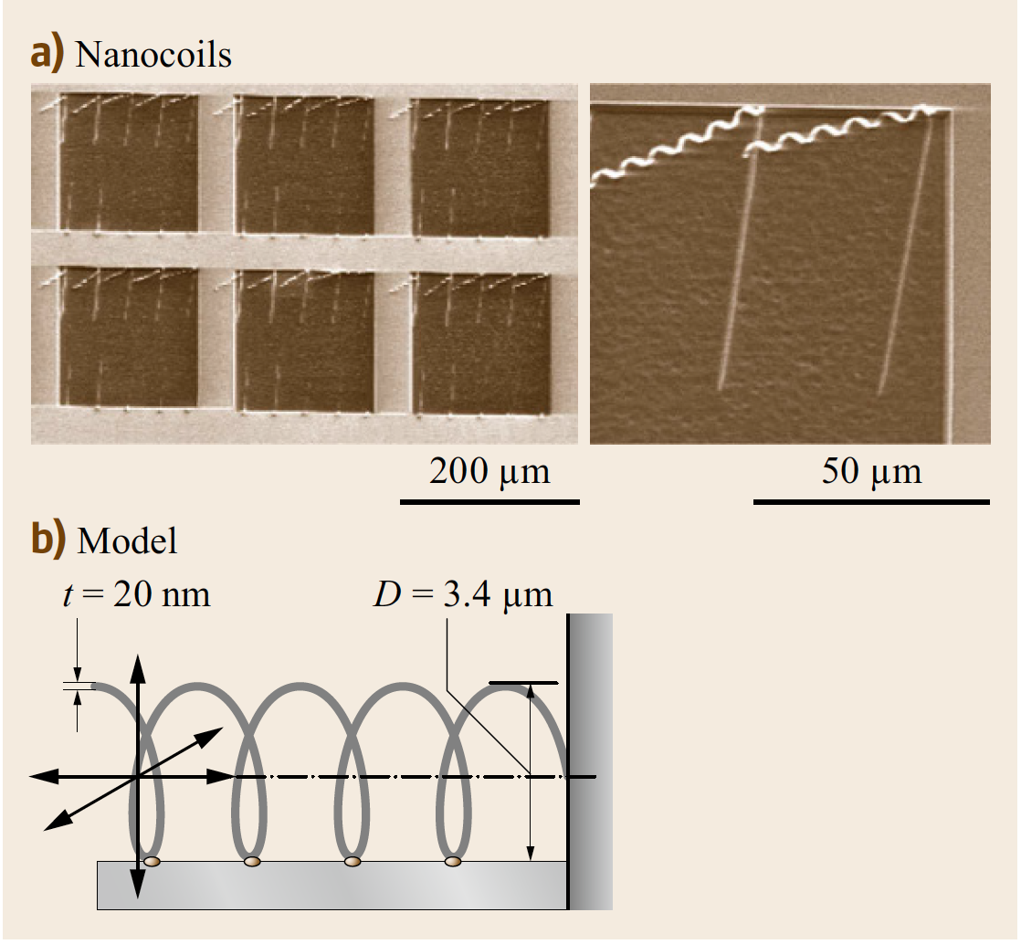
As-fabricated SiGe/Si bilayer nanocoils
As-fabricated nanocoils with a thickness of t = 20nm (without Cr layer) or 41 nm (with Cr layer). Diameter: D = 3.4um
Nanorobotic Assembly

Slide 145
Nanocoils
Special tools have been fabricated including a nanohook prepared by controlled tip-crashing of a commercially available tungsten sharp probe onto a substrate, and a sticky probe prepared by tip dipping into a double-sided SEM silver conductive tape.
Nanorobotic Assembly

Slide 146
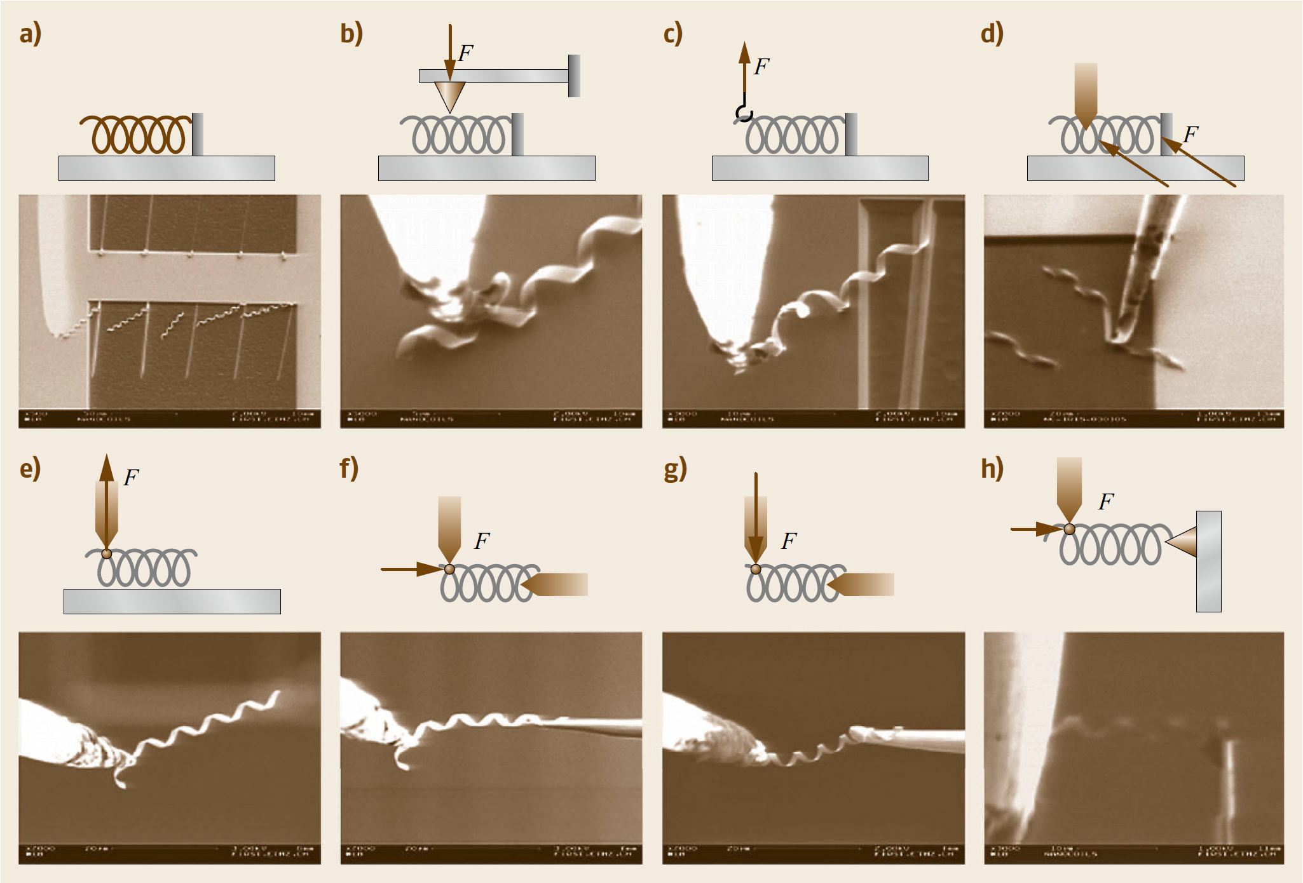
Nanocoils can be released from a chip by lateral pushing, picked up with a nanohook or a sticky probe, and placed between the probe/hook and another probe or an AFM cantilever.
Nanorobotic Assembly

Slide 147
Axial pulling/pushing, radial compressing/releasing, and bending/buckling have also been demonstrated.
These processes have shown the effectiveness of manipulation for the characterization of coil-shaped nanostructures and their assembly for NEMS, which have been otherwise unavailable.
Nanorobotic Assembly

Slide 148
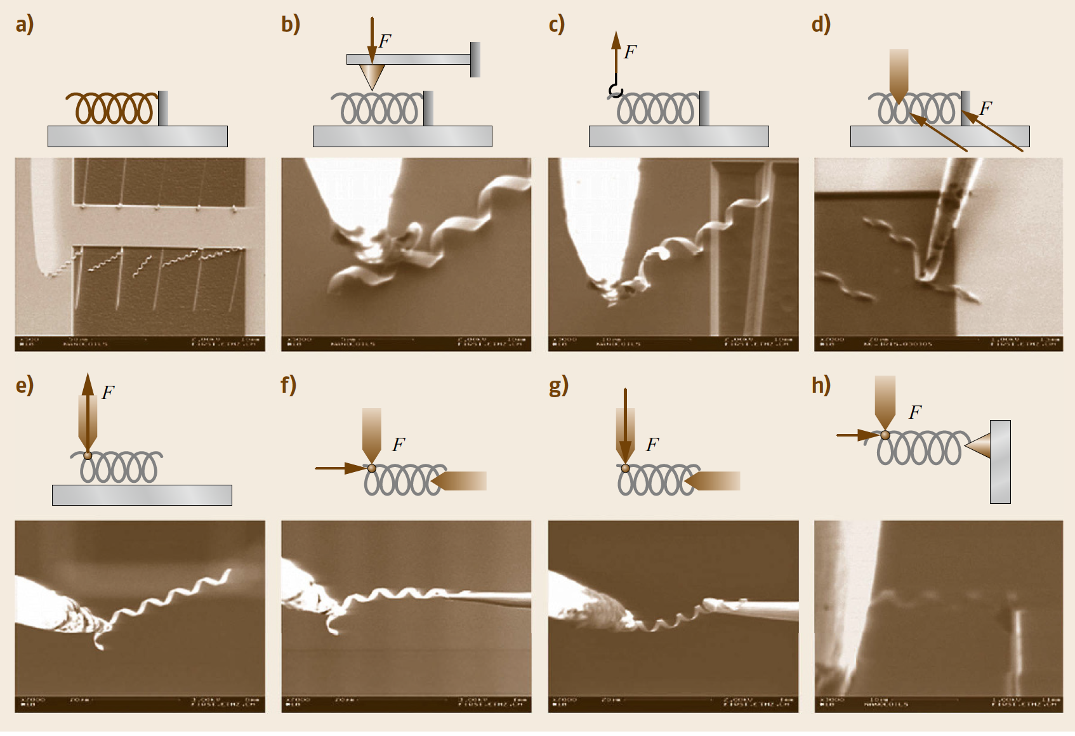
Nanorobotic manipulation of nanocoils
(a) original state, (b) compressing/releasing, (c) hooking, (d) lateral pushing /breaking, (e) picking, (f) placing/inserting, (g) bending, and (h) pushing and pulling

Slide 149
Nanocoil based devices
Cantilevered nanocoils can serve as nanosprings.
Nanoelectromagnets, chemical sensors and nanoinductors involve nanocoils bridged between two electrodes.
Electromechanical sensors can use a similar configuration but with one end connected to a moveable electrode.
Mechanical stiffness and electric conductivity are fundamental properties for these devices that must be further investigated.
Nanorobotic Assembly

Slide 150
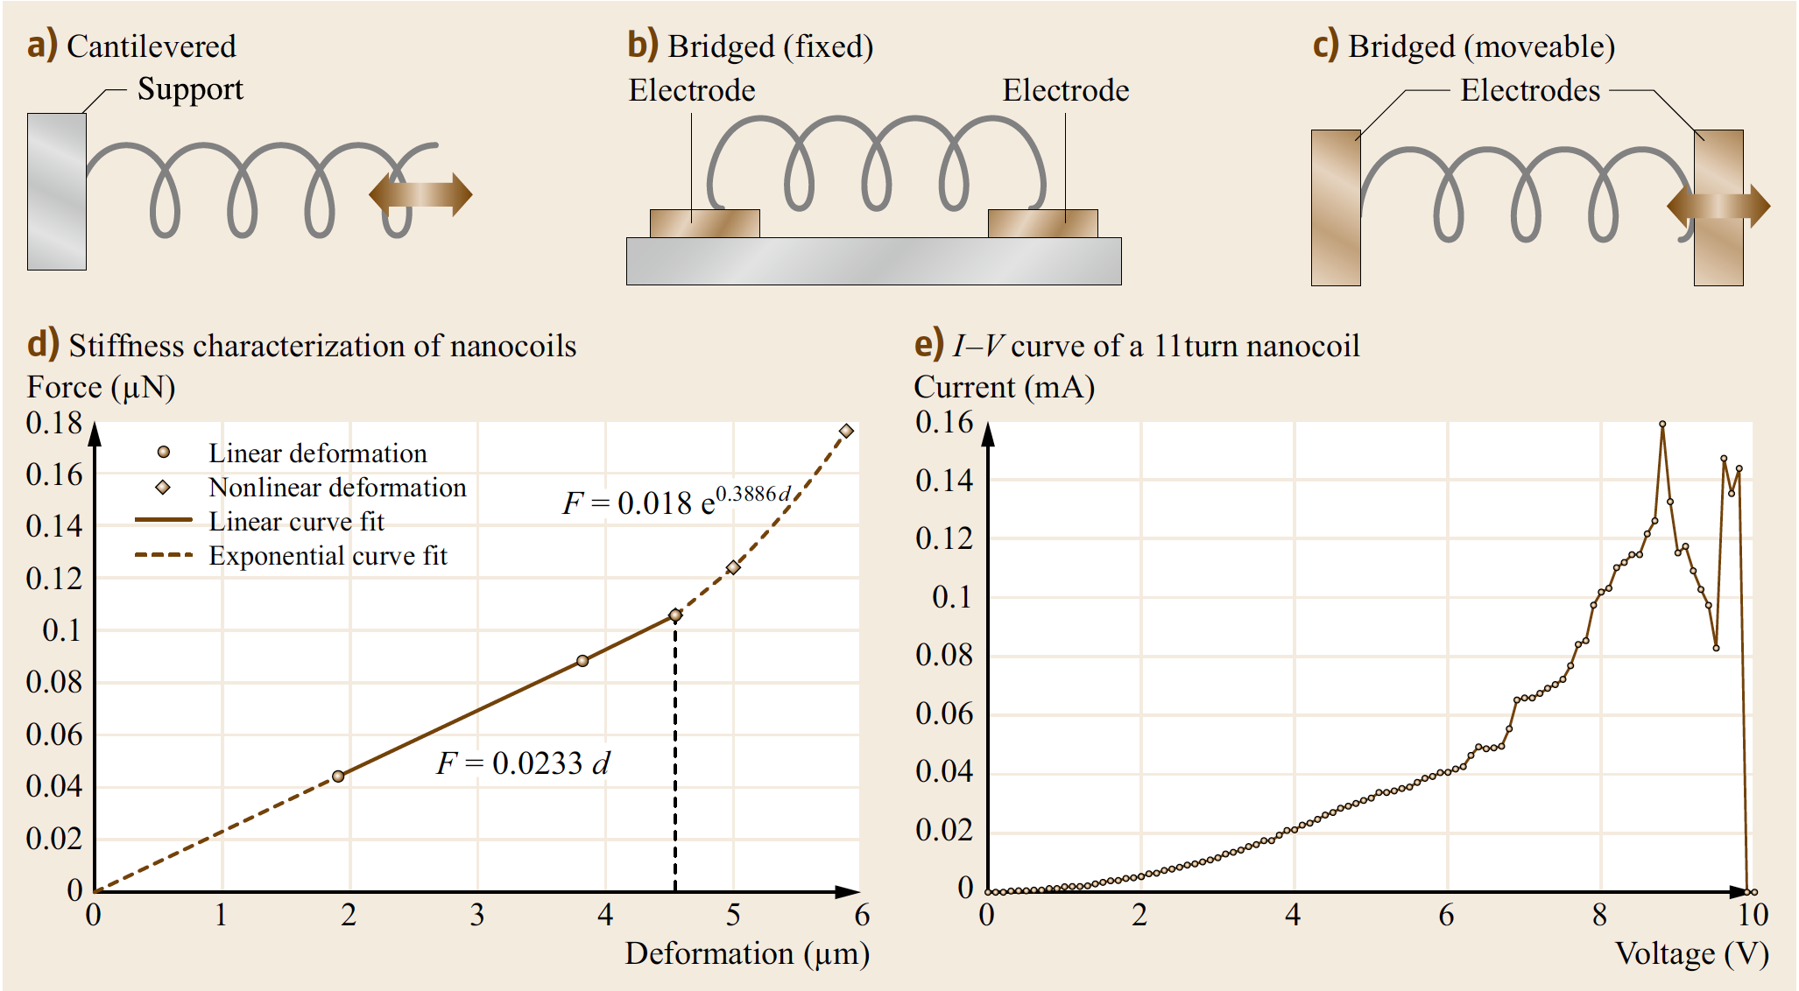
Nanocoil based devices
Cantilevered nanocoils can serve as nanosprings.
Nanorobotic Assembly

Slide 151
Nanocoil based devices
Nanoelectromagnets, chemical sensors, and nanoinductors involve
nanocoils bridged between two electrodes.
Nanorobotic Assembly

Slide 152
Nanocoil based devices
Electromechanical sensors can use a similar configuration but with one end
connected to a moveable electrode.
Nanorobotic Assembly

Slide 153
Nanocoil based devices
Mechanical stiffness (d) and electric conductivity (e) are basic properties of
interest for these devices.
Nanorobotic Assembly

Slide 154
Axial pulling is used to measure the stiffness of a nanocoil.
A series of SEM images are analyzed to extract the AFM tip displacement and the nanospring deformation, i. e., the relative displacement of the probe from the AFM tip.
From this displacement data and the known stiffness of the AFM cantilever, the tensile force acting on the nanospring versus the nanospring deformation was plotted.
Nanorobotic Assembly

Slide 155
The deformation of the nanospring was measured relative to the first measurement point.
This was necessary because proper attachment of the nanospring to the AFM cantilever must be verified.
Afterwards, it was not possible to return to the point of zero deformation.
Nanorobotic Assembly

Slide 156
Instead, the experimental data has been shifted such that, with the calculated linear elastic spring stiffness, the line begins at zero force and zero deformation.
The stiffness of the spring was estimated to be 0.0233N/m.
The linear elastic region of the nanospring extends to a deformation of 4.5um.
Nanorobotic Assembly

Slide 157
An exponential approximation was fitted to the nonlinear region.
When the applied force reached 0.176uN, the attachment between the nanospring and the AFM cantilever broke.
Finite element simulation (ANSYS 9.0) was used to validate the experimental data.
Nanorobotic Assembly

Slide 158
The measured stiffness falls into this range at 22.0% above the minimum value and 22.8% below the maximum value, and very close to the stiffness of a 4.5 turn nanospring, which has a stiffness of 0.0230N/m according to the simulation.
Nanorobotic Assembly

Slide 159
Electrical characterization experiments on a nanospring with 11 turns using the configuration as shown in the right figure.
Nanorobotic Assembly

Slide 160
The I–V curve is nonlinear, which may be caused by the resistance change of the semiconductive bilayer due to ohmic heating.
Another possible reason is the decrease in contact resistance caused by thermal stress.
Nanorobotic Assembly

Slide 161
The maximum current was found to be 0.159mA under an 8.8V bias.
Higher voltage causes the nanospring to blow off.
Nanorobotic Assembly

Slide 162
From the fast scanning screen of the SEM, the extension of the nanospring on the probes was observed around the peak current so that the current does not drop abruptly.
Nanorobotic Assembly

Slide 163
At 9.4V, the extended nanospring is broken down, causing an abrupt drop in the I–V curve.
Nanorobotic Assembly

Slide 164
From fabrication and characterization results, the helical nanostructures appear to be suitable to function as inductors.
They would allow further miniaturization compared to state-of-the-art microinductors.
For this purpose, higher doping of the bilayer and an additional metal layer would result in the required conductance.
Nanorobotic Assembly

Slide 165
Conductance, inductance, and quality factor can be further improved if, after curling up, additional metal is electroplated onto the helical structures.
Moreover, a semiconductive helical structure, when functionalized with binding molecules, can be used for chemical sensing using the same principle as demonstrated with other types of nanostructures.
With bilayers in the range of a few monolayers, the resulting structures would exhibit a very high surface-to-volume ratio with the whole surface exposed to an incoming analyst.
Nanorobotic Assembly

Slide 166
5. Applications of Nanorobots
https://www.express.co.uk/news/science/967564/Nanotechnology-medicine-nanobots-research-fight-disease-superbug-bacteria-pathogens
Nanotechnology breakthrough: How cell-sized robots could target bacteria to fight diseases

Slide 167
Application of Nanorobots
Robotic Biomanipulation
Nanorobotic Devices

Slide 168
Application of Nanorobots
Material science, biotechnology, electronics, and mechanical sensing and actuation will benefit from advances in nanorobotics.
Research topics in bionanorobotics include
… the autonomous manipulation of single cells or molecules,
… the characterization of biomembrane mechanical properties using nanorobotic systems with integrated vision and
… force-sensing modules, and more.

Slide 169
Application of Nanorobots
The objective is to obtain a fundamental understanding of single-cell biological systems and provide characterized mechanical models of biomembranes for deformable cell tracking during biomanipulation and cell injury studies.
Robotic manipulation at nanometer scales is a promising technology for structuring, characterizing and assembling nanobuilding blocks into NEMS.
Combined with recently developed nanofabrication processes, a hybrid approach is realized to build NEMS and other nanorobotic devices from individual carbon nanotubes and SiGe/Si nanocoils.

Slide 170
Robotic Biomanipulation
Biomanipulation – Autonomous Robotic Pronuclei DNA Injection
MEMS-Based Multi-Axis Capacitive Cellula Force Sensor

Slide 171
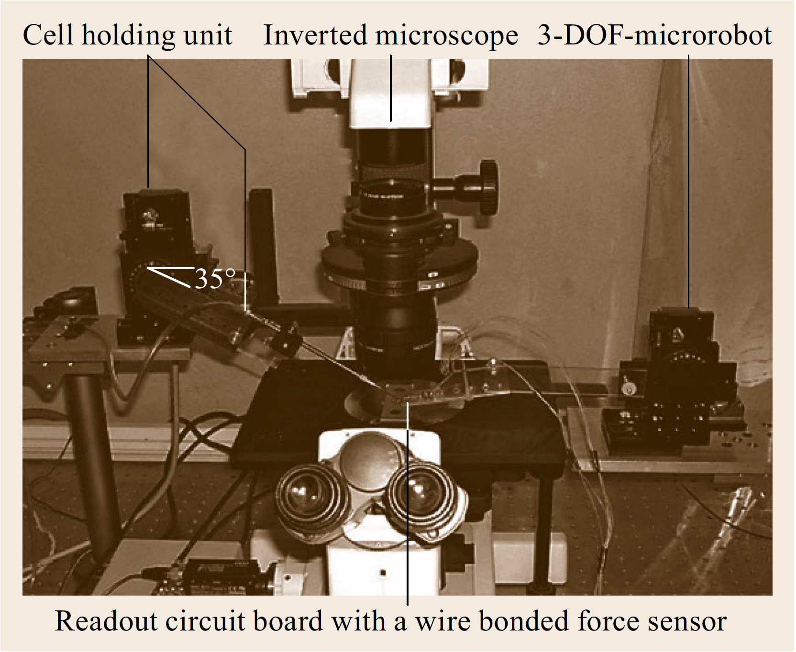
Robotic biomanipulation system with vision and force feedback
Injects DNA into mouse embryos

Slide 172
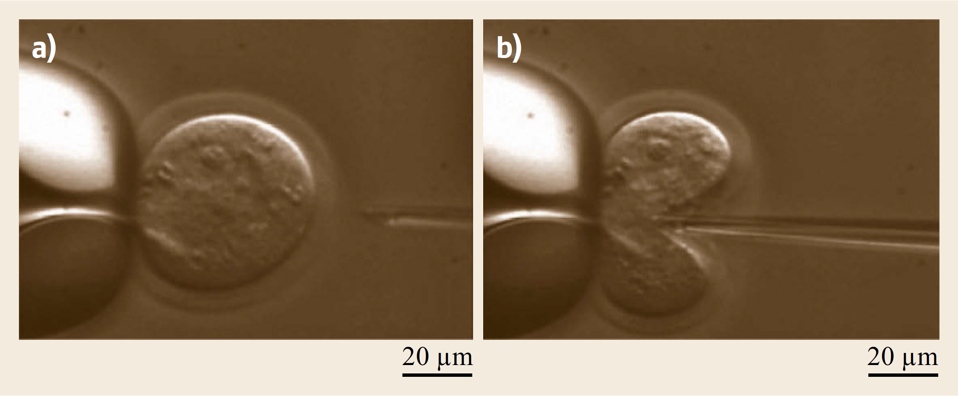
Cell injection process
(a,b) Cell injection of a mouse oocyte

Slide 173
To realize large-scale injection operations, a MEMS cell holder was fabricated using anodic wafer-bonding techniques.
Arrays of holes are aligned on the cell holder, which are used to contain and fix individual cells for injection.
When well-calibrated, the system with the cell holder makes it possible to inject large numbers of cells using position control.
The cell-injection operation can be conducted in a move–inject–move manner.
Successful injection is determined greatly by injection speed and trajectory, and the forces applied to cells.

Slide 174
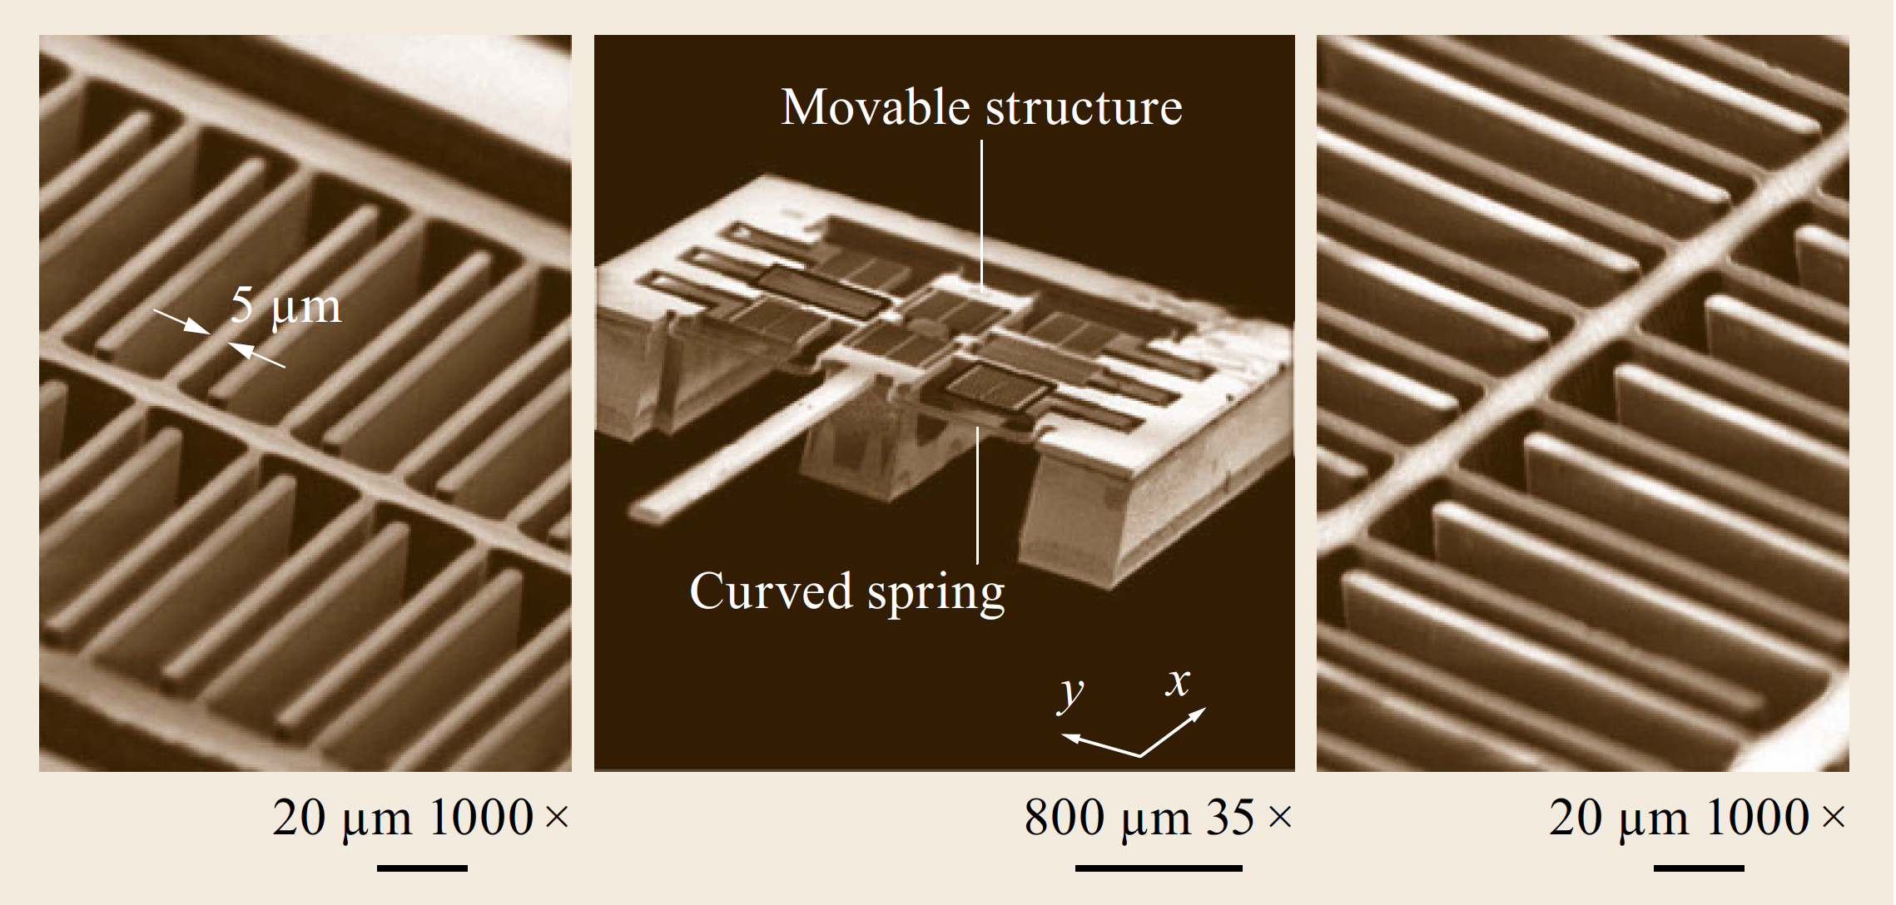
MEMS-Based 2-Axis Capacitive Cellular
Force Sensor
A cellular force sensor

Slide 175
The MEMS-based two-axis cellular force sensor is capable of resolving normal forces applied to a cell as well as tangential forces generated by improperly aligned cell probes.
The constrained outer frame and the inner movable structure are connected by four curved springs.
A load applied to the probe causes the inner structure to move, changing the gap between each pair of interdigitated comb capacitors.
Consequently, the total capacitance change resolves the applied force.
The interdigitated capacitors are orthogonally configured to make the force sensor capable of resolving forces in both the x- and y-directions.

Slide 176
The robotic system and high-sensitivity cellular force sensor are also applied to biomembrane mechanical property studies.
The goal is to obtain a general parameterized model describing cell membrane deformation behavior when an external load is applied.
This parameterized model serves two chief purposes.

Slide 177
First, in robotic biomanipulation, it allows online parameter recognition so that cell membrane deformation behavior can be predicted.
Second, for a thermodynamic model of membrane damage in cell injury and recovery studies, it is important to appreciate the mechanical behavior of the membranes.
This allows the interpretation of such reported phenomena as mechanical resistance to cellular volume reduction during dehydration, and its relationship to injury.
The establishment of such a biomembrane model will greatly facilitate cell injury studies.

Slide 178
Experiments demonstrate that robotics and MEMS technology can play important roles in biological studies such as automating biomanipulation tasks.
Aided by robotics, the integration of vision and force-sensing modules, and MEMS design and fabrication techniques, investigations are being conducted in biomembrane mechanical property modeling, deformable cell tracking, and single-cell and biomolecule manipulation.

Slide 179
Nanorobotic Devices
Nanorobotic devices involve tools, sensors, and actuators at the nanometer scale.
Shrinking device size makes it possible to manipulate nanosized objects with nanosized tools, measure mass in femtogram ranges, sense force at piconewton scales, and induce GHz motion, among other amazing advancements.
Top-down and bottom-up strategies for manufacturing such nanodevices have been independently investigated by a variety of researchers.

Slide 180
Nanorobotic Devices
Top-down strategies are based on nanofabrication and include technologies such as nanolithography, nanoimprinting, and chemical etching.
Presently, these are 2-D fabrication processes with relatively low resolution.
Bottom-up strategies are assembly-based techniques.
At present, these strategies include such techniques as self-assembly, dip-pen lithography, and directed self-assembly.

Slide 181
Nanorobotic Devices
These techniques can generate regular nanopatterns at large scales.
With the ability to position and orient nanometerscale objects, nanorobotic manipulation is an enabling technology for structuring, characterizing and assembling many types of nanosystems.

Slide 182
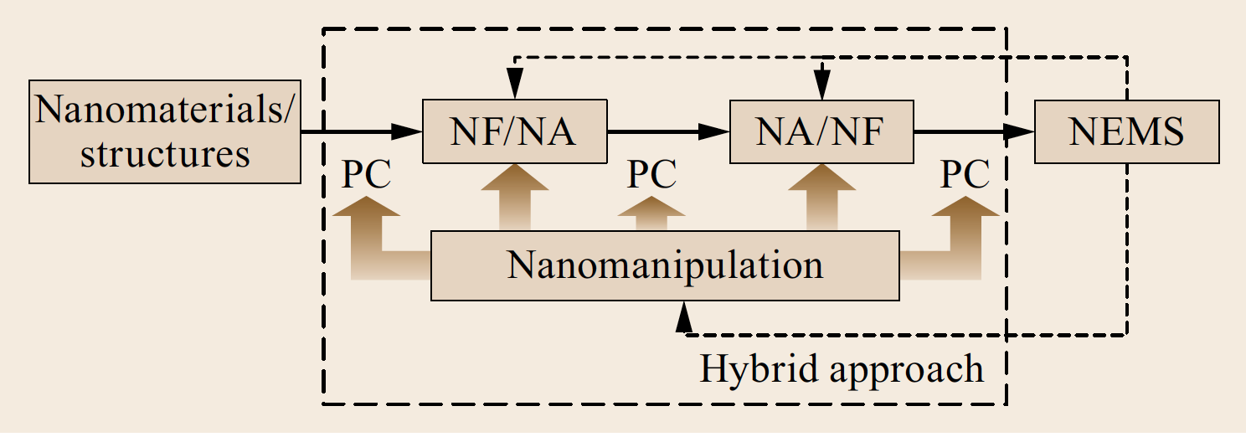
Nanorobotic Devices
By combining bottom-up and top-down processes, a hybrid nanorobotic approach (as shown in the Figure) based on nanorobotic manipulation provides a third way to fabricate NEMS by structuring as-grown nanomaterials or nanostructures.
PC: property characterization, NF: nanofabrication, NA: nanoassembly

Slide 183
Nanorobotic Devices
This new nanomanufacturing technique can be used to create complex 3-D nanodevices with such building blocks.
Nanomaterial science, bionanotechnology, and nanoelectronics will also benefit from advances in nanorobotic assembly.
PC: property characterization, NF: nanofabrication, NA: nanoassembly

Slide 184
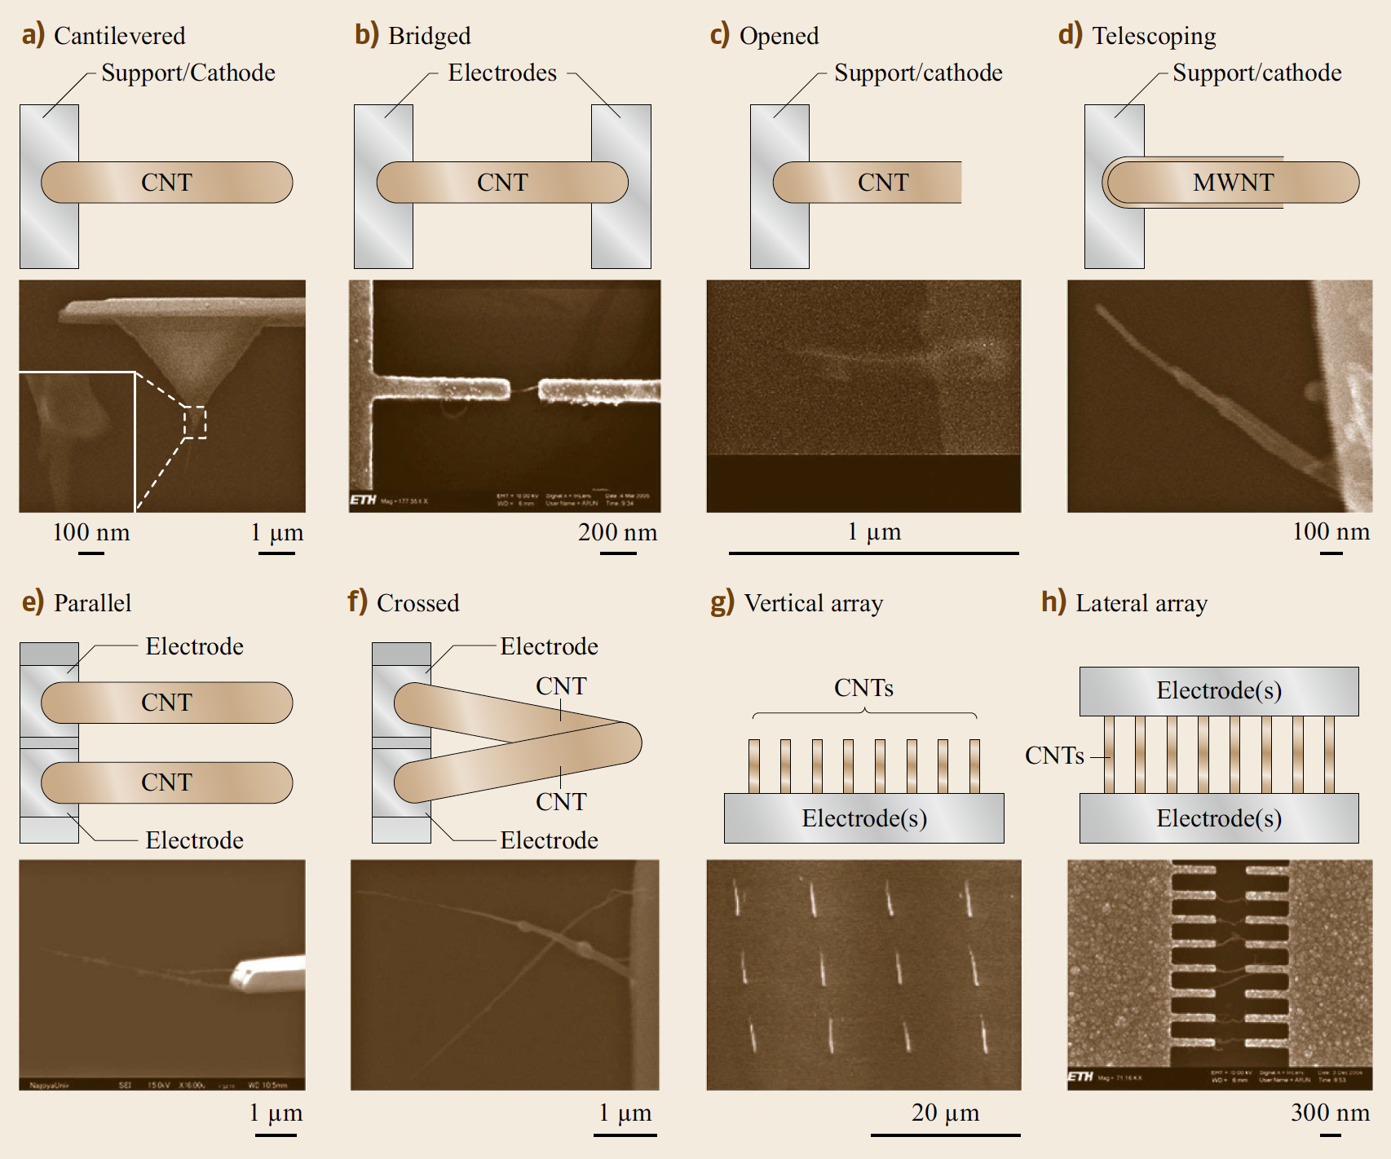
Configurations of individual nanotube-based NEMS
Scale bars: (a) 1um (inset: 100 nm), (b) 200 nm, (c) 1um, (d) 100 nm, (e) and (f) 1um, (g) 20 um, and (h) 300 nm.

Slide 185
Nanorobotic Devices: Cantilevered Nanotubes
For detecting deep and narrow features on a surface, cantilevered nanotubes have been demonstrated as probe tips for an AFM, an STM and other types of SPM.
Nanotubes provide ultrasmall diameters, ultralarge aspect ratios, and excellent mechanical properties.
Manual assembly, direct growth and nanoassembly have proven effective for their construction.

Slide 186
Nanorobotic Devices: Cantilevered Nanotubes
Cantilevered nanotubes have also been demonstrated as probes for the measurement of ultrasmall physical quantities, such as femtogram masses, mass flow sensors, and piconewton-order force sensors on the basis of their static deflections or change of resonant frequencies detected within an electron microscope.
Deflections cannot be measured from micrographs in real time, which limits the application of this kind of sensor. Interelectrode distance changes cause emission current variation of a nanotube emitter and may serve as a candidate to replace microscope images.

Slide 187
Nanorobotic Devices: Bridged individual nanotubes
Bridged individual nanotubes have been the basis for electric characterization.
A nanotube-based gas sensor adopted this configuration.

Slide 188
Nanorobotic Devices: Opened Nanotubes
Opened nanotubes can serve as an atomic or molecular container.
A thermometer based on this structure has been shown by monitoring the height of the gallium inside the nanotube using TEM.
Bulk nanotubes can be used to fabricate actuators based on charge-injection-induced bond-length change, and, theoretically, individual nanotubes also work on the same principle.

Slide 189
Nanorobotic Devices: Opened Nanotubes
Electrostatic deflection of a nanotube has been used to construct a relay.
A new family of nanotube actuators can be constructed by taking advantage of the ultralow inter-layer friction of a multiwalled nanotube.
Linear bearings based on telescoping nanotubes have been demonstrated.
Recently, a micro actuator with a nanotube as a rotation bearing has been demonstrated.

Slide 190
Relays
A relay is an electrically operated switch.
Many relays use an electromagnet to mechanically operate a switch, but other operating principles are also used, such as solid-state relays.
Relays are used where it is necessary to control a circuit by a separate low-power signal, or where several circuits must be controlled by one signal.

Slide 191
Nanorobotic Devices: Nanotube Linear Motor
A preliminary experiment on a promising nanotube linear motor with field emission current serving as position feedback has been shown with nanorobotic manipulation.

Slide 192
Nanorobotic Devices: Nanotweezers and -scissors
Cantilevered dual nanotubes have been demonstrated as nanotweezers and nanoscissors by manual and nanorobotic assembly, respectively.

Slide 193
Nanorobotic Devices: Nanotweezers and -scissors
Cantilevered dual nanotubes have been demonstrated as nanotweezers and nanoscissors by manual and nanorobotic assembly, respectively.

Slide 194
Nanorobotic Devices: Nanotube Thermal Probes
Based on electric resistance change under different temperatures, nanotube thermal probes have been demonstrated for measuring the temperature at precise locations.
These thermal probes are more advantageous than nanotube-based thermometers because the thermometers require TEM imaging.

Slide 195
Nanorobotic Devices: Nanotube Thermal Probes
The probes also have better reproducibility than devices based on dielectrophoretically assembled bulk nanotubes.
Gas sensors and hot-wire-based mass-flow sensors can also be constructed in this configuration rather than a bridged one.

Slide 196
Nanorobotic Devices: Arrays
The probes also have better reproducibility than devices based on dielectrophoretically assembled bulk nanotubes.
Gas sensors and hot-wire-based mass-flow sensors can also be constructed in this configuration rather than a bridged one.

Slide 197
Dielectrophoresis
https://en.wikipedia.org/wiki/Dielectrophoresis
Dielectrophoresis (DEP) is a phenomenon in which a force is exerted on a dielectric particle when it is subjected to a non-uniform electric field.
This force does not require the particle to be charged.

Slide 198
Dielectrophoresis
Although the phenomenon we now call dielectrophoresis was described in passing as far back as the early 20th century, it was only subject to serious study, named and first understood by Herbert Pohl in the 1950s.
Recently, dielectrophoresis has been revived due to its potential in the manipulation of microparticles, nanoparticles and cells.
Would be a nice theme for a presentation!

Slide 199
Dielectrophoresis
Dielectrophoresis assembling cancer cells in a 3D microfluidic model.

Slide 200
Nanorobotic Devices: Arrays
The integration of these devices can be realized using the configurations shown.
Arrays of individual nanotubes can also be used to fabricate nanosensors, such as position encoders.

