Slide 1
Introduction to Nanotechnology 134.152 Wednesday, 16:00ct, SEM134 (Freihaus, Sem.R. DB gelb 05 B) Lecturer: Associate Prof. DI Dr. techn. Ille C. Gebeshuber
No lecture on 27 November 2019
Introduction to Nanotechnology
Scanning Probe Microscopy across Dimensions
Nanorobotics
Biomimetics
Structural Colours
Carbon Nanotubes
Environment, Health and Safety Issues
Plant Surfaces: Structures and Functions for Biomimetic Applications

Slide 2
Recommended Literature
Springer Handbook of Nanotechnology
(Editor B. Bhushan, Springer Verlag 2017, 1500 pages)
ISBN 978-3-662-54357-3
Hardcover EUR 214.98 (used from EUR 150)
Kindle Ed. EUR 150.49
Complete eBook is available at the TU Wien Library

Slide 3
Recommended Literature
Travels to the Nanoworld: Miniature Machinery in Nature and Technology by Michael Gross
(Perseus Publishing, 272 pages )
ISBN 978-0738204444
From EUR 5.39 @ amazon.com

Slide 4
Recommended Literature
Wo die Maschinen wachsen by Ille C. Gebeshuber
(Ecowin, Wals bei Salzburg, 236 pages )
ISBN 978-3711000903
EUR 24 @ amazon.de
Available @ TU Wien Library

Slide 5
Recommended websites
Molecular nanotechnology, many links:
http://www.zyvex.com/nano/
http://www.foresight.org/
NanoTrust (Austrian Academy of Sciences):
https://www.oeaw.ac.at/ita/en/projects/nanotrust/overview/
IBM Research (USA):
http://www.research.ibm.com/pics/nanotech/projects.addl.shtml
Richard P. Feynman´s famous after dinner speech:
http://www.zyvex.com/nanotech/feynman.html

Slide 6
Introduction to Nanotechnology
Introduction

Slide 7
Background and Definition of Nanotechnology
1959 Feynman´s famous after dinner speech.
Nanotechnology literally means any technology performed on a nanoscale that has applications in the real world.
Nanotechnology encompasses the production and application of physical, chemical, and biological systems at scales ranging from individual atoms or molecules to submicron dimensions, as well as the integration of the resulting nanostructures into larger systems.
It is widely felt that nanotechnology will be the next industrial revolution.
Introduction

Slide 8
US Nanotechnology Intitiative
The US NTI was announced by president Clinton in the year 2000.
Budget for 2001: 497 million US$.
The objective of this initiative was to form a broad-based coalition in which academia, the private sector, and local, state, and federal governments would work together to push the envelope of nanoscience and nanoengineering to harvest nanotechnology’s potential social and economic benefits.
Introduction

Slide 9
US Nanotechnology Budget 2020
The President’s 2020 Budget requests $1.4 billion for the NNI, with a cumulative total of nearly $29 billion since the inception of the NNI in 2001 (including the 2020 request), affirming the important role that nanotechnology continues to play in the Administration’s innovation agenda.
The NNI investments in 2018 and 2019 and those proposed for 2020 reflect a sustained emphasis on broad, fundamental research in nanoscience.
Introduction

Slide 10
Austria Nanotechnology Budget
From 2004 to 2007, the Federal Ministry of Transport, Innovation and Technology (BMVIT) made € 45 Million in subsidies available to the NANO Initiative.
More than 80% of this amount was invested in highly innovative R&D project clusters. These projects, some of which lasted as long as 7 years and involved more than 200 participating Austrian companies and research institutions, initiated a significant boost in innovation.
Introduction

Slide 11
Austria Nanotechnology Budget
For the years 2008-2010, another € 23 million were invested in NANO projects.
For the total programme period from 2004 to 2010 the BMVIT provided around € 68 million of funding for the Austrian NANO Initiative.
In the overall support portfolio of the FFG, the total volume of support for all programmes, initiatives and areas has risen from € 317.5 million at the time of its foundation in 2004 to some € 550 million in 2008.
By 2010 the investment totaled 68 million euros.
Introduction

Slide 12
Delphi survey
1. Short introduction to nanotechnology
2. Three rounds of questioning
What do you think about the current potential of nanotechnology?
Which threats do you see coming from nanotechnology?
How important do you think will nanotechnology be in the future?
3. Joint conclusion of the experts round
https://en.wikipedia.org/wiki/Delphi_method
Introduction

Slide 13
Cells - biological nanomachines
Introduction

Slide 14
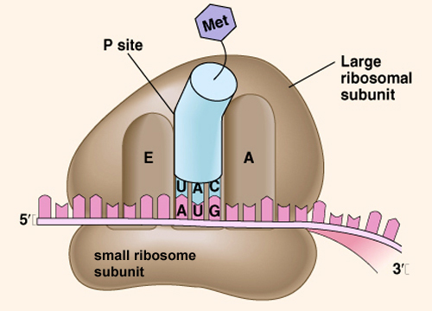
A biological system can be exceedingly small.
Many of the cells are very tiny, but they are very
active; they manufacture various substances; they
walk around; they wiggle; and they do all kinds of
marvelous things – all on a very small scale. Also,
they store information. Consider the possibility
that we too can make a thing very small which
does what we want – that we can manufacture
an object that maneuvers at that level.
(Richard P. Feynman, 1959)
Introduction

Slide 15
Living cells
Nanomechanical machines
Diameter about 1μm
Smallest free living organism (Mycoplasma genitalium): diameter 0.2 to 0.3 µm
Introduction

Slide 16
DNA
A human cell's DNA has about three meters in length.
10 base pairs per turn (3.4nm)
Distance between base pairs 0.34nm.
Introduction

Slide 17
Ribosome
17 to 23nm diameter
Introduction

Slide 18
Viruses
Diameter 0.02 to 0.3µm
Parvoviruses have only 18nm diameter.
The smallest virus codes for 3-10 proteins.
Introduction

Slide 19
Lessons from Nature
Photosynthesis
Selfcleaning surfaces (lotus leaf)
Bacterial flagellum (10 000 rotations per minute, bearing 20-30nm, clearance 1nm)
Introduction

Slide 20
Man-made nanotechnology
Science and technology continue to move forward in making the fabrication of micro/nanodevices and systems possible for a variety of industrial, consumer, and biomedical applications.

Slide 21
Applications in different fields
MEMS (micro electro mechanical systems)
US$ 400 million digital micromirror devices sold in 2001 (launched in 1996 by Texas Instruments)
The global microelectromechanical systems (MEMS) market is estimated to reach USD 28.84 billion by 2024, according to a new report by Grand View Research, Inc. The industry is expected to witness tremendous growth owing to increasing demand in consumer and automotive application segment.
http://www.grandviewresearch.com/press-release/global-mems-market
Introduction

Slide 22
Applications in different fields
© Sandia National Lab, New Mexico, USA
Introduction

Slide 23
Applications in different fields
MEMS
65 million accelerometers sold in 2002.
MEMS: 65 billion units sold in in 2016. Estimation: rise to almost 138 billion units in 2021.
© National Physical Laboratory,Middlesex, UK © National Physical Laboratory,Middlesex, UK
Introduction

Slide 24
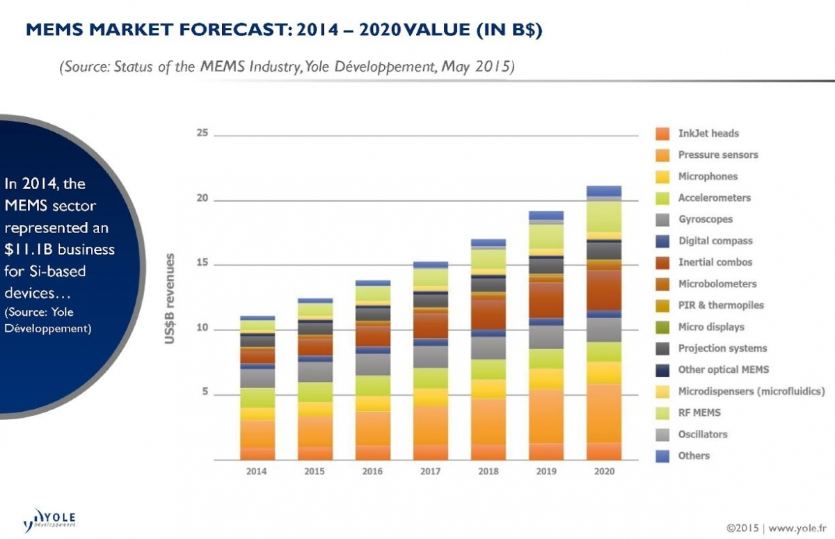
Applications in different fields
CAGR = Compound Annual Growth Rate
Introduction

Slide 25
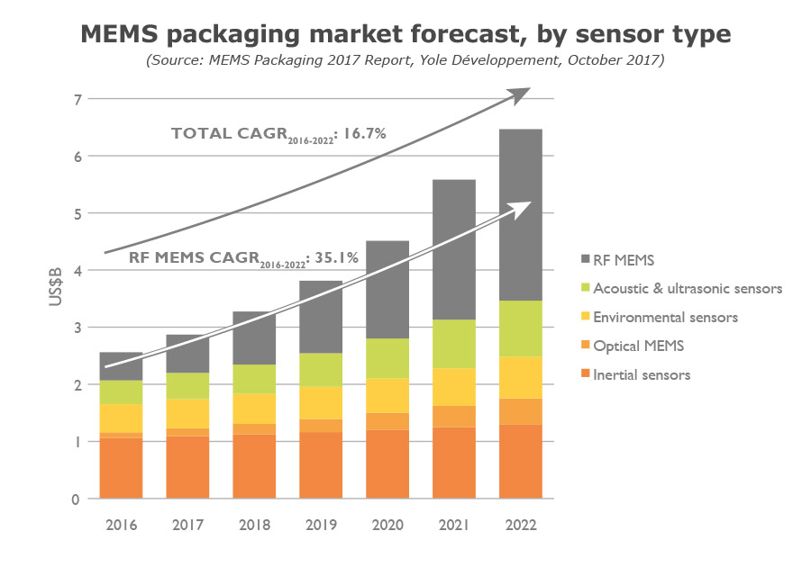
Applications in different fields
CAGR = Compound Annual Growth Rate
Introduction

Slide 26
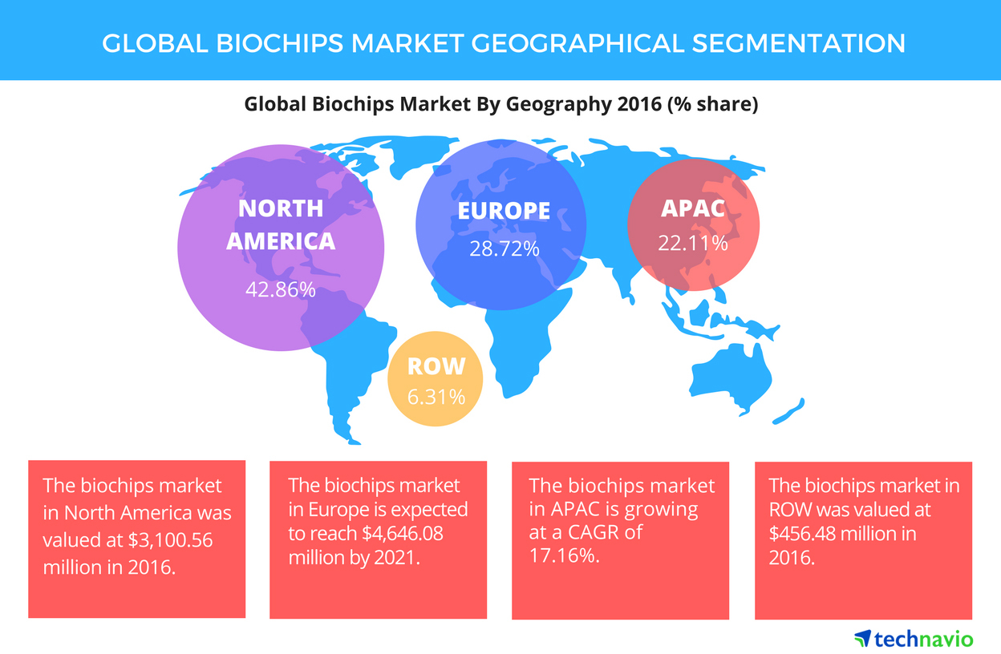
Applications in different fields
BIOMEMS
Lab-on-a-chip (20 million units sold in 2002)
a biochip can perform thousands of biological reactions, such as decoding genes, in a few seconds.
© Siemens AG
Introduction

Slide 27
Applications in different fields
NEMS (nano electro mechanical systems)
AFM Millipede: more than 4,000 tips (0.5μm thick and 70μm long) working simultaneously over a 7 mm² field
0.5 gigabytes in an area of 3 mm²
© IBM 2002
Introduction

Slide 28
Applications in different fields
NEMS
Single electron transistor (SET)
© Royal Institute of Technology, Stockholm, Sweden
Introduction

Slide 29
Reliability Issues of MEMS/NEMS (1/3)
There is an increasing need for a multidisciplinary, system oriented approach to manufacturing micro/ nanodevices that function reliably.
Common potential failure mechanisms for MEMS/NEMS that need to be addressed in order to increase reliability are: adhesion, friction, wear, fracture, fatigue, and contamination.
Introduction

Slide 30
Reliability Issues of MEMS/NEMS (2/3)
Mechanical properties are known to exhibit a dependence on specimen size.
Mechanical property evaluation of nanometer-scaled structures is carried out to help design reliable systems, since good mechanical properties are of critical importance in such applications.
Introduction

Slide 31
Reliability Issues of MEMS/NEMS (3/3)
Some of the properties of interest are: Young’s modulus of elasticity, hardness, bending strength, fracture toughness, and fatigue life.
Finite element modeling is carried out to study the effects of surface roughness and scratches on stresses in nanostructures.
When nanostructures are smaller than a fundamental physical length scale, conventional theory may no longer apply, and new phenomena may emerge.
Molecular mechanics is used to simulate the behavior of a nano-object.
Introduction

Slide 32
End of the Introduction
Introduction

Slide 33
Nanostructures, Micro-/Nanofabrication and Micro-/Nanodevices
Part A: Nanostructures, micro-/nanofabrication and micro-/nanodevices

Slide 34
Nanomaterials synthesis and applications: molecule based devices
Nanomaterials synthesis and applications: molecule based devices
Part A: Nanostructures, micro-/nanofabrication and micro-/nanodevices

Slide 35
top-down vs. bottom-up approach
Nature relies on chemical strategies to assemble nanoscaled biomolecules.
mimicking Nature´s bottom-up approach→ first man-made nanohelices, nanotubes, molecular motors
molecule based devices
Nanomaterials synthesis and applications: molecule based devices
Part A: Nanostructures, micro-/nanofabrication and micro-/nanodevices

