Slide 1
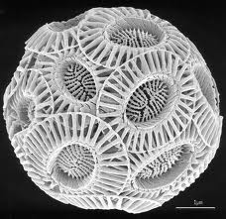
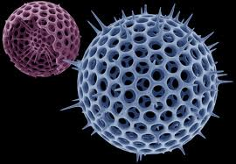
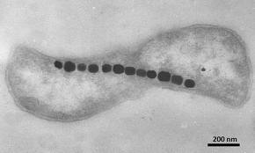
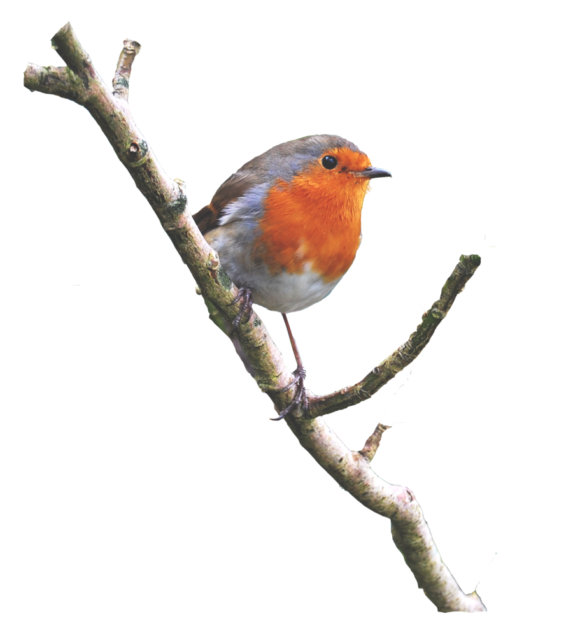
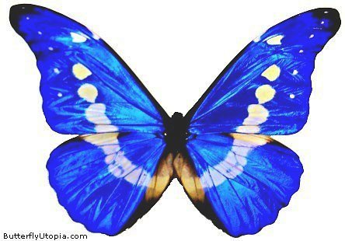
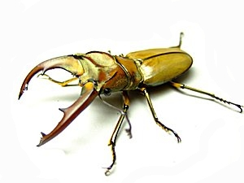
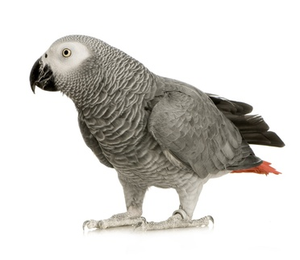
“Producing each of its creations ... nature intermingled the harmony of beauty and the harmony of expediency and shaped it into the unique form which is perfect from the point of view of an engineer.”
M. Tupolev

Slide 2





Biomimetics – Learning from living nature for better engineering and sustainable economic approaches
Ille C. Gebeshuber
Aramis Technologies, Malaysia (2009-2015)
Universiti Kebangsaan Malaysia (2009-2015)
Vienna University of Technology, Austria (from 1999)
gebeshuber@iap.tuwien.ac.at

Slide 3
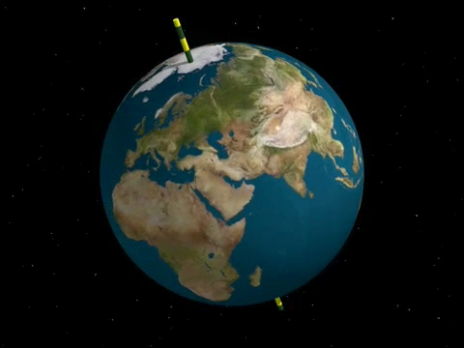
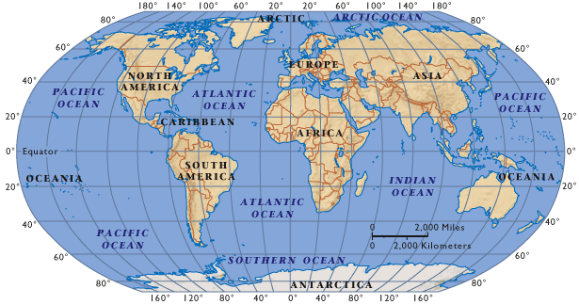
A Journey to the Equator
http://www.roger-mueller.ch/assets/images/Weltkarte.gif
http://www.josleys.com/htmlgalleries/globe/Sphere.JPG

Slide 4
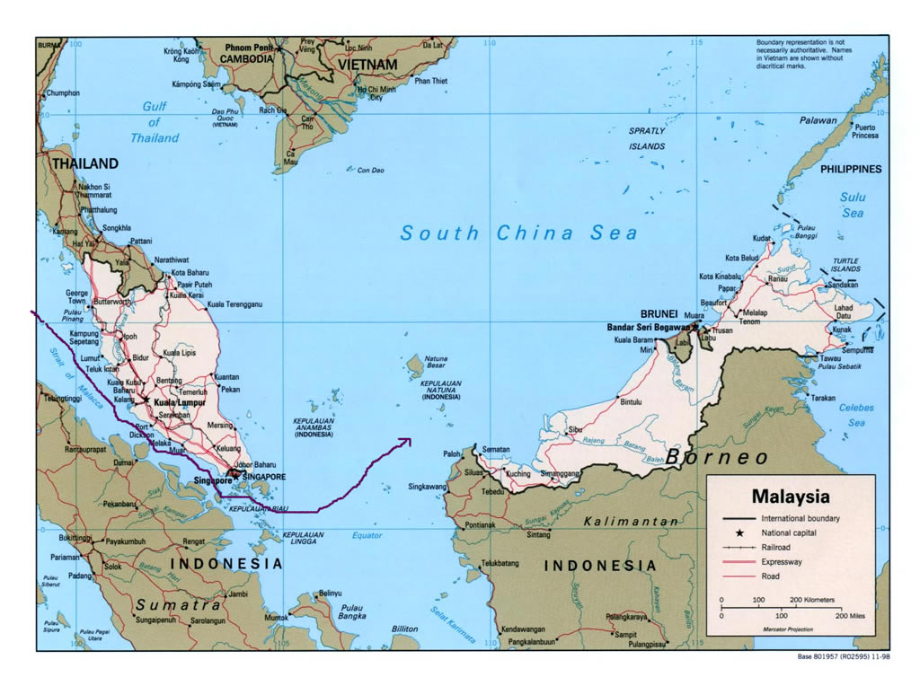
Malaysia
http://www.defenseindustrydaily.com/images/GEO_Malaysia_Singapore_Malacca_Map_lg.jpg

Slide 5
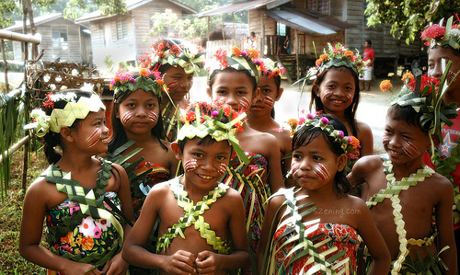

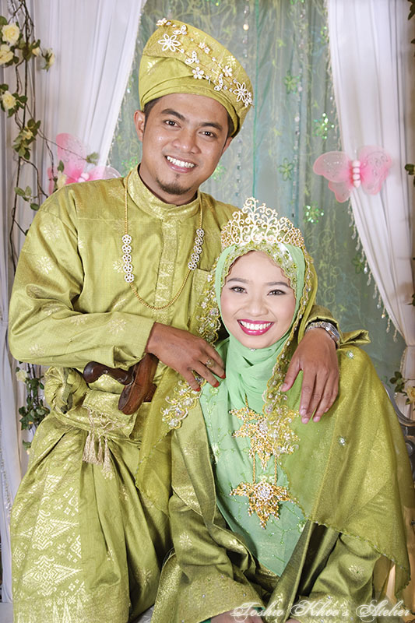
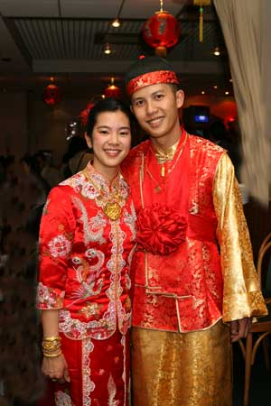
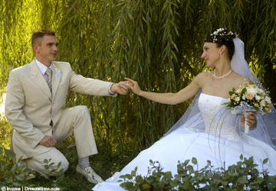
Malays, Chinese and Indians
http://farm4.static.flickr.com/3204/2920212185_168f5c44dd.jpg
http://www.marryabroad.co.uk/Assets/General/marryeurope.jpg
http://www.brunomedici.com/images/F&C-Man_213.jpg
http://www.pixcellence.co.uk/assets/images/HinduWeddingPhotography_4404b.jpg
http://toshiokhoo.com/wp-content/gallery/a-malay-wedding/mw-09.jpg

Slide 6
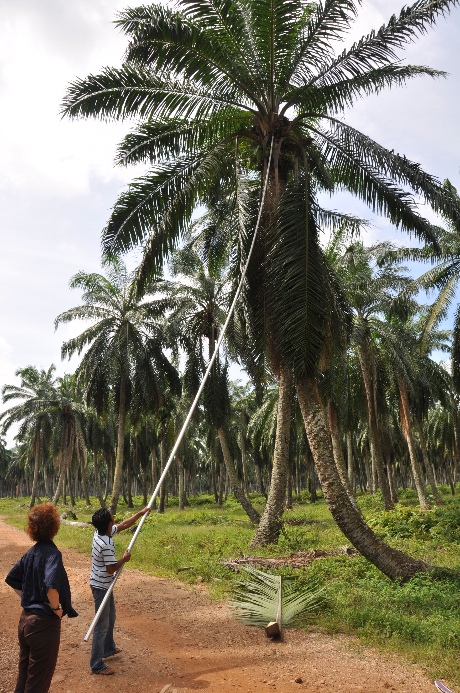
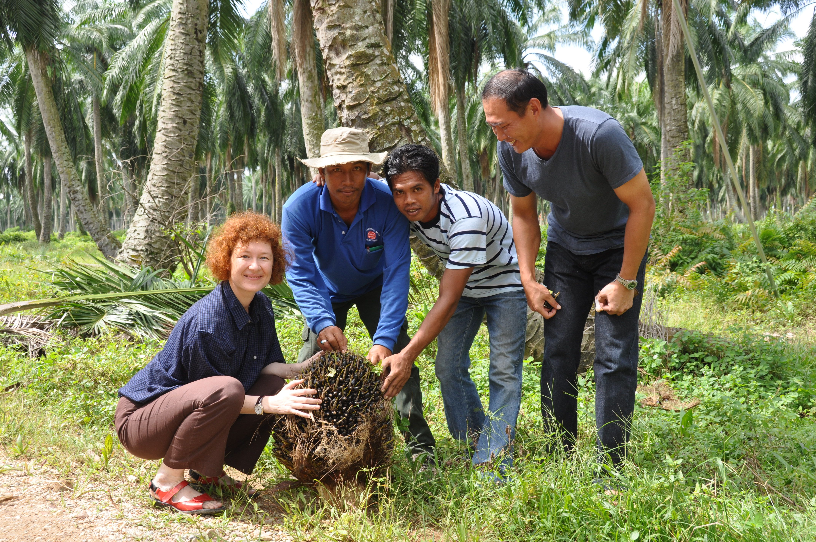
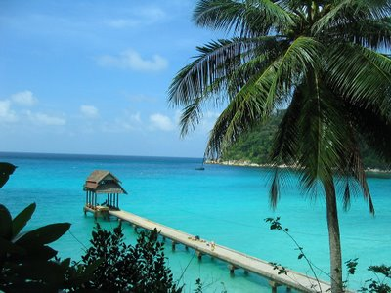
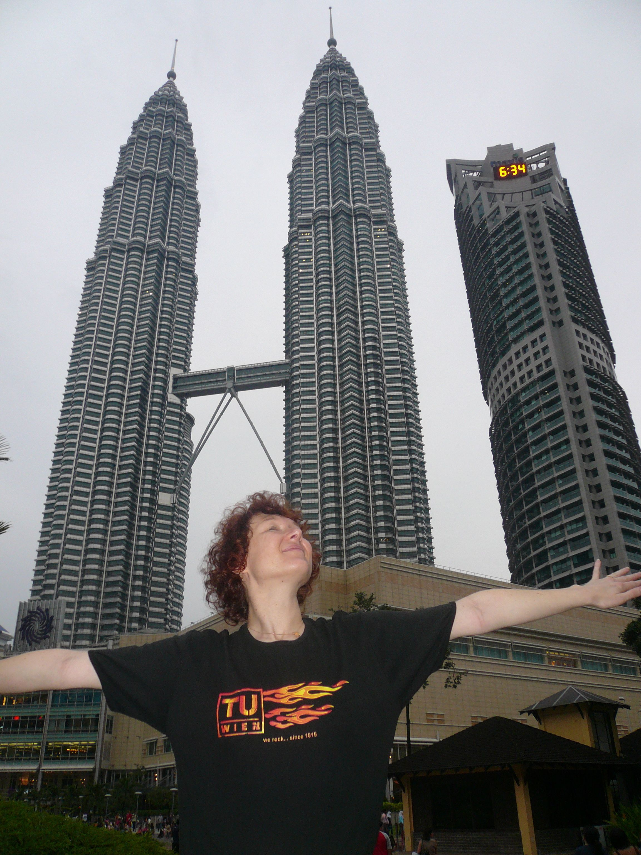
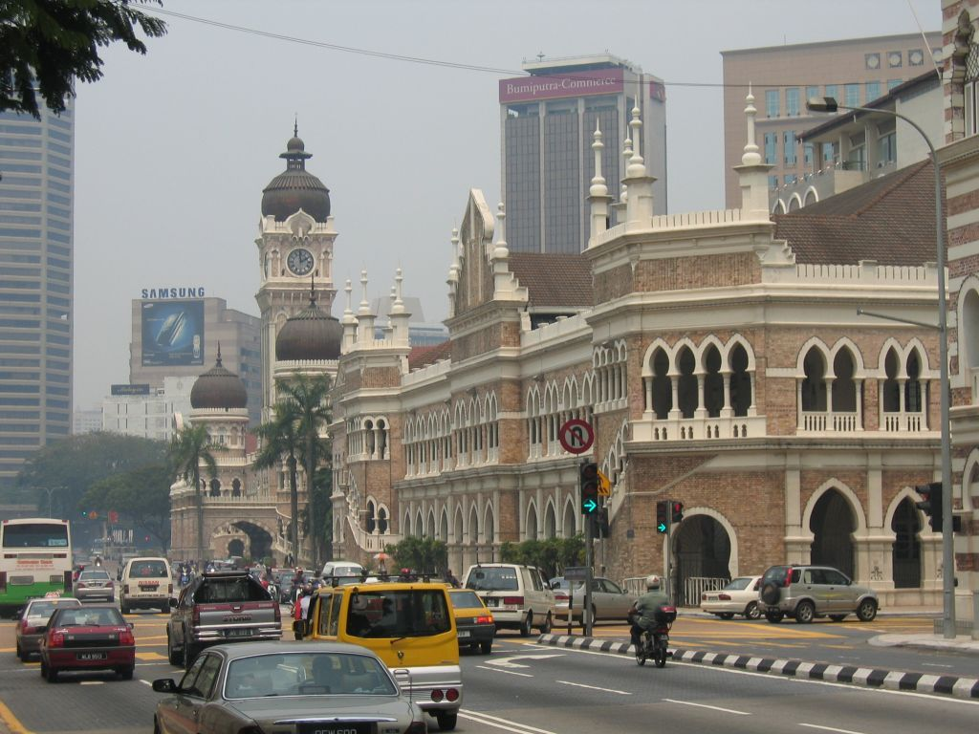
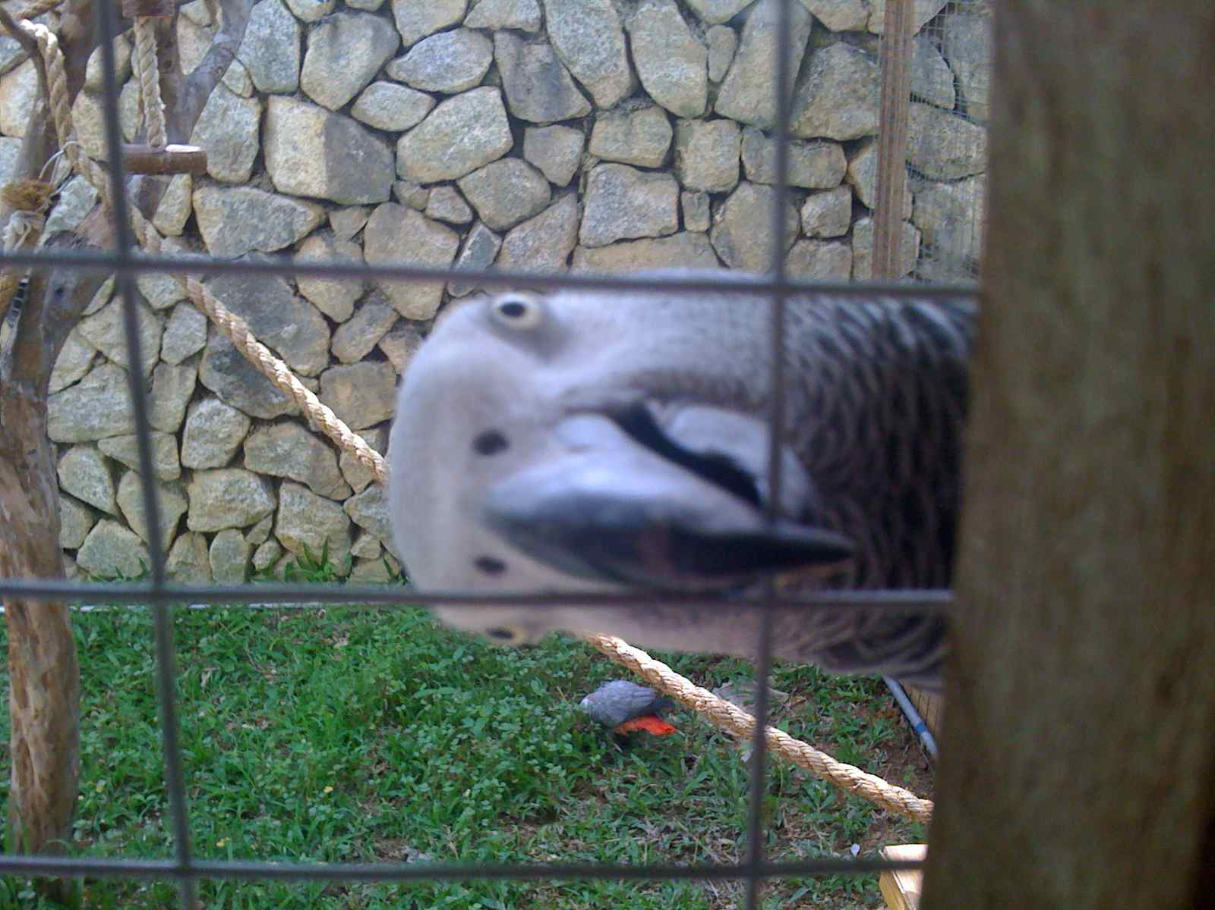
A Diverse Country
http://ericstona.files.wordpress.com/2007/04/kuala-lumpur.jpg
http://www.malaysia-travel-info.com/images/Perhentian-Islands.jpg

Slide 7
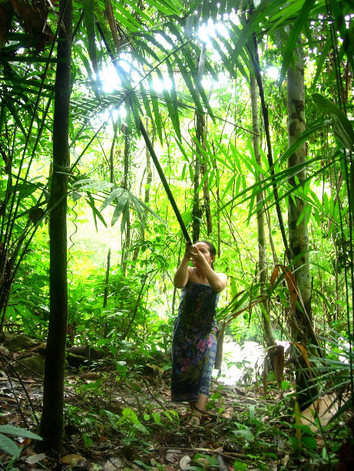
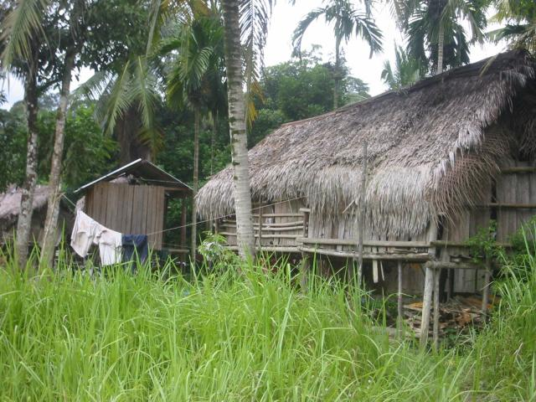
Orang Asli
http://www.impressions.com.my/endau/erwest5.jpg
http://farm4.static.flickr.com/3204/2920212185_168f5c44dd.jpg
http://www.backpackingmalaysia.com/images/gallery/Orang_Asli_Village2.jpg
Notes:
http://www.impressions.com.my/endau/erwest5.jpg

Slide 8
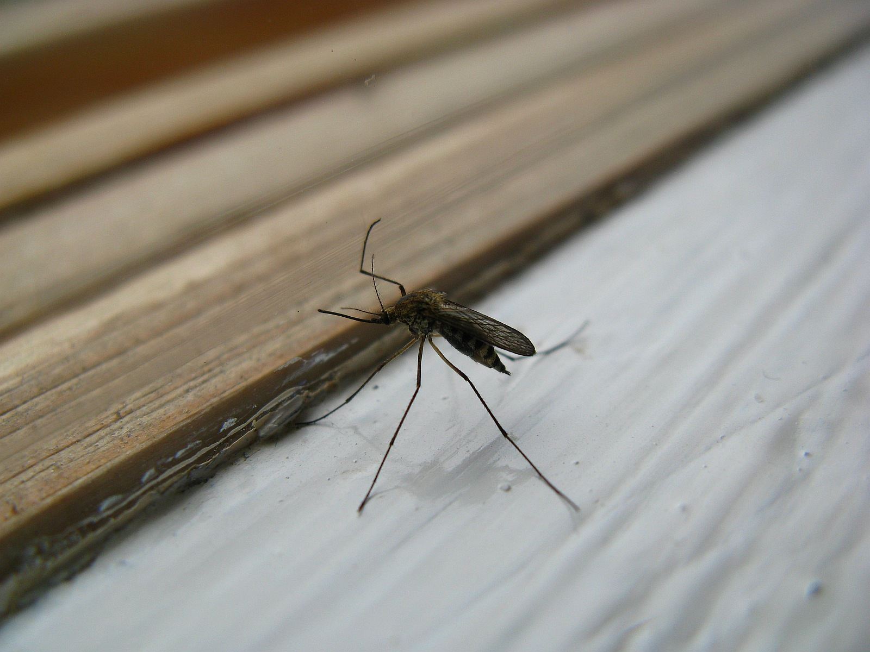
What is a mosquito?
http://static.panoramio.com/photos/original/15707908.jpg

Slide 9
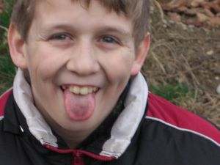
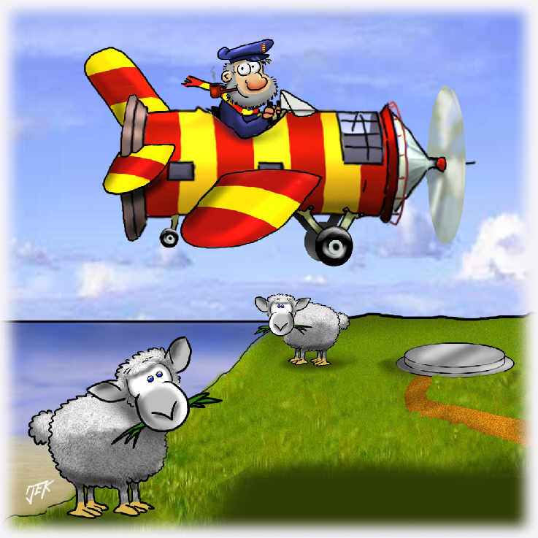
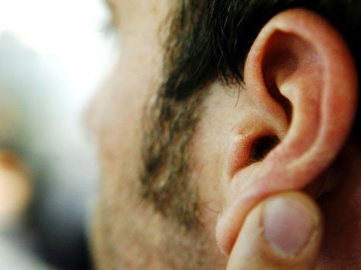
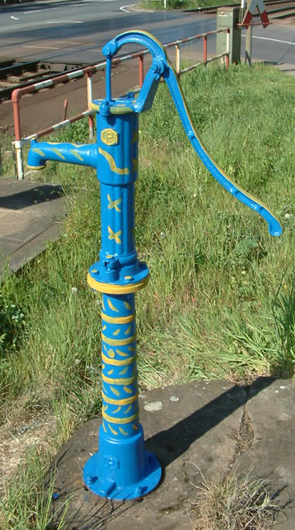
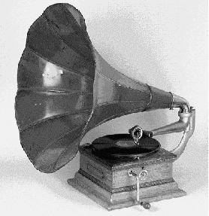
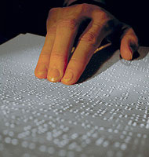
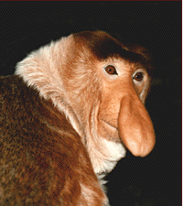
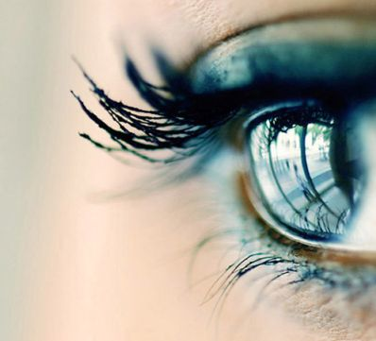
What is a mosquito?
http://www.ariva.de/flugzeug_a259374
http://www.ekir.de/pep/images/668.jpg
http://magazin.naturspot.de/pict/nasenaffe.gif
http://sum1.onreact.com/bilder/auge.jpg
http://amstetten.evang.at/Bilder/zungezeigen.jpg
http://4.bp.blogspot.com/_NdzbS_1Yx4s/R-PY40uX7II/AAAAAAAAAGE/hcn44-mDKHY/s320/grammophon2.jpg
http://www.tz-online.de/bilder/2008/11/25/22210/1841099979-ohr_475px.9.jpg

Slide 10
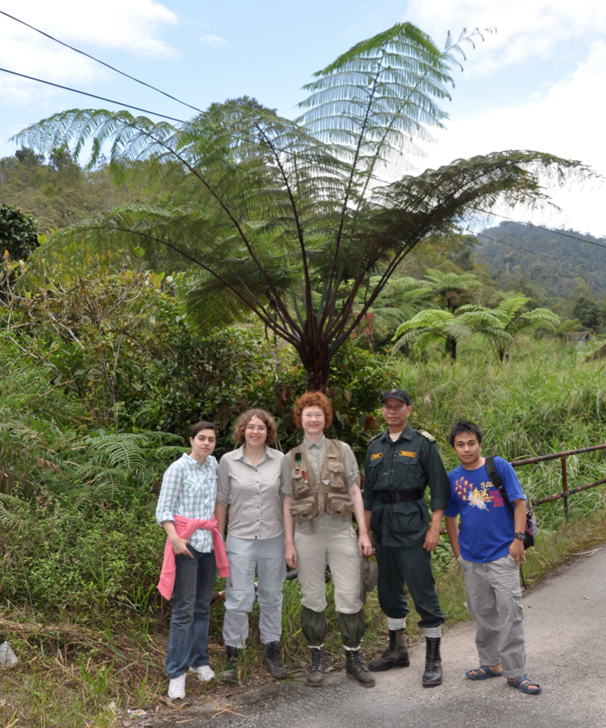
Things to wear in the jungle

Slide 11
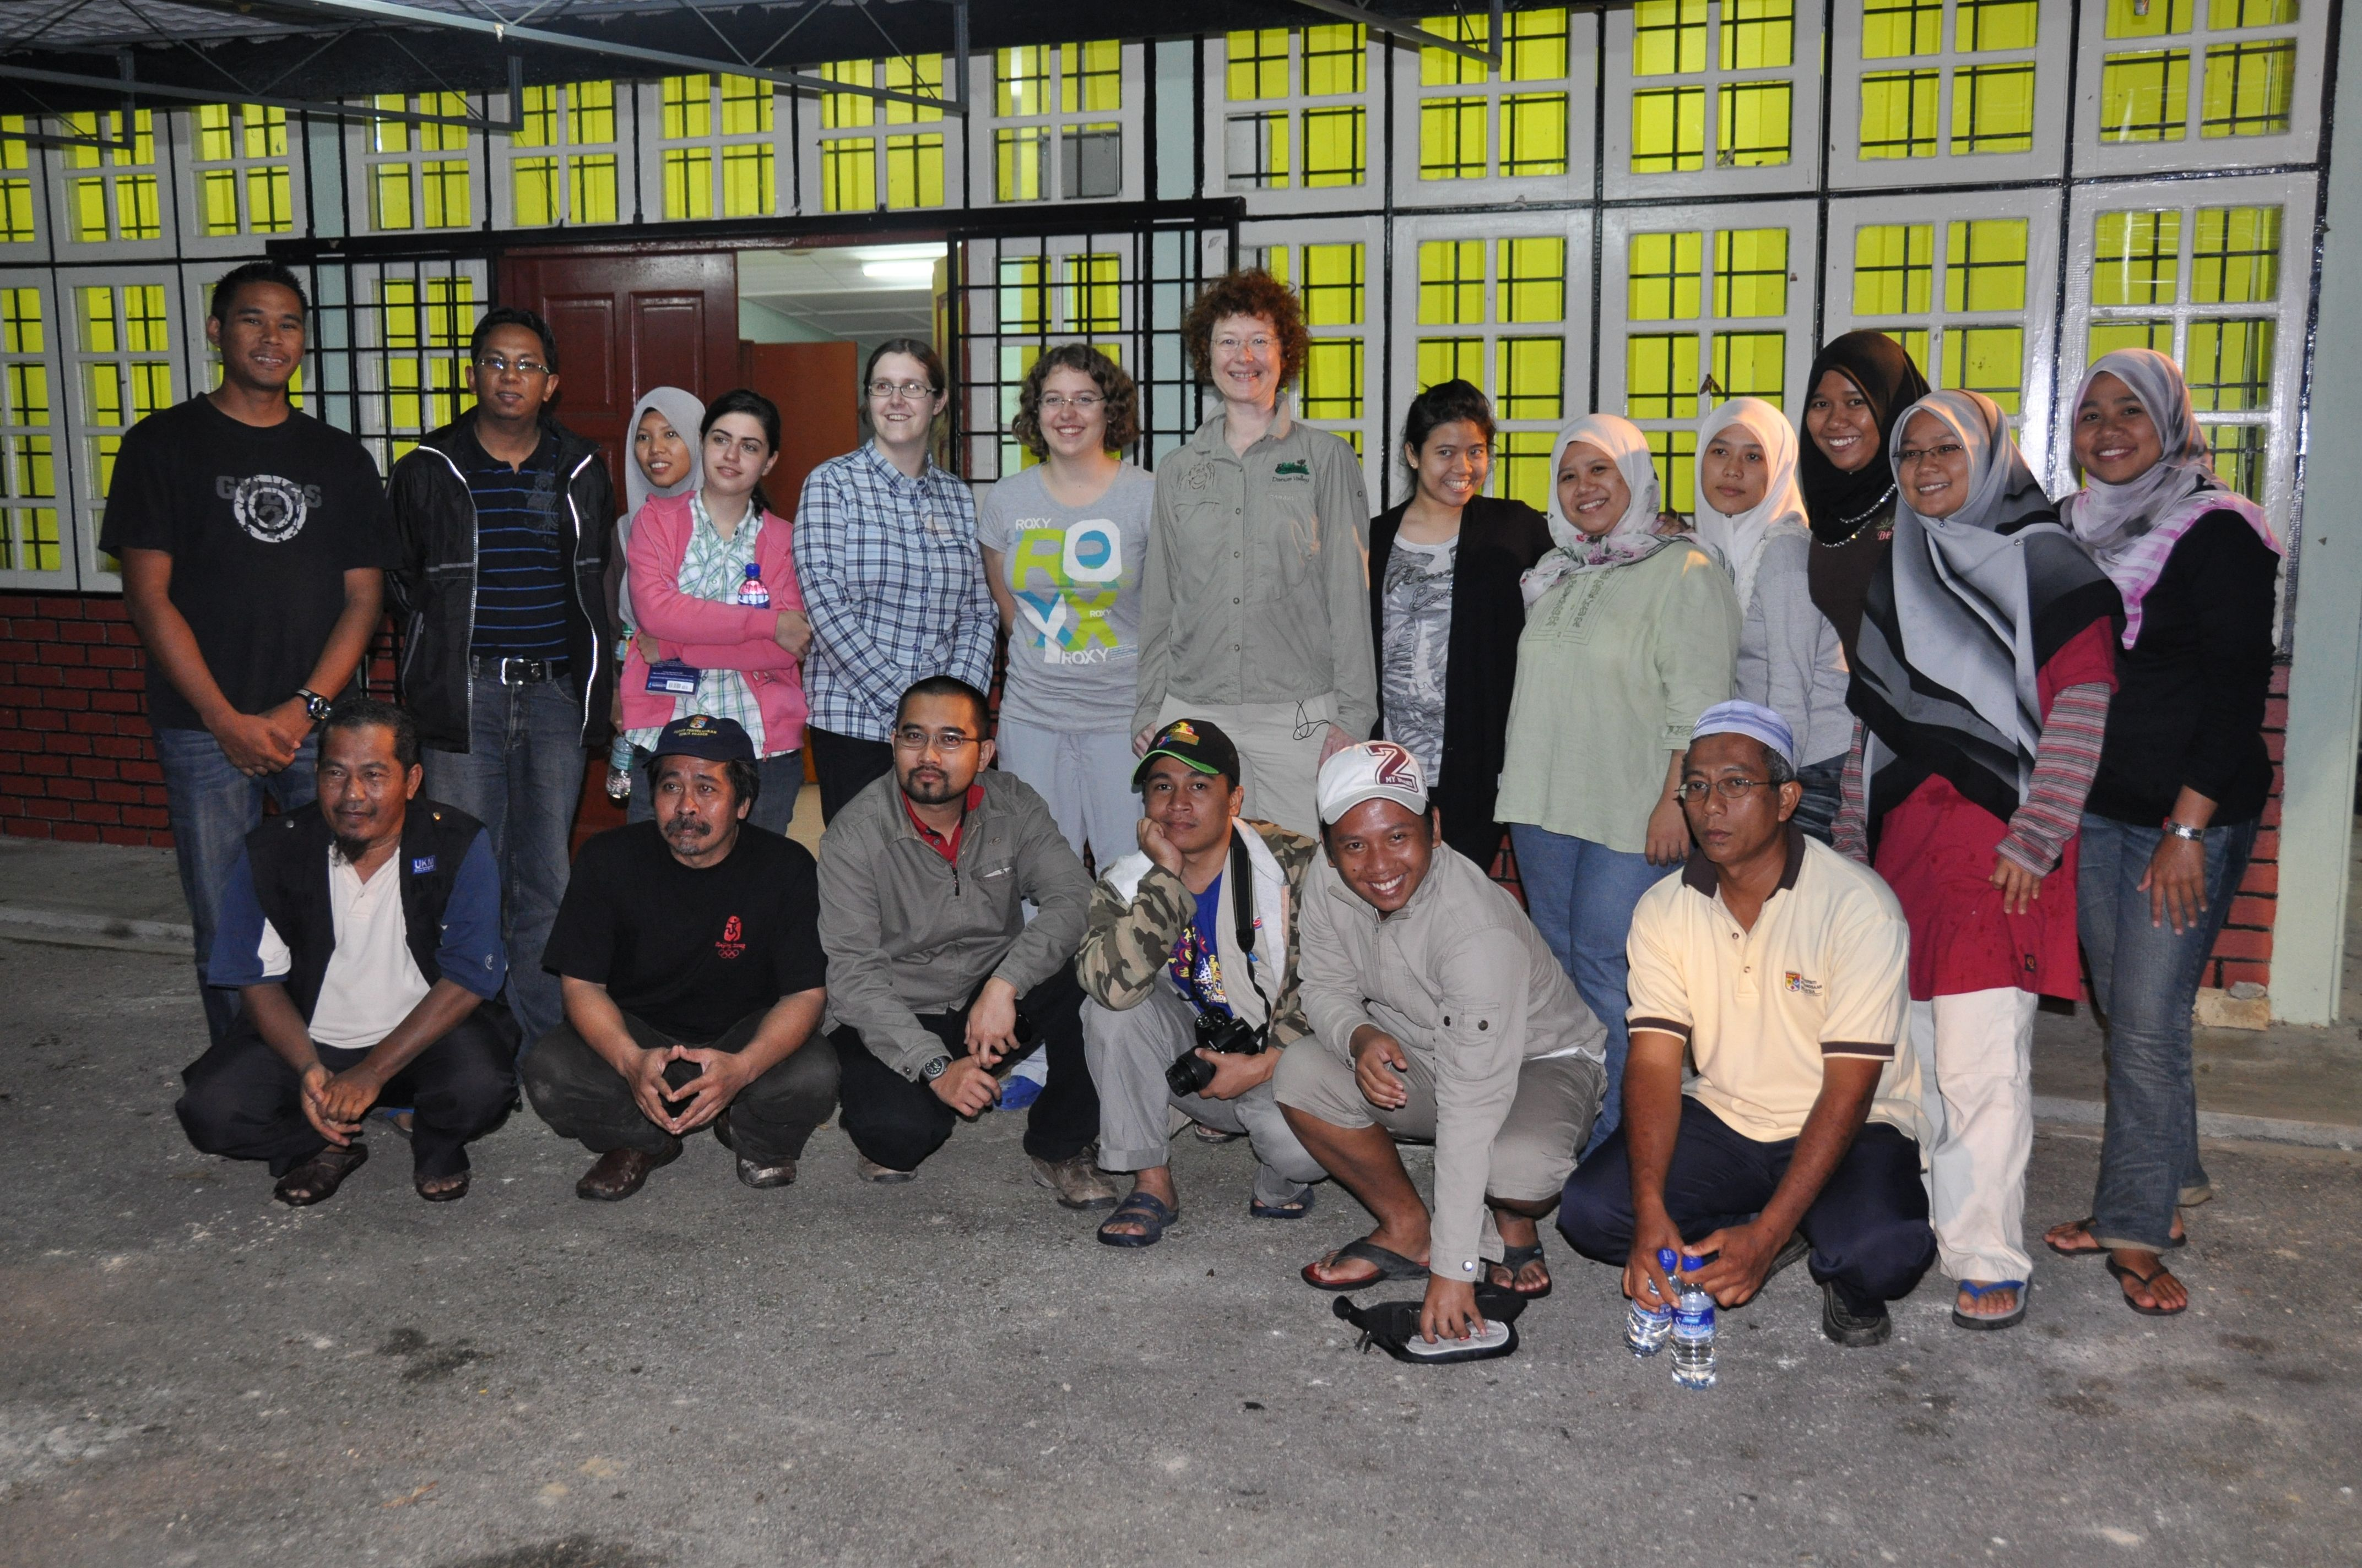
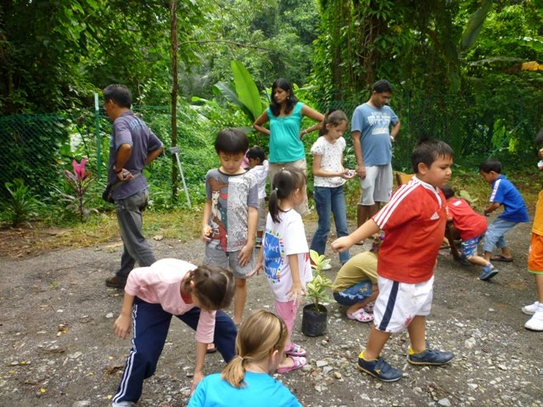
On big expedition

Slide 12
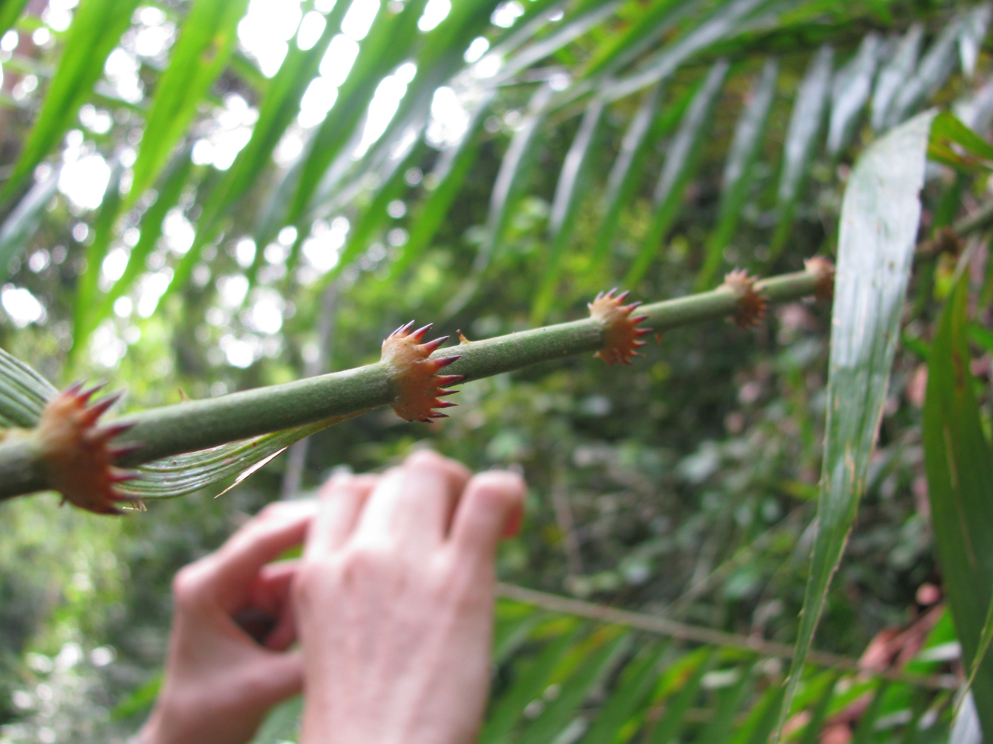
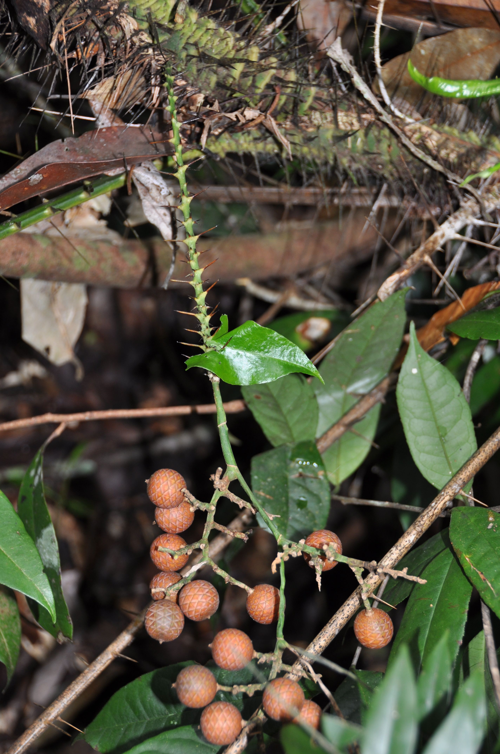
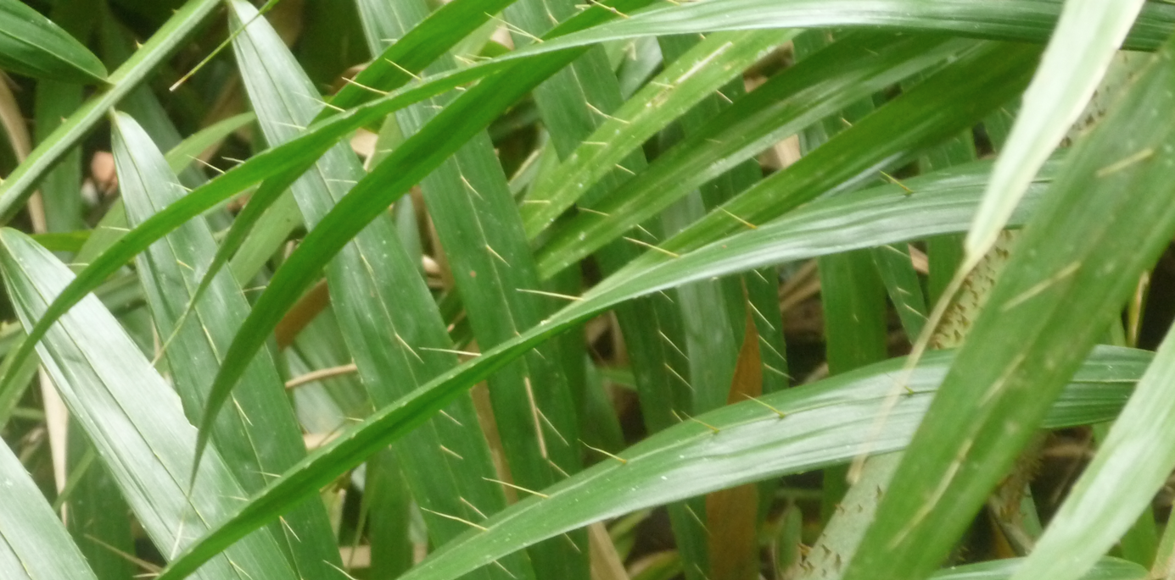
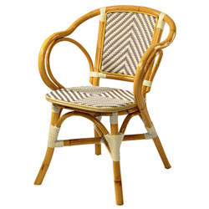
Rotan
http://www.vega-direct.at/IMAGE_POOL/wga/0810/rattanarm_wga_0810_ue01a_2.jpg

Slide 13
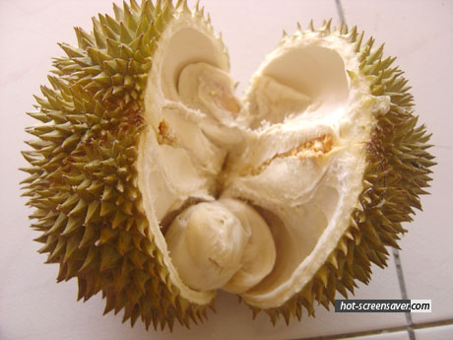
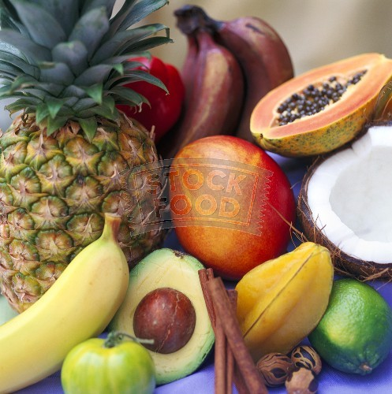
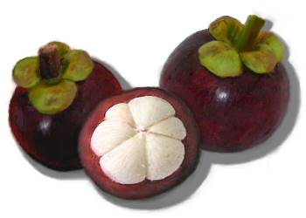
Tropical Fruits
http://2.bp.blogspot.com/_olhzL-oEec4/SWd8dwM9NJI/AAAAAAAAAIk/COE3ZwrRsAU/s400/mangosteen.jpg
http://www.hot-screensaver.com/wp-myimages/malaysia-durian.jpg
http://www.stockfood.de/bilder-fotos/Verschiedene%20tropische%20Früchte%20und%20Gewürze-245009.jpg

Slide 14
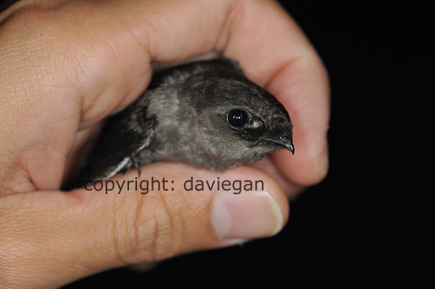
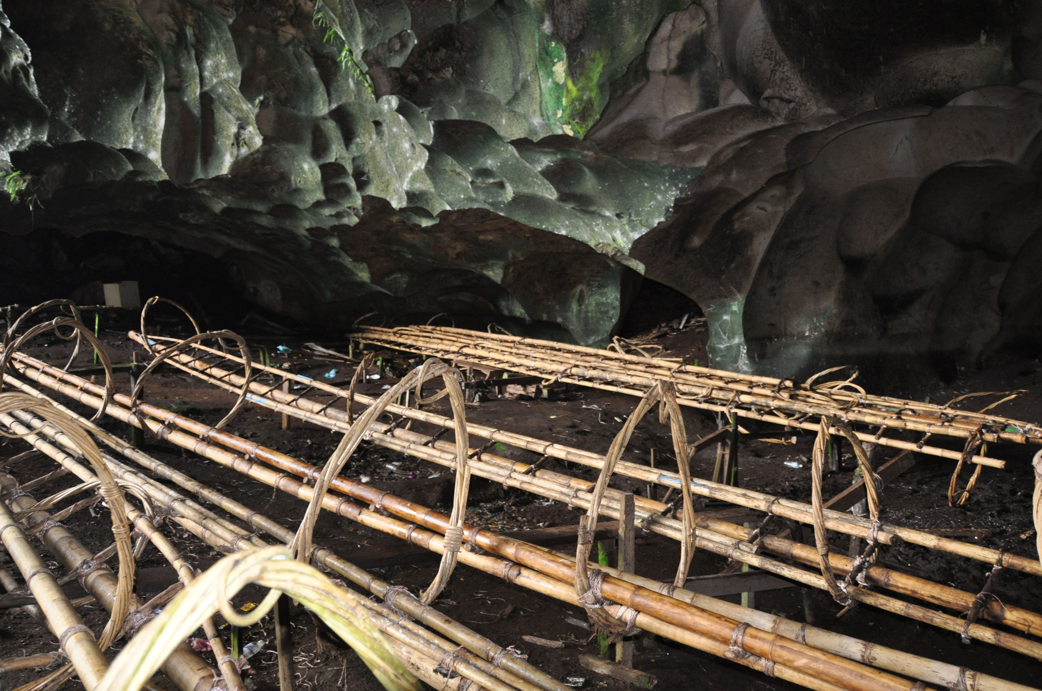
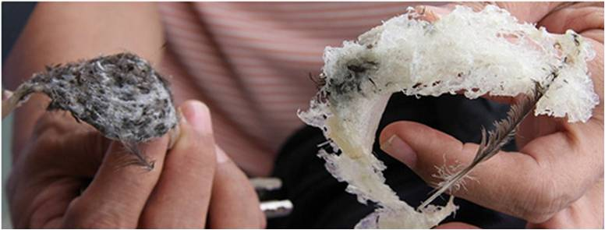
Edible bird nests
http://daviegan.files.wordpress.com/2009/07/swiftletdg.jpg
http://www.purenessbirdnest.com.sg/images/cavehousebirdnest.jpg

Slide 15
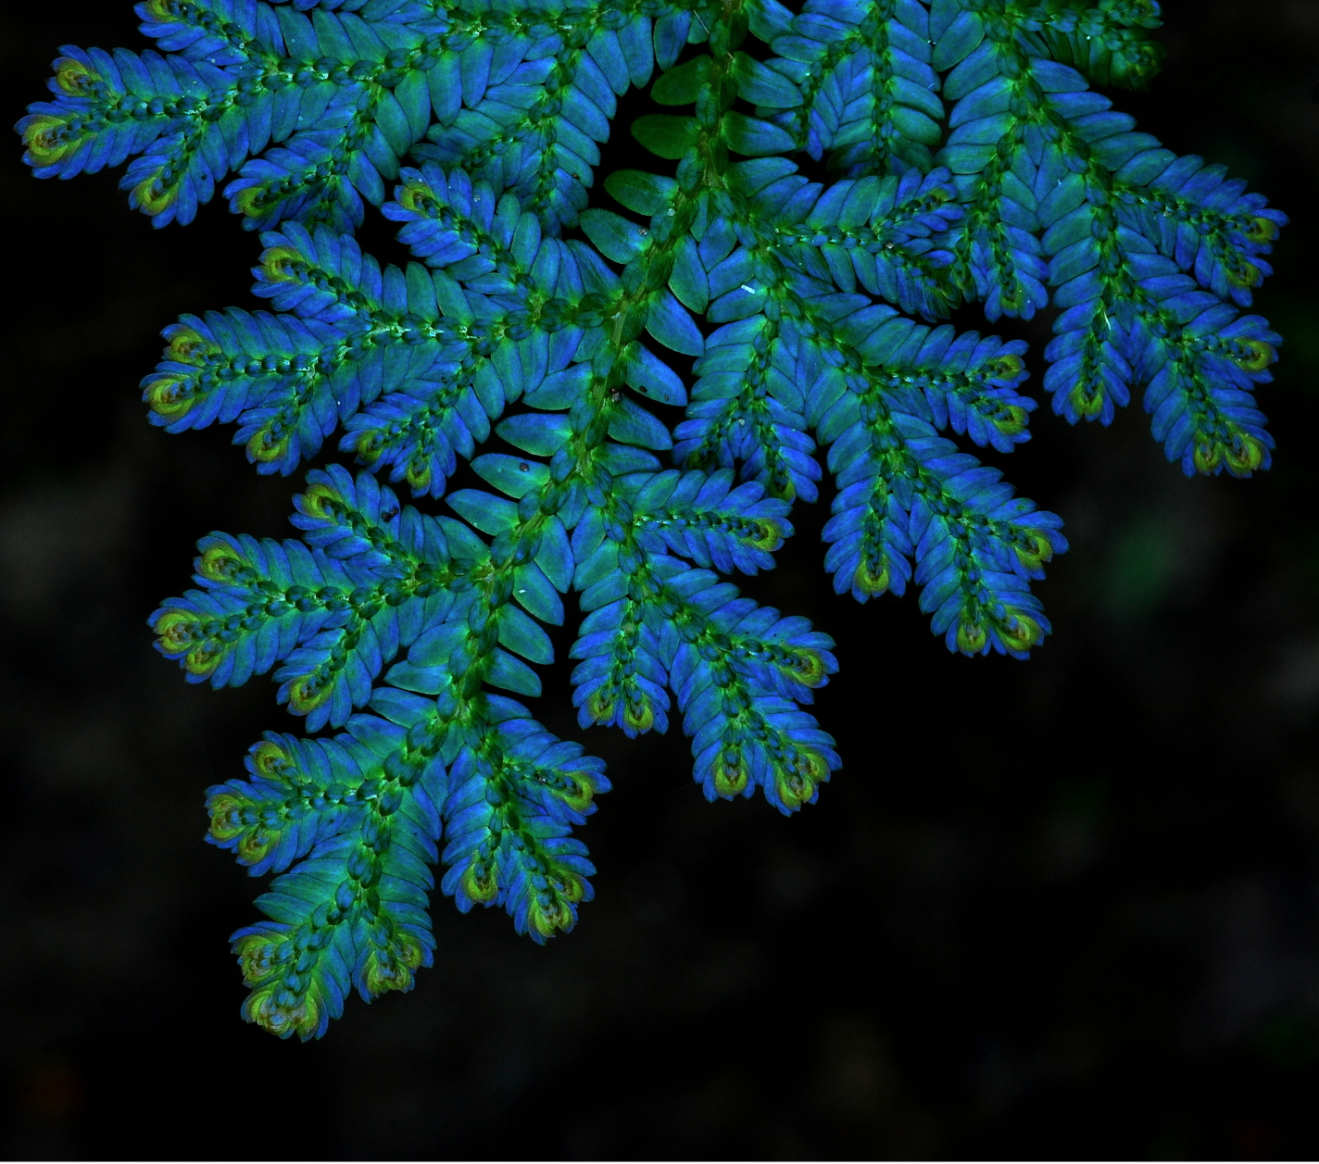
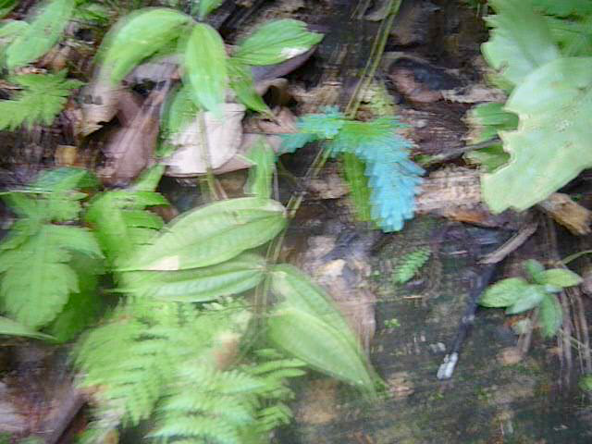
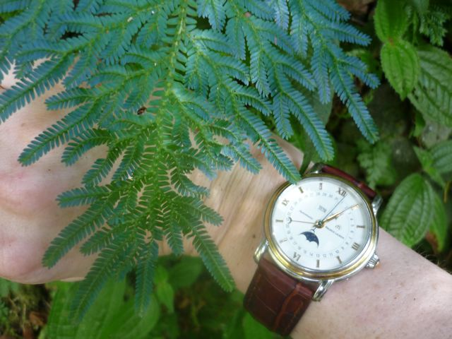
Blue Fern
farne
© Foozi Saad, Malaysia

Slide 16
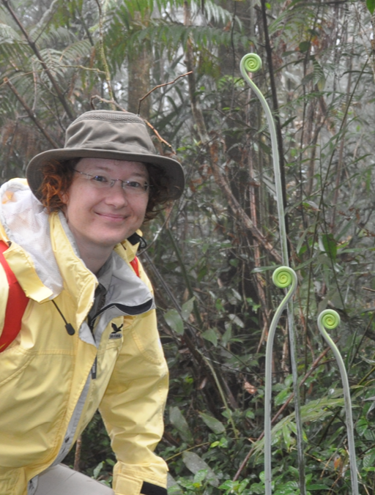
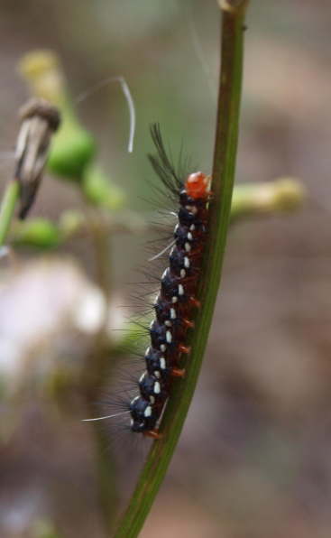
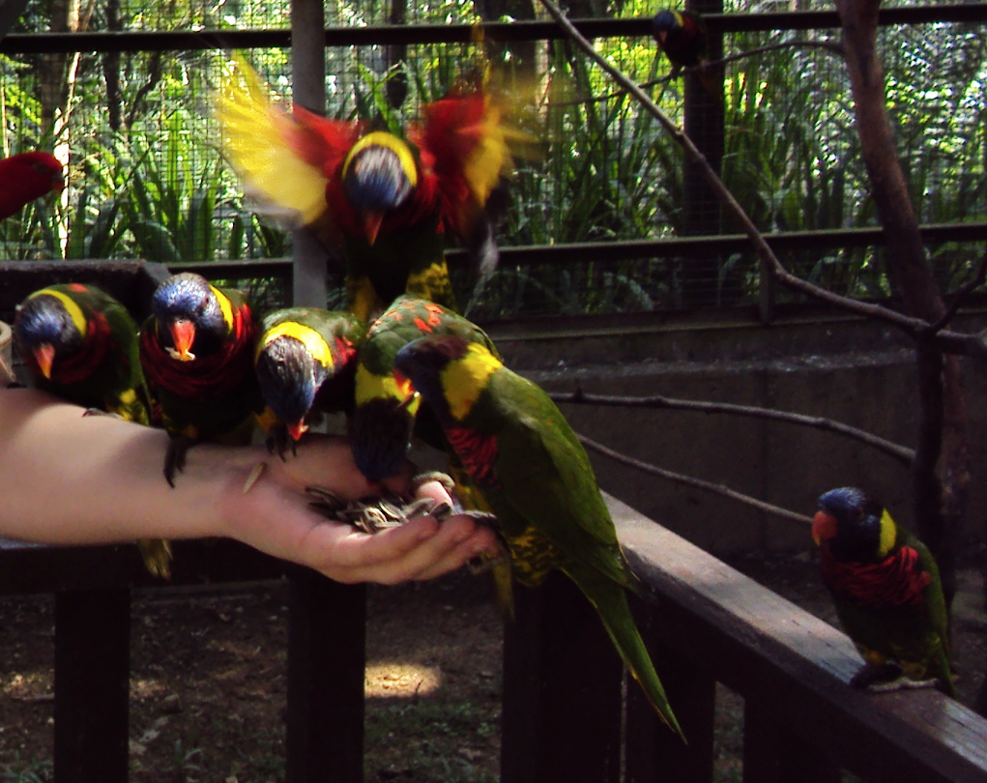






Animals and Plants in the Rainforest
http://www.MIR.com.my/VThian
http://bioweb.uwlax.edu/bio203/s2009/houk_step/wallaces-flying-frog.jpg

Slide 17





Animals and Plants in the Rainforest
http://www.cringel.com/files/images/adia-2007-08-04-DSC-2814-hornbill-in-bird-park-malaysia-kuala-lumpur-cringel.com.jpg
http://1.bp.blogspot.com/_lFELKwm4ZV8/Sjh4GChSJII/AAAAAAAAC1s/my5-o3oHDuo/s400/DSCF7115+Rajah+Brooke+Birdwing.jpg
http://1.bp.blogspot.com/_yzw2AzY2du4/So_p9xUoUDI/AAAAAAAADV0/XqxLiF4T13M/s400/Rajah-Brookes-Birdwing-(Fem.jpg
http://eatk0okies.files.wordpress.com/2008/03/rambutan.jpg

Slide 18




Leeches
http://www.bitkisel.gen.tr/katalog_resimleri/Cali-vita.jpg

Slide 19

Spiders

Slide 20

We can’t solve problems by using the same kind of thinking we used when we created them.
Albert Einstein

Slide 21
Motivation
Our view of the environment has changed from regarding it as a constant that provides resources and acts as a sink for waste towards a more complex view, where the environment is seen as a variable that can be influenced by our activities and on which we are utterly dependent.
Problems: industrialization, species extinction, potential collapse of the marine ecosystem, global challenges, planetary boundaries, etc.
Barnosky A.D. et al. (2012) Approaching a state shift in Earth’s biosphere. Nature 486, 52-58.
Barnosky A.D. et al. (2011) Has the Earth’s sixth mass extinction already arrived? Nature 471, 51-57.
Rockström J. et al. (2009) A safe operating space for humanity. Nature 461, 472-475.
Steffen W. et al. (2015) Planetary boundaries: Guiding human development on a changing planet. Science 347, 6223.

Slide 22
Value-based Science
Responsibility
Global Ethics
Sustainability
Biomimeticians are already highly interdisciplinary, bridging science, technology and business – good start!
Gebeshuber I.C. (2016) Value based science: What we can learn from micro- and nanotribology. Tribology - Materials, Surfaces and Interfaces 10(1), 10-18.

Slide 23
Innovision
** Not just faster, smaller, cheaper. **
The path from innovation to innovision is characterized by a new framework of thinking that is the prerequisite for the provision of solutions.
This new framework of thinking is based on lessons from living nature.
Gebeshuber I.C. (2016) Ecotribology: Development, Prospects, and Challenges. In: Eco-Tribology - Research Developments, (Ed. J. Paulo Davim), Springer, 1-39.

Slide 24




Construction – man-made

Slide 25




Construction – natural

Slide 26

Biomimetics

Slide 27







Biomimetics
Biomimetics is the Abstraction
of Good Design from Nature.
Center for Biomimetics, UK

Slide 28

ENGINEERING NATURE
Challenges Solutions
BIOMIMETICS BY ANALOGY:
Specific
problem
Analoguous
problem
Apply findings
in search of
solutions
(e.g. winglets)
BIOMIMETICS BY INDUCTION:
Develop
applications
(e.g. self
cleaning
surface)
Basic research
(concepts)
Gebeshuber I.C. and Drack M. (2008) An attempt to reveal synergies between biology and mechanical engineering. Proc. IMechE Part C: J. Mech. Eng. Sci. 222(7), 1281-1287.

Slide 29
Materials
Phytomining – mining with plants – as inspiration for biomimetic metal management

Slide 30


Karman S.B., Diah S.Z.M. and Gebeshuber I.C. (2015)
Raw materials synthesis from heavy metal industry effluents with bioremediation and phytomining: A biomimetic resource management approach. Adv. Mat. Sci. Eng. #185071, 21 p.

Slide 31
Structures
Optimized functional micro- and nanostructures inspired by organisms

Slide 32

© seabagg
http://www.flickr.com/photos/seabagg/3923303391/

Slide 33


Scale bars:
500nm (A,D, F,G),
200nm (B,C,E,J,L),
2um (H), and 1um (K).
Prum R.O., Quinn T. and Torres R.H.
Anatomically diverse butterfly scales all produce structural colours by coherent scattering
J. Exp. Biol. 209, 748-765, 2005

Slide 34

© Foozi Saad

Slide 35



White butterflies
white
black
5um
1cm
1um
The beads presu-mably cause the matt-white colour of the wings and increase the reflectance amplitude.
1um
40um
Stavenga D.G., Stowe S., Siebke K., Zeil J. and Arikawa K.
Butterfly wing colours: Scale beads make white pierid wings brighter
Proc. Royal Society B Biol. Sci. 271(1548), 1577-1584, 2004

Slide 36
Processes
Biomineralization at ambient conditions

Slide 37




Biomineralization
© R.M. Crawford and F. Hinz
I.C. Gebeshuber Biomineralization in marine organisms: status, challenges and prospects for biotechnology. Springer Handbook of Marine Biotechnology, 2015.

Slide 38
Biomineralization
More than 70 different materials!
Metals, alloys, ceramics, polymers and composites.
With help of proteins @ at ambient conditions.
Carbonates such as Calcite CaCO₃ in mussels.
Phosphates such as Hydrxyapatite Ca₅[OH(PO₄)₃] in bones.
Oxides such as Magnetite Fe₃O₄ in magnetotactic bacteria.
Sulfates such as Celestite SrSO₄ in radiolarians.
Sulfides such as Pyrite FeS₂ in magnetotactic bacteria.
Native elements such as Gold nanocrystals Au in yeast and sponges.
… and many more!
I.C. Gebeshuber Biomineralization in marine organisms: status, challenges and prospects for biotechnology. Springer Handbook of Marine Biotechnology, 2015.

Slide 39


Young J.R. and Henriksen K. (2003) Biomineralization within vesicles: The calcite of coccoliths. Rev. Mineralogy Geochem. 54, 189-216.

Slide 40

© Iwan Ramawan

Slide 41
Towards Sustainability
Gebeshuber I.C. (2016) Ecotribology: Development, Prospects, and Challenges. In: Eco-Tribology - Research Developments, (Ed. J. Paulo Davim), Springer, 1-39.

Slide 43
General Biomimetic Principles
Can be applied by engineers who are not at all involved in biology.
Integration instead of additive construction
Optimization of the whole instead of maximization of a single component feature
Multi-functionality instead of mono-functionality
Fine-tuning regarding the environment
Energy efficiency
Nachtigall W. (2009) Vorbild Natur: Bionik-Design für funktionelles Gestalten. Springer, Berlin.

Slide 44
General Biomimetic Principles
Can be applied by engineers who are not at all involved in biology.
Direct and indirect usage of solar energy
Limitation in time instead of unnecessary durability
Full recycling instead of piling waste
Interconnectedness as opposed to linearity
Development via trial-and-error processes
Nachtigall W. (2009) Vorbild Natur: Bionik-Design für funktionelles Gestalten. Springer, Berlin.

Slide 45
Principles for
Sustainable Biomimetics
Evolve to survive
Sustainability can be ensured when information to ensure enduring performance is continually incorporated and embedded.
2. Resource efficiency regarding material and energy
Skillfully and conservatively take advantage of local resources and opportunities.
3. Adaptation to changing conditions
Appropriately respond to dynamic contexts.
Biomimicry 3.8 in Gebeshuber I.C. (2012) Green Nanotribology and sustainable nanotribology in the frame of the global challenges for humankind. in: Green Tribology - Biomimetics, Energy Conservation, and Sustainability, Springer, pp. 105-125.

Slide 46
Principles for
Sustainable Biomimetics
4. Integration of development with growth
Invest optimally in strategies that promote both development and growth.
5. Responsiveness and being locally attuned
Fit into and integrate with the surrounding environment.
6. Usage of life-friendly chemistry
Use chemistry that supports life processes.
Biomimicry 3.8 in Gebeshuber I.C. (2012) Green Nanotribology and sustainable nanotribology in the frame of the global challenges for humankind. in: Green Tribology - Biomimetics, Energy Conservation, and Sustainability, Springer, pp. 105-125.

Slide 47

http://ben.biomimicry.net/wp-content/
uploads/2013/02/Biomimicry38_
Lifes_Birthday_Geological_Timeline6.jpg

Slide 48
Recommended Reading
Nano Risk Governance:
Gebeshuber I.C. (2014) Grüne und nachhaltige Nanotribologie, in: Nano Risiko Governance Der gesellschaftliche Umgang mit Nanotechnologien (Eds. Gazsó A. and Haslinger J.), Springer
Biomimetics – Materials:
Karman, Diah and Gebeshuber (2015) Phytomining, Adv. Mat. Sci. Eng.
Biomimetics – Structures:
Gebeshuber and Lee (2016) Nanostructures for Coloration, Springer Encyclopaedia of Nanotechnology, Springer
Biomimetics – Processes:
Gebeshuber (2015) Biomineralization in Marine Organisms, Springer Handbook of Marine Biotechnology, Springer
Sustainable Biomimetics:
Gebeshuber I.C. (2012) Green Nanotribology and sustainable nanotribology in the frame of the global challenges for humankind. Green Tribology, Springer

