Slide 1
Environment, Health and Safety Issues in Nanotechnology
Ille C. Gebeshuber, IAP TU Wien
Quelle: Springer HB of Nanotechnology, B. Bhushan (Ed.), 2017

Slide 3
Nanotechnology offers substantial economic and societal benefits, but its impacts on environment, health, and safety (EHS) issues are not clearly understood or defined.
Interactions between nanomaterials (sourced from nanotechnology development) and the human body and even with the ecological system have attracted much concern.
NIOSH .. National Institute for
Occupational Safety and Health

Slide 4
Three main EHS points dealt with:
Impacts of the Development of Nanotechnology on Environment, Health, and Safety Issues
Current Progress of the Most Important Nanomaterials
Physicochemical Characteristics of Nanoparticles that Determine the Toxicity Impacts
ELSI .. Ethical, Legal and Social Issues

Slide 5
1. Impacts of the Development of Nanotechnology on Environment, Health, and Safety Issues
Nanomaterials (NMs) or nanoparticles (NPs) with novel physicochemical properties are the main products or research subjects in nanotechnology development.
The most significant change in the properties of NPs is the increase in the surface-to-volume ratio compared to their large bulk counterparts.

Slide 6
There is great concern over adverse impacts on the environment, health, and safety (EHS).
NPs may be released into the environment with the possibility of human or ecosystem exposure at various stages in their life cycles.
It is proposed that NPs may enter the body and accumulate in organs, and the release of NPs into the environment might harm the ecological system.

Slide 7
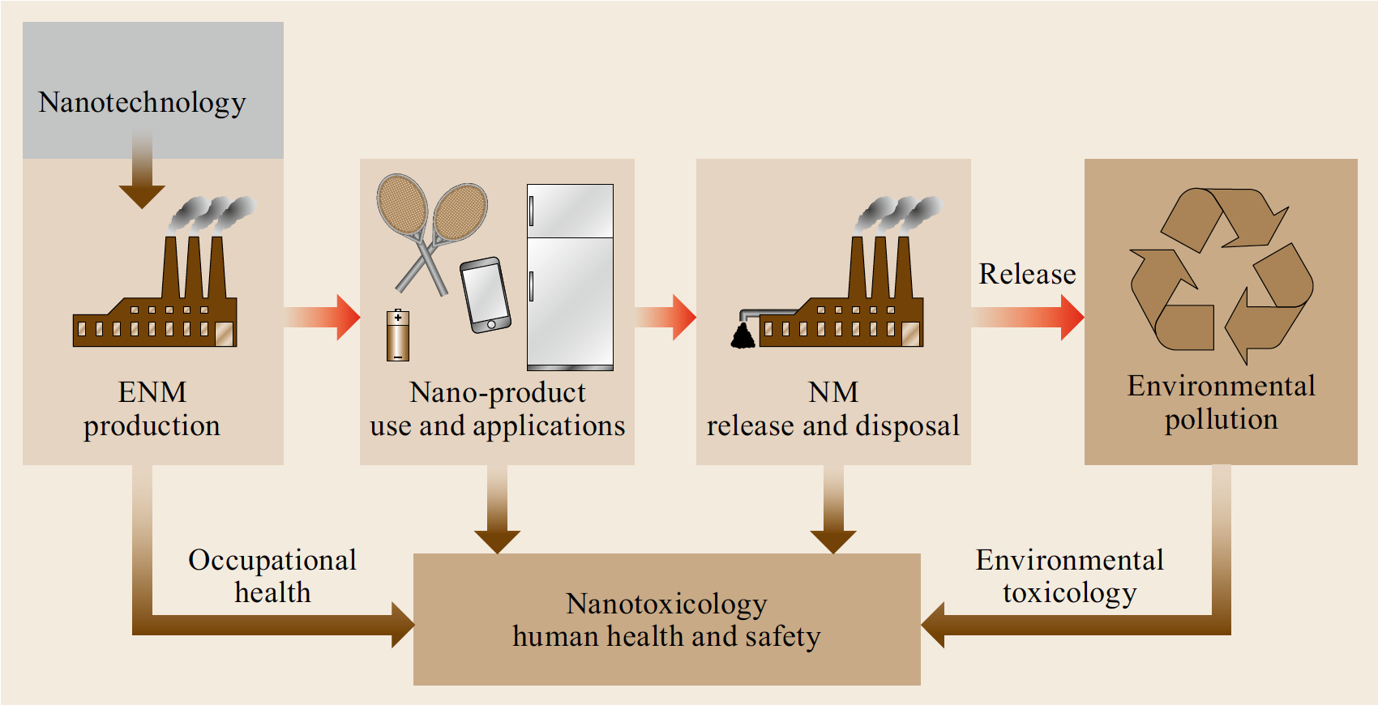
EHS Impacts of Nanotechnology
Red arrows: flows of nanomaterials to the environment
Brown arrows: potential health and safety impacts

Slide 8
The field of nanotoxicology emerged around 2004 to 2005.
Nanotoxicology: the study of the adverse effects of engineered nanomaterials (ENMs) on living organisms and the ecosystem, including the prevention and amelioration of such adverse effects.

Slide 9
Life-cycle assessment of EHS impacts is important yet difficult to carry out.
The formula of NMs and related manufacturing processes are new and often subject to confidentiality constraints in the nanotechnology industry.
This means risk estimations for impacts of NMs on EHS vary from one scenario to another.

Slide 10
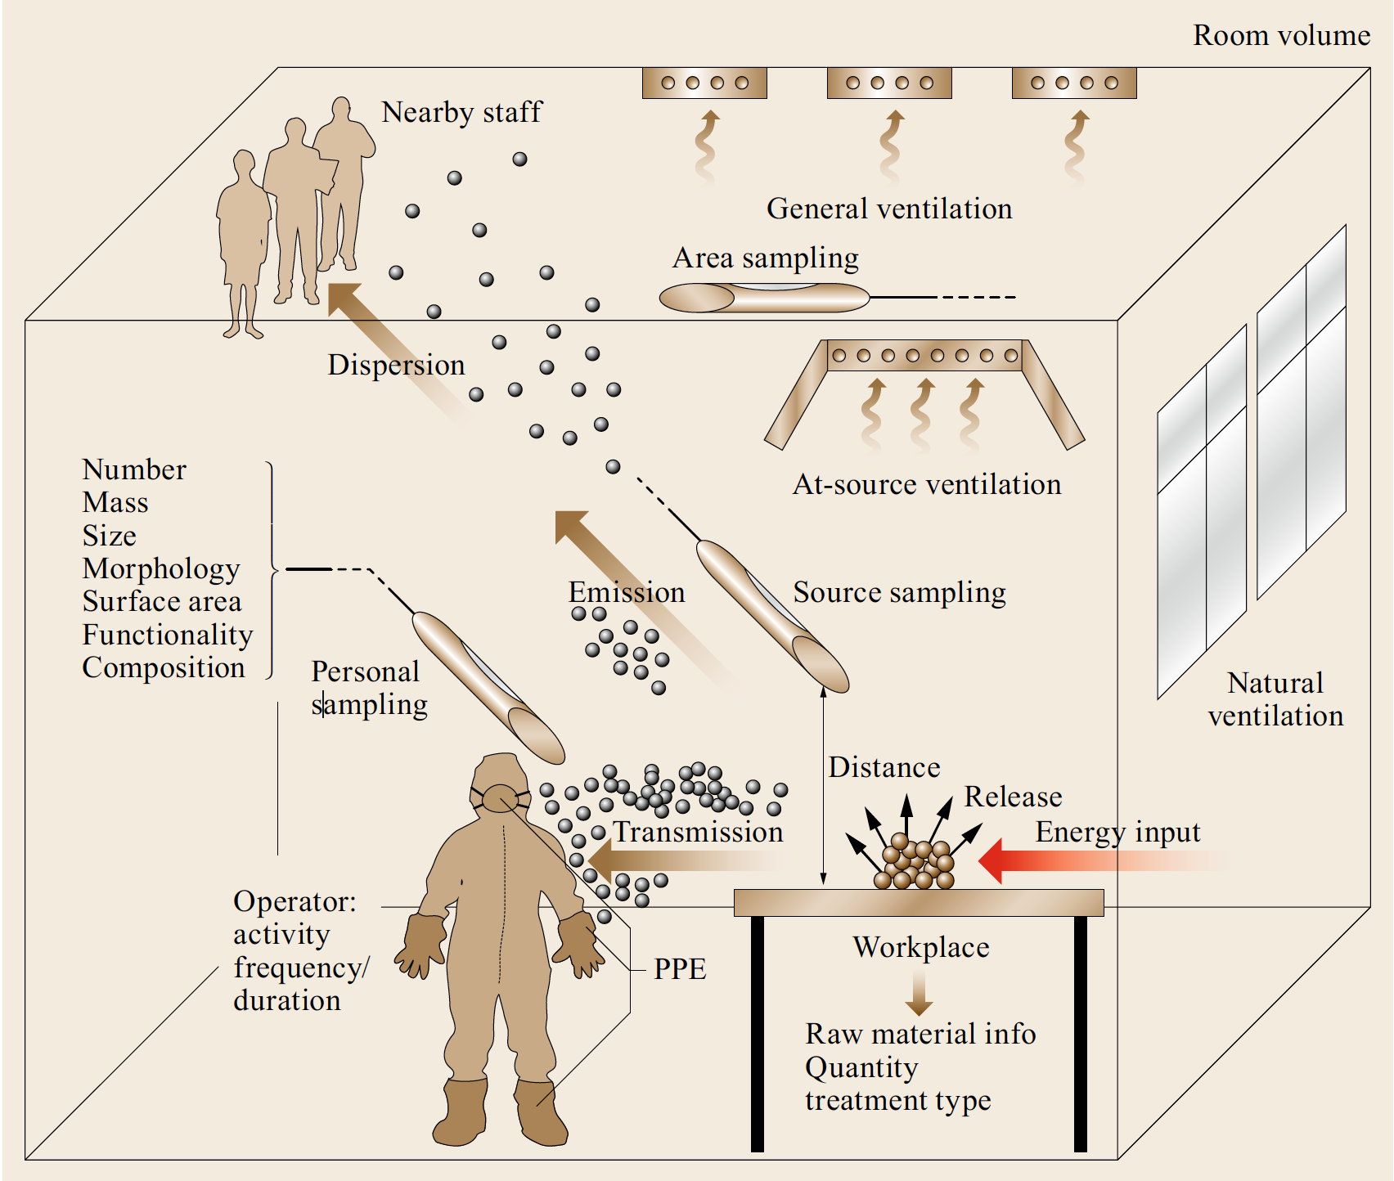
Elements and processes in an occupational exposure scenario

Slide 11
The most accurate estimation of NMs that could potentially be released to the environment may be the one that is based on the production volume of the raw nanomaterials.
NMs like silica, titania, alumina, iron oxides, and zinc oxides dominate the engineered nanomaterials (ENM) market in terms of mass flow through the global economy.

Slide 12
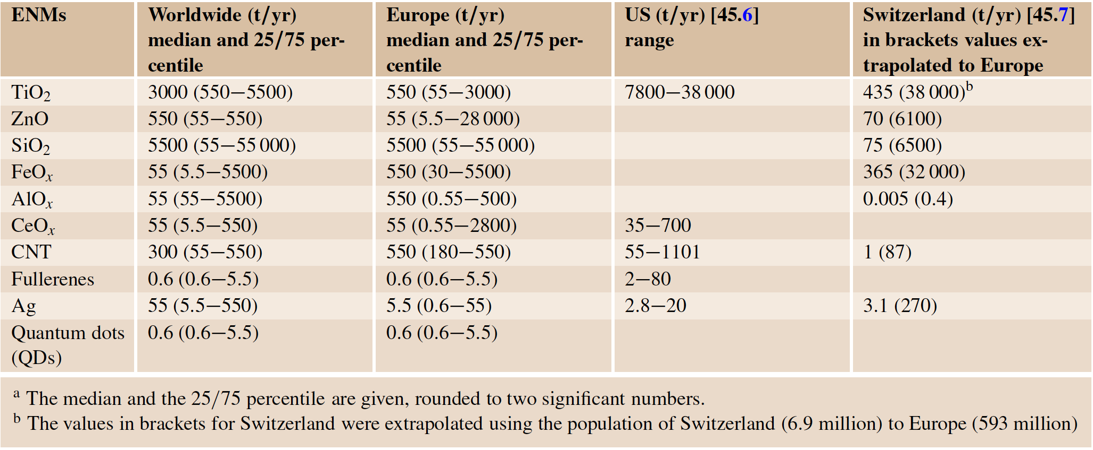
Production/utilization quantities of ten nanomaterials in the world and in Europe (in t/yr)

Slide 13
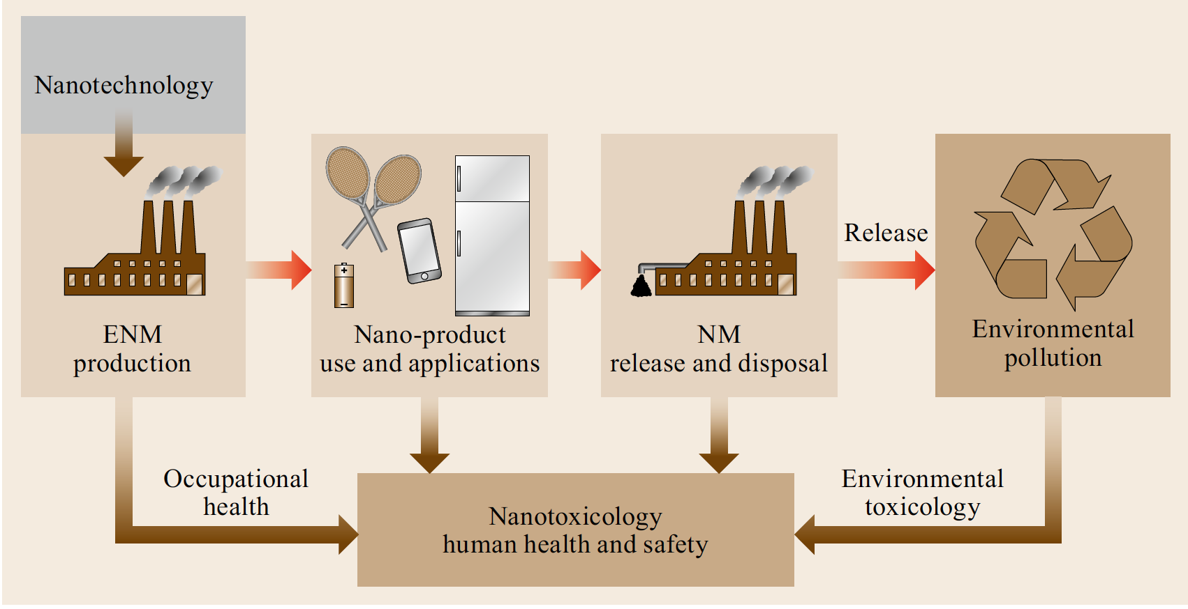
The modeling of the NM’s flow should generally track its entire life cycle ...

Slide 14
… this includes
ENM production,
incorporation into products,
ENM release from products during use, transport and disposal of ENM
during and after recycling processes,
transfer to air, soil, water and sediments (ecosphere),
and transport within environmental compartments of the nature system.
ENM .. engineered nanomaterial

Slide 15
In nanotechnology there are two principle nanoscale manufacturing strategies: the top-down and the bottom up approach

Slide 16
The top-down approach dominates compared to the bottom-up approach, but it is believed to produce more waste.
It has been suggested that the bottom-up approach represents should be emphasized in order to minimizing the unwanted waste for sustainable development in nanotechnology

Slide 17
2. Current Progress of the Most Important Nanomaterials
2.1 Carbon Nanotubes
2.2 Silver Nanoparticles
2.3 Zinc Oxide Nanoparticles
ROS .. Reactive Oxygen Species

Slide 18
2.1 Carbon Nanotubes
CNTs have a needle-like shape and are strong and tough in character, similar to asbestos.
In vitro evidence showed that exposure to CNTs could reduce viability, induce apoptosis, and cause DNA (deoxyribonucleic acid) damage

Slide 19
In vivo pulmonary toxicity studies usually show CNT causing clear adverse toxicity effects.
Long CNTs (longer than 15μm) in mice result in asbestos-like, length-dependent, pathogenic behaviors including inflammation and granulomas.
Frustrated phagocytosis

Slide 20
Results suggest a potential link between inhalation exposure to long CNTs and mesothelioma which is generally regarded as the specific type of cancer caused by inhalation exposure to asbestos.

Slide 21
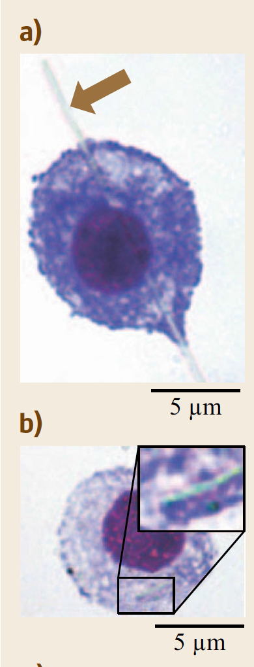
The phagocytosis of asbestos and CNTs by macrophages
Incorporation of long-fiber amosite
(a) (arrow) leading to frustrated phagocytosis,
but short-fiber amosite (b) is successfully phagocytosed by peritoneal macrophages.

Slide 22
Granuloma formation and/or fibrotic responses in the lungs are the dominant injuries after inhalation exposure to CNTs.
It is worth noting that long CNTs have much more significant effects.
The inhalation of carbon nanotubes has a high possibility to induce pulmonary fibrosis but also can directly cause acute and serious injuries to the pulmonary system.

Slide 23
A cautious attitude should be taken with all carbon nanomaterials.

Slide 24
2.2 Silver Nanoparticles
With excellent antimicrobial activity, silver nanoparticles (AgNPs) are widely used as a major ingredient in industrial, consumer, and medical products binding of Ag to sulfide groups of amino acids and proteins may be involved in the dissolution process of AgNPs.
This intracellular binding of silver ions to proteins disrupts protein structure and function, thereby resulting in toxic effects.

Slide 25
2.3 Zinc Oxide Nanoparticles
Zinc oxide NPs have been used in personal care products including cosmetics and sunscreens as they efficiently absorb ultraviolet radiation and are also highly transparent to visible light.
Dermal penetration

Slide 26
For damaged skin, exposure of epidermal and dermal cells to high concentrations of ZnO NPs is sure to cause cytotoxicity and undesirable immune responses, which will instigate the penetration of even more particles to even deeper sites or even into the lymphatic or blood circulation.

Slide 27
Inhalation causing metal fume fever, which is characterized in humans by short-term pulmonary and systemic alterations and is caused by inhalation of metal oxide aerosol.

Slide 28
The National Institute for Occupational Safety and Health (NIOSH) recommended the permissible exposure limit of 5mg/m³ averaged over a work shift of up to 10h/day, 40 h/week for zinc oxide fume inhalation exposure.
Whereas no exposure limit is available for nano-ZnO aerosol to date.

Slide 29
ZnO NP toxicity similarly include generation of reactive oxygen species and subsequent DNA damage and apoptosis.

Slide 30
3. Physicochemical Characteristics of Nanoparticles that Determine the Toxicity Impacts
Conventional toxicology places emphasis on chemical composition, dose, and exposure route as the primary variants in toxicity assessment of a chemical or a bulk material.
However, many other factors, especially the physicochemical characteristics of nanoparticles, should be considered when we perform the same work in nanotoxicology.

Slide 31
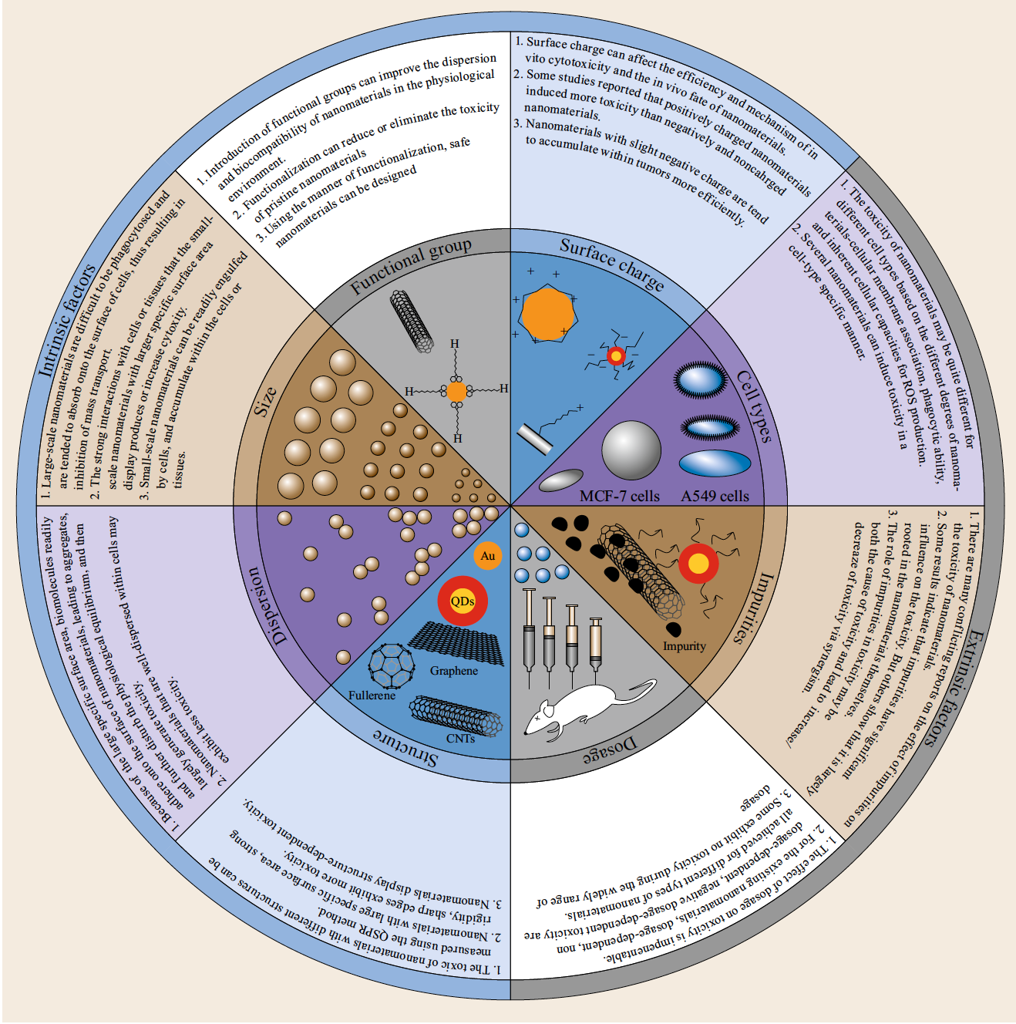
Dominant factors influencing the toxicities of nanomaterials

Slide 32
Dominant factors influencing the toxicities of nanomaterials

Slide 33
Dominant factors influencing the toxicities of nanomaterials

Slide 34
This makes nanotoxicity evaluation much more complex and difficult than conventional toxicology.

Slide 35
Intrinsic factors: nanostructure, size, aggregation state
Extrinsic factors: dose, cell-/organ-specific responsiveness, exposure routes, and biological species

Slide 36
Characteristics that determine toxicity
3.1 Particle Size and Surface Area
3.2 Nanostructure and Shape
3.3 Agglomeration and Aggregation
3.4 Chemical Composition, Purity, and Impurities
3.5 Coating, Surface Modification, and Surface Charges

Slide 37
3.1 Particle Size and Surface Area
As NM size decreases, the surface area/mass ratio exponentially increases and more atoms are displayed on the particle surface compared with the bulk material.
The decreased particle size and increased surface areas make the NM surfaces more reactive to the surrounding biological components.

Slide 38
Many studies have indicated that a small size can increase toxic effects compared to the bulk counterpart.
This means that the physicochemical characteristics of size and surface area have dominant roles in determining toxic potential when NPs interact with organisms.

Slide 39
3.2 Nanostructure and Shape
Engineered nanoparticles (ENPs) may exhibit various shapes and structures, e.g., spheres, needles, tubes, rods, etc.
One in vitro study showed that SWCNTs, MWCNTs, and C60 exhibit quite different cytotoxicity to alveolar macrophages, although they all represent carbon materials.

Slide 40
CNTs with different lengths contribute to obviously different lung fibrosis potential after inhalation exposure.
The cytotoxicity and even the bioeffects of different carbon nanomaterials in vitro are highly dependent on their nanostructures.

Slide 41
3.3 Agglomeration and Aggregation
NPs have higher surface activity compared to larger sized versions of the same chemical composition.
An agglomeration is a collection of particles that are loosely bound together by relatively weak forces, including van der Waals forces, electrostatic forces, simple physical entanglement, and surface tension, with a resulting external surface area similar to the sum of the surface area of the individual components.

Slide 42
Highly agglomerated SWCNTs cause more serious toxic effects on glial cells in both the peripheral nervous system and central nervous system compared with better dispersed SWCNTs.

Slide 43
3.4 Chemical Composition, Purity and Impurities
Roughly, there are four categories of NMs based on their chemical composition:
1. Carbon nanomaterials
2. Metallic and metallic oxide materials
3. Silicon nanomaterials
4. Organic nanomaterials

Slide 44
It was found that Ag and ZnO NMs possessed much higher cytotoxicity to cells than SiO₂, TiO₂, and CeO₂ based on the same mass level.
Raw nanotubes contain significant impurities.
Much evidence has shown that the impurities in NMs contribute greatly to increased toxicity through induction of oxidative stress.

Slide 45
3.5 Coating, Surface Modification, and Surface Charges
Coating and surface modifications of nanoparticles play an essential role in control of the physicochemical and surface properties of NMs.
By employing these techniques, scientists can reduce material toxicity, increase solubility, enhance biocompatibility, and prevent aggregation of NMs in solution or in the air.

Slide 46
E.g., that the cellular uptake of Au NPs is highly dependent on the surface chemistry.

Slide 47
Conclusions and Perspectives
The presence and release of nanoparticles into the environment has important implications for human health and the environment.
Scientists should not only focus on the beneficial effects of NPs, but also need to be careful in regard to possible adverse impacts on EHS.

