Slide 1
Scanning Probe Microscopy across dimensions
I.C. Gebeshuber^{1,2}, R.A.P. Smith², HP. Winter², F. Aumayr²
¹Austrian Center of Competence for Tribology AC²T, Wiener Neustadt, Austria &
²Institut f. Angewandte Physik, Vienna University of Technology, Austria
Notes:
Hallo!

Slide 2
10⁰m
10⁻¹m
10⁻²m
10⁻³m
10⁻⁴m
10⁻⁵m
10⁻⁶m
10⁻⁷m
10⁻⁸m
10⁻⁹m
10⁻¹⁰m
10⁻¹¹m
woman
small animal
lady bug
flea
amoeba
red blood cell
cholera bacterium
tobacco mosaic virus
large organic molecule
large molecule
atom
atom orbitals
light microscopy
transmission and scanning
electron microscopy
scanning probe microscopy
Gebeshuber I.C. et al. (2006) "Scanning Probe Microscopy: From living cells to the subatomic range", In: Applied Scanning Probe Methods III, Springer, 27-53.

Slide 3
SPM methods
Cells:
Diatoms
Short excursion to biogenic adhesives
Biotribology
Single molecules
Chaperonins: Probing protein-protein
interactions in real time
Atoms
Nanostructuring atomically flat surfaces with ions
Ion bombardment of atomically flat crystals
Subatomic features
Atom orbitals
Electron spins

Slide 4
Some SPM methods

Slide 5
Generalized scheme of an SPM
A scanning probe microscope (SPM) raster scans a sharp probe over a surface.
The mechanical, electrical, magnetic, optical and chemical interaction between the sharp probe and the surface provides a 3D representation of surface parameters at or near the atomic scale. The samples can be in air, vacuum, or immersed in some liquid.

Slide 6
Some types of SPMs
Scanning tunneling microscopy (STM, 1982)
atomic force microscopy (AFM, 1984)
scanning near field optical microscope (SNOM, 1986)
magnetic force microscope (MFM)
magnetic resonance force microscope (MRFM)
scanning thermal microscope
scanning potentiometry microscope
ballistic electron emission microscope (BEEM)
scanning capacitance microcope
scanning ion conductance microscope (SICM)

Slide 7
Scanning Probe Microscopes: Scanning Tunneling Microscopy
The STM measures a weak electrical current flowing between tip and sample (tunneling current).

Slide 8
Scanning Probe Microscopes: Atomic Force Microscopy
The AFM measures the interaction force between the tip and surface.
The tip may be dragged across the surface, or may vibrate as it moves.
© P. Hansma, UCSB

Slide 9
AFM operational modes
Contact mode
Non-contact mode
Intermittent mode
Phase imaging

Slide 10
Scanning Probe Microscopes: Scanning Near Field Optical Microscopy
In SNOM, the excitation laser light is focused through an aperture with a diameter smaller than the excitation wavelength, resulting in an evanescent field (or near-field) on the far side of the aperture.

Slide 11
Scanning Probe Microscopes: Scanning Near Field Optical Microscopy
When the sample is scanned at a small distance below the aperture, the optical resolution of transmitted or reflected light is limited only by the diameter of the aperture.
In particular, lateral resolution of 20 nm and vertical resolution of 2–5 nm have been demonstrated.

Slide 12
Scanning Probe Microscopes: Scanning Near Field Optical Microscopy
The NSOM scans a very small light source very close to the sample.
Detection of this light energy forms the image.
NSOM can provide resolution below that of the conventional light microscope.

Slide 13
Scanning Probe Microscopes: Scanning Ion Conductance Microscopy
The SICM measures the ion current between two electrodes, one in a sharp glass needle, one in the bath solution.
Resolution: half the diameter of the pipette. Great for biological samples.
© P. Hansma, UCSB

Slide 14
Human Chromosomes
AFM, 20.20 μm²
© Terry McMaster, Bristol University

Slide 15
Cells

Slide 16
Cells: Diatoms
Single cellular organisms
Size: some micrometers
10 000s different species
Reproduce via cell division
Under ideal conditions, within ten days the offspring of one single cell number one billion cells (assembly line production of nanostructures)
Surfaces made from amorphous glass
© W. Oschmann

Slide 18
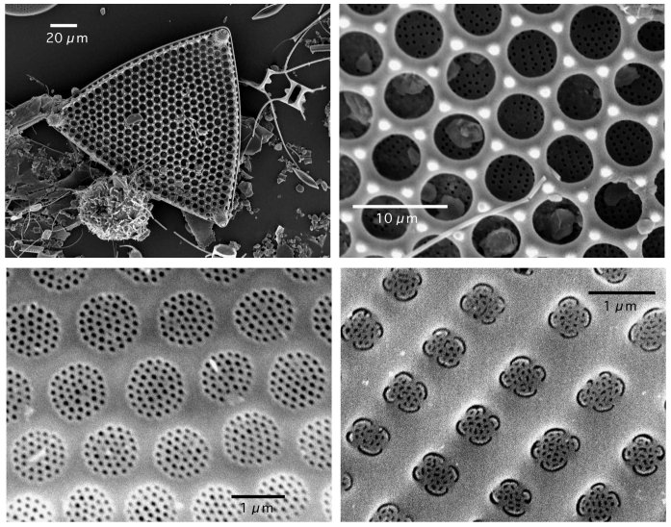
Top: Tricaeratium favus, bottom left: Roperia tessellata,
bottom right: Achnathes brevipes © Gebeshuber et al., J. Mat. Sci. 2002

Slide 19
AFM of Living Cells: Diatoms I
AFM
8.8 μm²
Gebeshuber I.C. et al. (2003) "Atomic force microscopy study of living diatoms in ambient conditions", J. Microsc. Oxf. 212, pp. 292-299.

Slide 20
AFM of Living Cells: Diatoms II
Gebeshuber I.C. et al. (2003) "Atomic force microscopy study of living diatoms in ambient conditions", J. Microsc. Oxf. 212, pp. 292-299.

Slide 21
Underwater Adhesives (AFM)
Most man made adhesives fail to bond in wet conditions, owing to chemical modification of the adhesive or its substrate.
Engineering strong and robust underwater adhesives that are stable in wet environments are a challenge to current technology.
Diatoms produce excellent underwater adhesives.
Diatoms living close to the poles of the earth produce ice binding molecules.

Slide 22
Underwater Adhesives (AFM)
Gebeshuber I.C. et al. (2002) "In vivo nanoscale atomic force microscopy investigation of diatom adhesion properties", Mat. Sci. Technol. 18, pp. 763-766.
Gebeshuber I.C. et al. (2003) "Atomic force microscopy study of living diatoms in ambient conditions", J. Microsc. Oxf. 212, pp. 292-299.

Slide 23
To access the adhesive under the diatom → remove cell with STM tip!

Slide 24
Diatom adhesives

Slide 25
Biotribology
© Stanford University
© Mount Allison University, Canada
Technical microsystems often experience failure.
Biological micro- and nanomechanical systems are reliable also at this scale.

Slide 26
© R.W. Crawford, AWI Bremerhaven, Germany

Slide 27
Biotribology
The aim of biotribology is to gather information about friction, adhesion, lubrication and wear of biological systems and to apply this knowledge to innovate technology, with the additional benefit of environmental soundness.
Gebeshuber I.C. et al. Nanosci. Nanotechnol. 5/1, 79-85 (2005)

Slide 28
Diatom species interesting for biotribology
Bacillaria paxillifer (old name: B. paradoxa)

Slide 30
Movie

Slide 31
Diatom species interesting for biotribology
Ellerbeckia arenaria

Slide 33
Diatom species interesting for biotribology
Eunotia sudetica

Slide 35
scale bars
5μm,10μm
50μm, 5μm,10μm
20μm,5μm

Slide 36
scale bars
50μm,50μm
10μm,5μm
20μm, 5μm

Slide 37
scale bars
5μm,25μm
50μm,20μm
10μm, 10μm

Slide 38
AFM of Living Cells: Fibroblasts
© 2000 Radmacher group, Germany

Slide 39
Single Molecules

Slide 40
Chaperonins GroEL-GroES
© Cell Press 1996
Chaperonins are proteins involved in making certain that other proteins form properly.
© http://www.res.titech.ac.jp/~seibutu/ htaguchi/chaperonin/cpn_structure.html

Slide 42
Watching protein-protein interactions in real time
© 2000 Cambridge University Press
Viani M.B. et al. (2000) Nature Struct. Biol. 7, pp. 644-647

Slide 43
Watching protein-protein interactions in real time
Viani M.B. et al. (2000) Nature Struct. Biol. 7, pp. 644-647

Slide 44
Atoms

Slide 45
Nanostructuring atomically flat surfaces with ions

Slide 46
Omicron UHV AFM/STM

Slide 47
Atomically flat HOPG crystals before ion bombardement
STM AFM
HOPG, 4*4 nm² HOPG, 1*1 nm²

Slide 48
HOPG after ion bombardment
STM, 100.100nm², HOPG bombarded
with 800 eV Ar⁺ ions

Slide 49
Nanodefect aggregation on HOPG steps

Slide 50
HOPG after ion bombardment
STM, 10.10nm², HOPG bombarded with 800 eV Ar⁺ ions
Gebeshuber I.C. et al. (2003) Nucl. Instrum. Meth.
Gebeshuber I.C. et al. (2003) Int. J. Mass. Spectrosc.

Slide 51
Ion bombardment of atomically flat insulator crystals

Slide 52
Potential Sputtering
500 eV Ar⁺ 500 eV Ar⁷⁺
UHV AFM contact mode image of sapphire (Al₂O₃, c-plane 0001) bombarded with ions with the same kinetic, but different potential energy.

Slide 53
Nanodot formation on Silicon

Slide 54
Nanodot formation on Silicon

Slide 55
Ion induced nanodefects on LiF

Slide 56
Subatomic features

Slide 57
Atom orbitals (AFM)
The charge distribution in atoms with closed electron shells is spherically symmetric, whereas atoms with partially filled shells can form covalent bonds with pointed lobes of increased charge density.
Covalent bonding in the bulk can also affect surface atoms, leading to four tiny humps spaced by less than 100 picometers in the charge density of adatoms on a (001) tungsten surface.

Slide 58
Atom orbitals (AFM)
Giessibl and coworkers imaged these charge distributions by means of atomic force microscopy with the use of a light-atom probe (a graphite atom), which directly measured high-order force derivatives of its interaction with a tungsten tip.
This process revealed features with a lateral distance of only 77 picometers.

Slide 59
Atom orbitals (AFM)
F.J. Giessibl, S. Hembacher, H. Bielefeldt and J. Mannhart (2000) Subatomic features on the Silicon (111)-(7*7) surface observed by atomic force microscopy. Science 289, pp. 422-425.
S. Hembacher, F.J. Giessibl and J. Mannhart (2004) Force Microscopy with Light-Atom Probes. Science 305, pp. 380-383.

Slide 60
MFRM
Magnetic resonance force microscopy (MRFM) is an imaging technique that acquires magnetic resonance images (MRI) at nanometer scales, and possibly at atomic scales in the future.
MRFM is potentially able to observe protein structures which cannot be seen using X-ray crystallography and protein nuclear magnetic resonance spectroscopy.

Slide 61
MFRM
Detection of the magnetic spin of a single electron has been demonstrated using this technique.
The sensitivity of a current MRFM microscope is 10 billion times greater than a medical MRI used in hospitals.

Slide 62
Seeing single spins (AFM)
D. Rugar, R. Budakian, H. J. Mamin and B.W. Chui (2004) Single spin detection by magnetic resonance force microscopy Nature 430, pp. 329-332.

Slide 63
3D microscope with atomic resolution
Developed further, the MFRM technique could prove useful for investigating the atomic structure inside materials used in the electronics industry and to image biomolecules - like proteins - at atomic resolution.
However, to reach this goal, nuclear spins have to be detected.
Nuclear spins are harder to detect than electron spins, because a proton´s magnetic moment is 658 times weaker than an electron's.

Slide 64
ESR-STM
Electron spin resonance-scanning tunneling microscopy (ESR-STM) is a rapidly developing surface-science technique that is sensitive to a single spin existing on or nearby a solid surface.
The single spin is detected through elevated noise at the Larmor frequency that appears when the single spin participates in the tunneling process between the tip and the surface.

Slide 65
Seeing single spins (STM)
H.C. Manoharan (2002), Spin spotting, Nature 416, pp. 24-25 (Nature News&Views on C. Durkan and M. Welland (2002), Electronic spin detection in molecules using scanning-tunneling-microscopy-assisted electron-spin resonance, Appl. Phys. Lett. 80, 458-460, an article which is reproducing (with different sample) Y. Manassen et al. (1989), Direct observation of the precession f individual paramagnetic spins on oxidezed silicon surfaces. Phys. Rev. Lett. 62(21), 2531-2534)

Slide 66
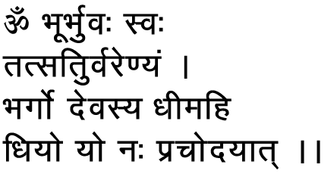
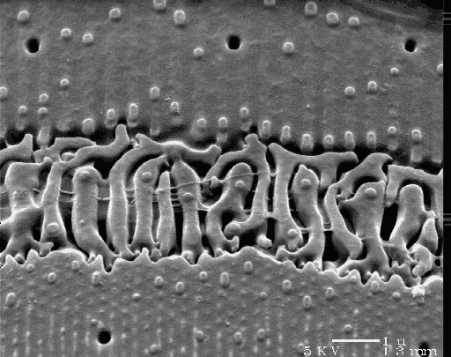
Gayatri mantra,
written in Sanskrit
Ellerbeckia arenaria,
the rubberband diatom

Slide 67
Thank you for your attention !

